Slide 1
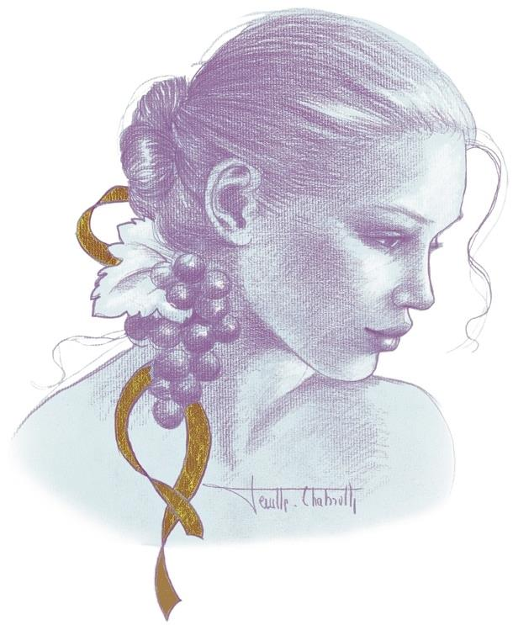
The wines of
Domaine AF Gros, Bourgogne

Slide 2
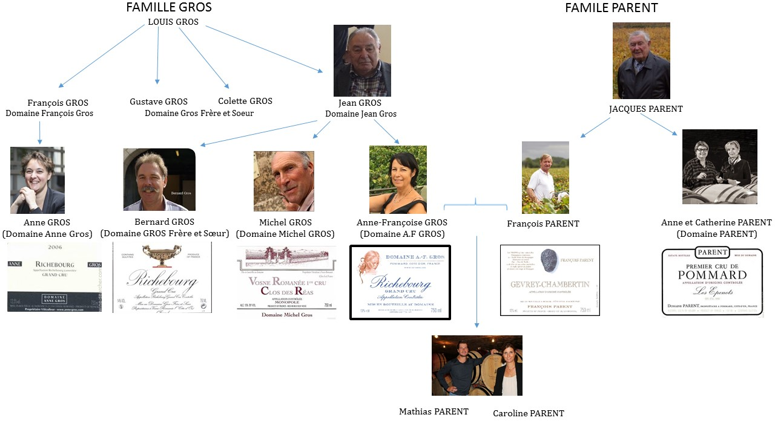

Slide 3
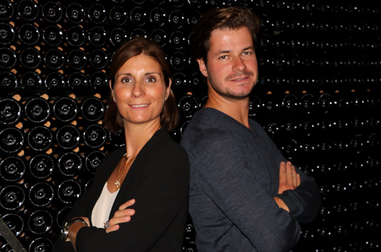
Caroline Parent-Gros, Commercial Director
& Mathias Parent, Winemaker
Anne-Francoise GROS’ estate was created in 1988, when her father, Jean GROS, decided to retire, and his estate was divided among Anne-Françoise (Domaine A.-F GROS), and her 2 brothers, Michel (Domaine Michel GROS) and Bernard (Domaine GROS frère & Soeur).
Anne GROS is a cousin of Anne-Francoise and also is one of the female trailblazers in the world of Burgundy.
Domaine AF GROS comprises 14 hectares: 10Ha in Cote d’Or (Côte de Beaune and Côte de Nuits) + 4 Ha in Moulin à Vent.

Slide 4
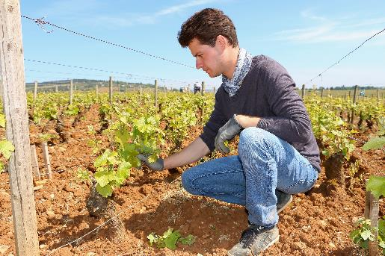
François PARENT, Anne–Francoise’s husband, was the winemaker until 2013. He is known today all over the world for his highly extracted wines, their optimal expression of the Pinot Noir, and their unique combination of elegance and depth.
Mathias PARENT is now doing the winemaking.
François PARENT inherited some vineyard from his own family, the PARENT’s family in Pommard. His vines are also run by Domaine AF GROS, and the wines are sold under the label « Francois PARENT », the label with the black truffle.

Slide 5
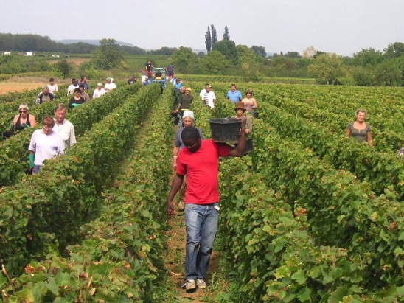
Traditional vineyard management based on sustainability principles.
Selective pruning to optimize yield and vigour, along with optimized leaf pulling, green harvest when needed, and ploughing of the soils.
No pesticides and no insecticides, use of sexual confusion.
100% manual harvesting.
The grapes are brought back to the winery in small cases to avoid any tamping down, in less than 20 minutes after they are cut.

Slide 6
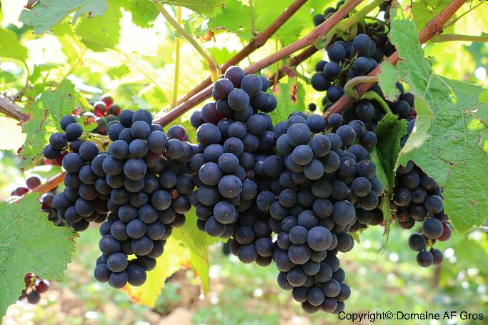
Comprehensive sorting in 4 steps:
In the vineyard,
With a dynamic sorting table at the arrival in the winery,
Manual sorting by 8 persons. The clusters are 100% de-stemmed.
Final sorting is done after de-stemming.
The new generation of de-stemmer that we use preserves the skin of the clusters (berries) so that the sugars will spread slowly and regularly to avoid any break in the fermentation.

Slide 7
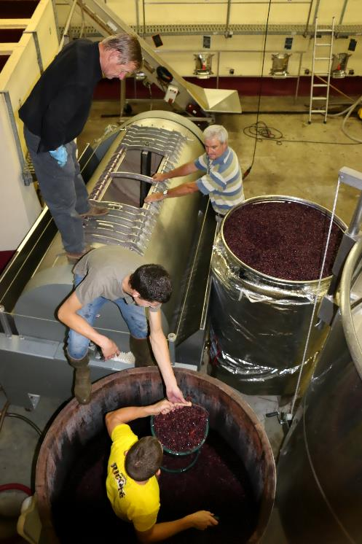
Vinification of our red wines from Cote d’Or
For the vinification, we use stainless steel and wood tanks.
Cold maceration (5°C) for about 4-5 days to extract flavours and colour. During that time, we do some remontage (pump over) to keep a good contact between solid and liquid parts + homogeneous temperature of 5°C.
After 5 days, the alcoholic fermentation starts. Tanks are heated up to 25-30°C for over 10 days.

Slide 8
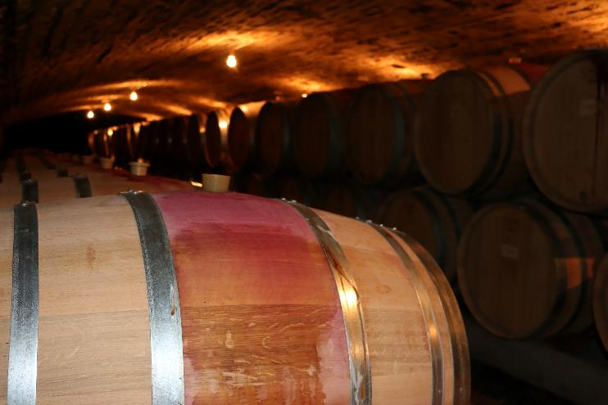
Pigeage (punch-down) depends on the appellation and structure of the wine. Usually at the end of the fermentation.
For each tank, 2 to 4 pigeage at the end of the fermentation
2-3 daily pumping over + daily juice releasing (delestage) .
After a gentle pressing with a pneumatic press, wines are decanted during 2-3 days at 12°C, and are barrelled.
Malo-lactic fermentation is done in barrels. Low temperature, about 45 days. Monitored for minimal use of SO2.

Slide 9
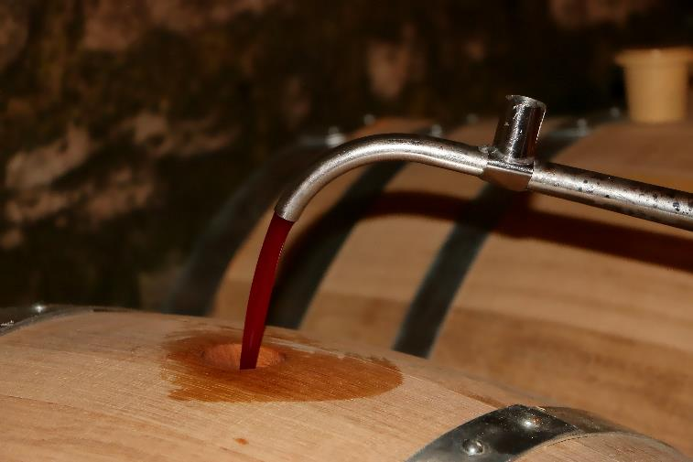
Elevage: The wines are aged between 12 to 18 months in French oak barrel. The oaks come mainly from forests of Chatillonais and Fontainebleau. We work with 2 main coopers and ask them for long and low burning barrels.
Generics are aged in 5000 Liters tank (60%) and in oak barrels from 2-3 wines (40%).
Elevage is done during an average of 12 months for village wines (50% new oak), 15 months for the 1er crus (65% new oak) and 18 months for the Grands Crus (100% new oak).

Slide 10
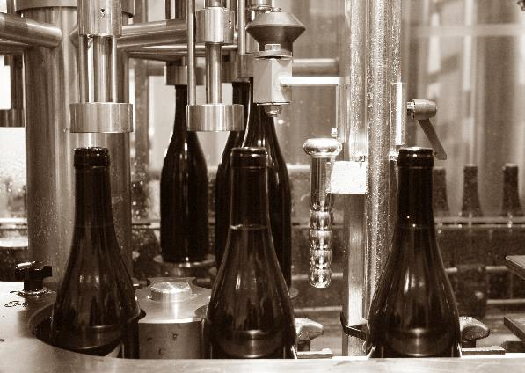
-The wines are racked, aggregated and placed in tanks for the last 3 months of elevage so that the fine lees can settle down.
-Wines are not systematically filtered: We check the turbidity and, if necessary, do a light filtration (lenticular filer system: cellulose sheets) but no fining.
-The wines are bottled by gravity.

Slide 11
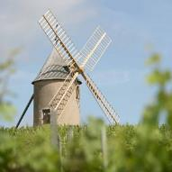

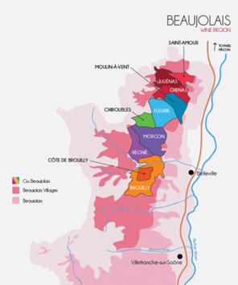
Our latest release: Cru from Beaujolais !
From our new vineyard in the prized region of Moulin a Vent, Mortperay.
Garnet-red color, with iris and spices aromas. Velvety tannins, suave and long delightful after-taste, a Classic right off the starting gate!
Limited quantities!

Slide 12
Vinification of the Moulin à Vent
During an average year with no hail or freeze over.
100% Manual harvesting
The clusters of grapes arrive at the winery in small cases, and in air-conditioned trucks. The grapes are first sorted on a vibrating table to eliminate any water, insects and leaves. Whole bunches are sorted manually, then distributed among 3 different tanks.
Tank n°1 (1/3 of the harvest): is completely closed for carbonic fermentation for 6 to 8 days. The fermentation is done ¾ of the way, then the grapes are devatted and pressed (pneumatic pump for 1.15 hours at a maximum 17 pounds/square inch). The juice is placed in tanks in order to finalize the fermentation process and optimize oxygenation of the yeasts. This maneuver allows for a very fruity and aromatic wine.
Tanks n°2 and 3: are open tanks with whole bunches. The fermentation is started directly. Daily pumping over of the must, daily crushing of the cap to liberate the sugar levels in the berries, and feed sugar to the yeasts. The vatting lasts about 15 days. The grapes are then devatted and pressed (pneumatic pump for 2 hours at a maximum 17 pounds/square inch). The wines are left to settle for 4 to 5 days before cask funneling.
They mature for 8 to 9 months, partially in a large wooden tank, called a “foudre”, of 5000 liters (about 50% of the crop), and the rest in three-four years old 228L barrels.
The wines are racked, then blended for 1 month in stainless steel tanks. They are filtered if necessary, their SO2 and CO2 levels adjusted, and finally bottled.

Slide 13
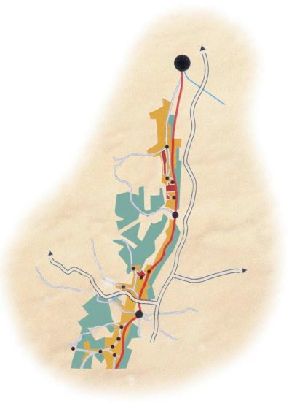
Dijon
Clos de Vougeot
Chambole Musigny
Vosne Romanee
Nuits St Georges
Savigny les Beaune
Pommard
Beaune

Slide 14
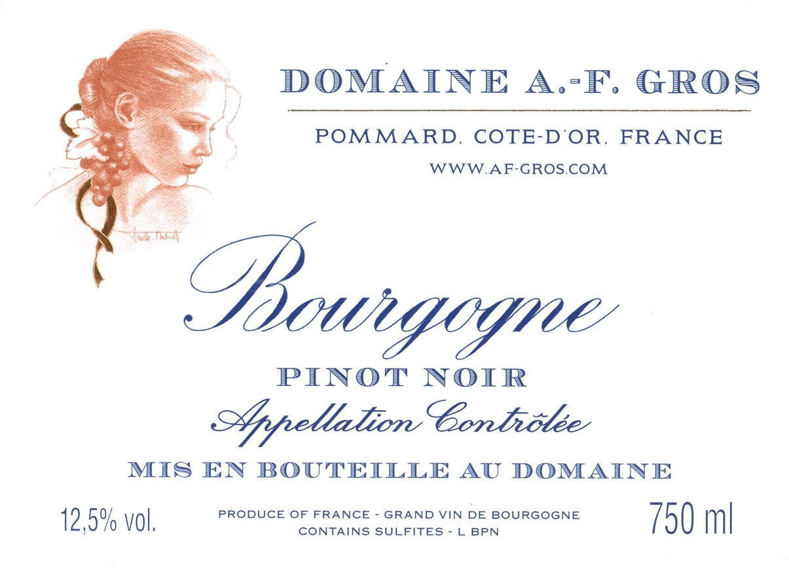
Our Bourgogne Pinot Noir comes from the flats of Pommard, and is made for early drinking, with a focus on red fruit flavors, soft and voluptuous flavors, and a distinct French Burgundy style. (0,7422Ha)

Slide 15
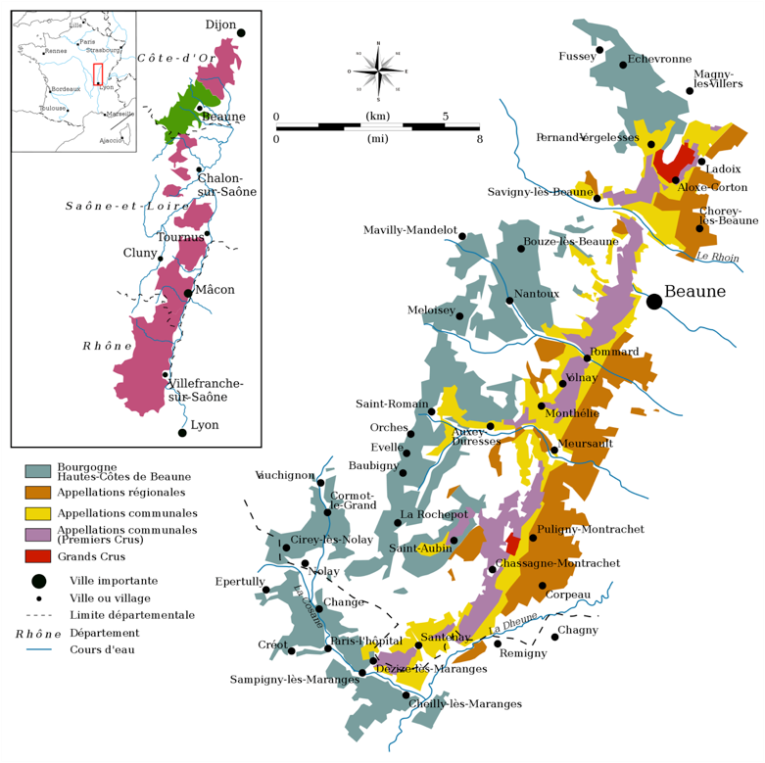
Cote de Beaune

Slide 16
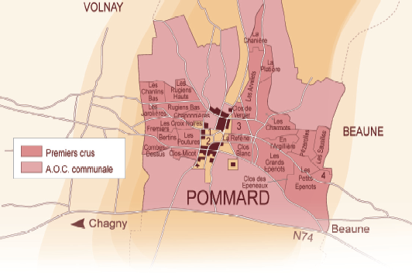
Pommard’s Geological fault
The geological fault of Pommard runs through the vineyard and separates 2 regions;
The side of Volnay with iron rich soils, giving more powerful, tannic, wines like the Pommard 1er cru les Rugiens.
The side of Beaune, with more limestone in the soil, producing deep, very elegant wines like the Beaune 1er Cru Boucherottes.

Slide 18
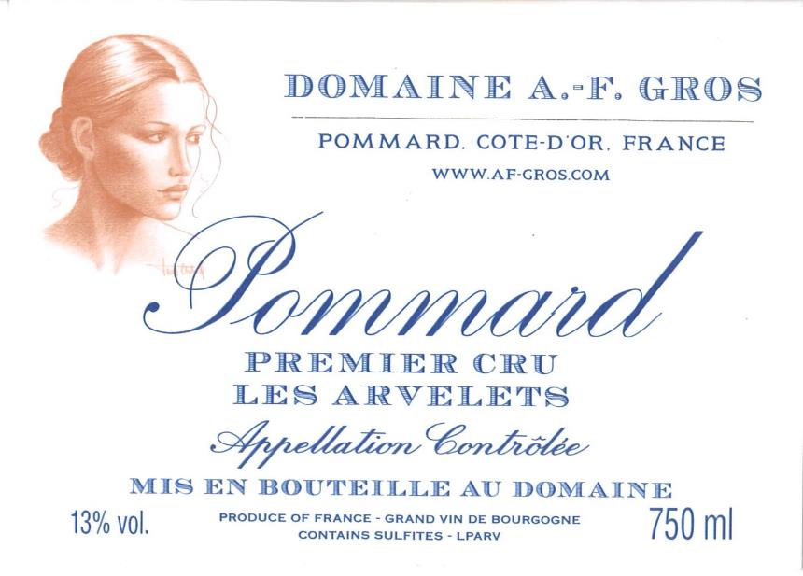
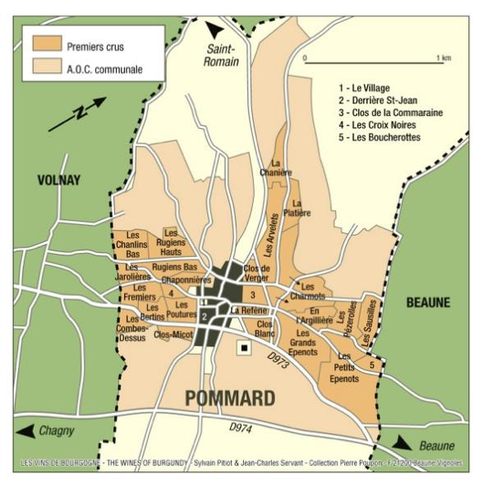
The Arvelets Premier Cru vineyard is situated uphill from Pommard Epenots; the word Arvelets comes from the latin “Arva”, which means a cultivated field.
Deep, dark red colour, with mauve highlights. Its aromas are redolent of blackberry, bilberry, or gooseberry, cherry pit and ripe plum.
Often, wild and feline notes develop with age.
At full maturity, it tends towards leather, chocolate and pepper. (0,3126Ha)

Slide 19
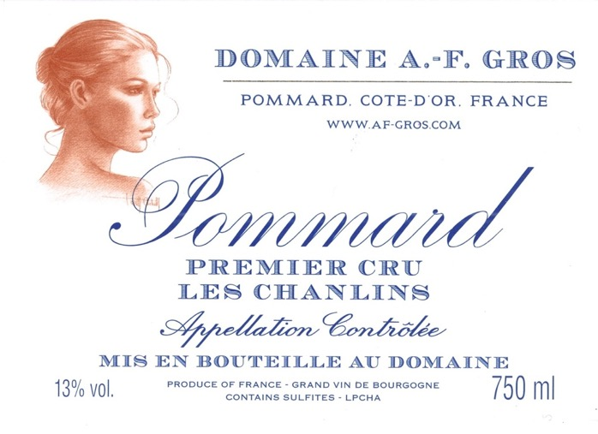
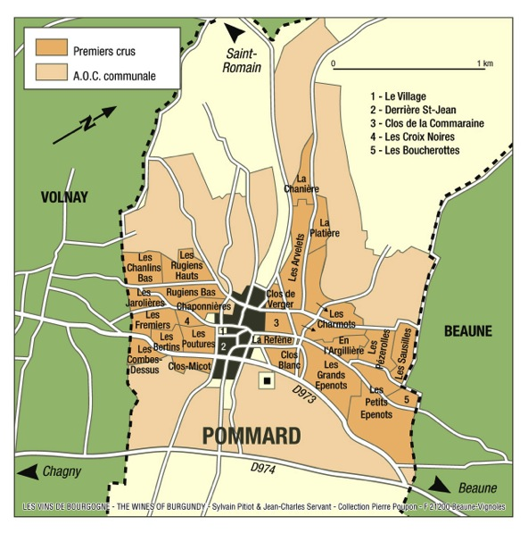
“Les Chanlins”, a premier cru bordering Volnay, is a continuation of Volnay Pitures (formerly known as Volnay Chanlins), the vineyard is steep with more limestone and pebbles rather than clay, producing classic wines which are typically generous and long lived . (0,1334Ha)

Slide 20
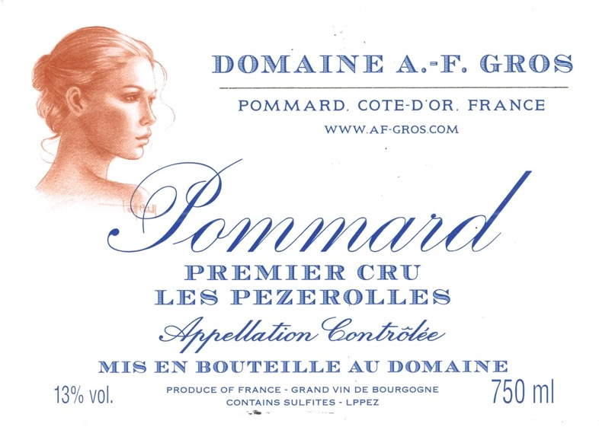
"Les Pézerolles", Premier Cru, produces a refined Pommard, akin to Volnay. The name comes from the old French "Poizerolles", which meant "chickpeas”, likely cultivated next to the vines in the Middle Ages. The wine has floral notes, subtle red fruit aromas, and a very elegant structure. (0,3408Ha)

Slide 21
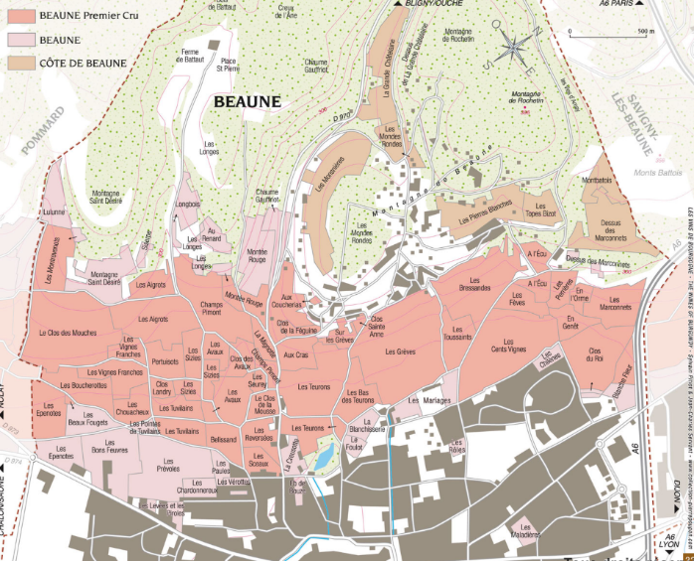
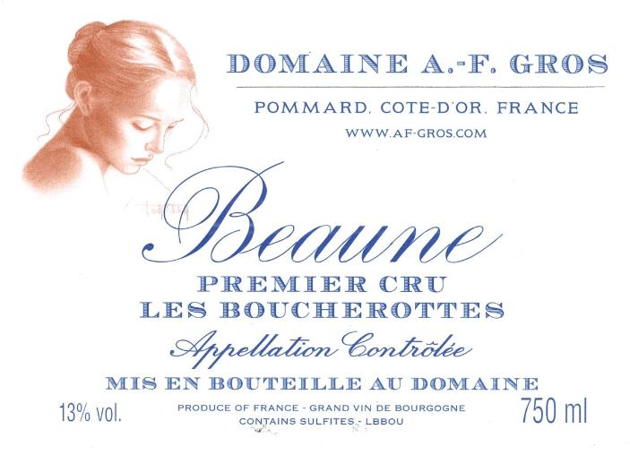
The “Boucherottes” name originally means “thorny bushes” and signifies that the vineyard is and was surrounded by vegetation that is typical of poor, high clay content soils. These soils give lushness to the wine, with rich fruit, plump texture, and a firm structure. This wine will age harmoniously for 12 to 15 years. 30% New barrel. (0,3008Ha)

Slide 22
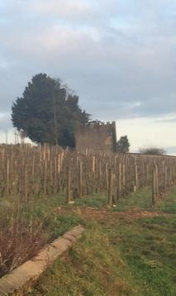
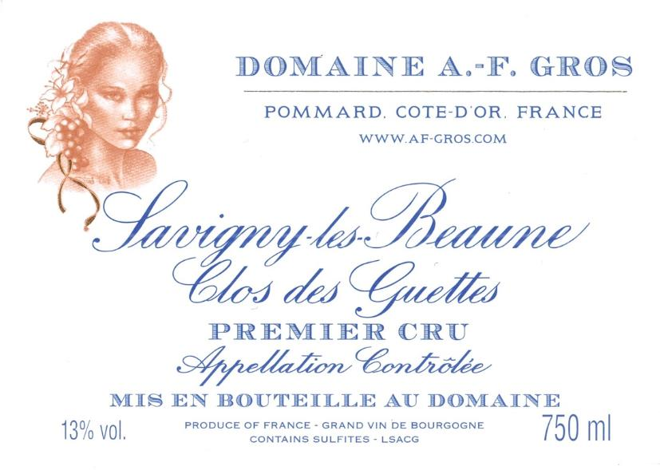
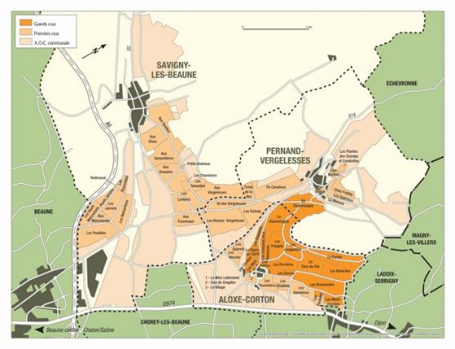
“Clos des Guettes” is a vineyard that is high up on the hill in Savigny; it was used in ancient times as a watching post. With great aromas and balance, the full-bodied wines it produces will age very well up to 12 years. (0,6674Ha)

Slide 23
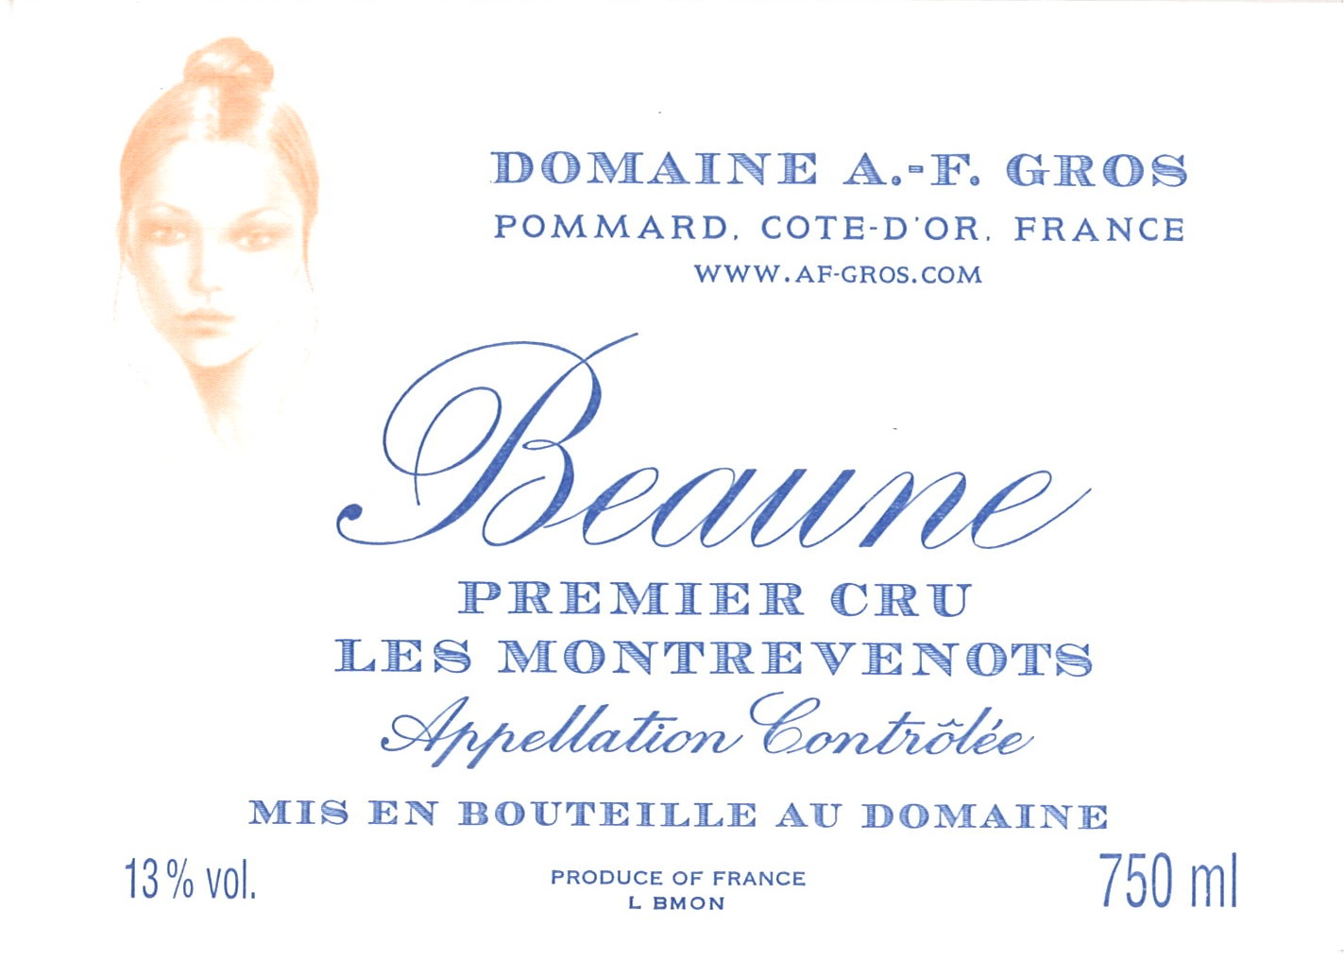
For the whites: The clusters of grapes arrive at the winery in small cases, and in air-conditioned trucks. The grapes are first sorted on a vibrating table to eliminate any water, insects and leaves. They are sorted manually then pressed (pneumatic pressurizer at 25 lbs./square inch for 2 hours), cooled at 12°C (53.6 Fahrenheit), and left to settle naturally for 24 hours. They are put in barrels where first occurs the alcohol fermentation, then the malolactic fermentation. No stirring of the lees. The CO2 and SO2 levels are adjusted after the malolactic fermentation.
Maturing is done for 12 months with an average of 50% new barrels. Racking and fining ensue. Adjustment in CO2 and SO2. The wines are then bottled using gravity.
Montrevenots was planted in Chardonnay in 2010. 1st vintage 2015. (0,2565Ha)

Slide 24
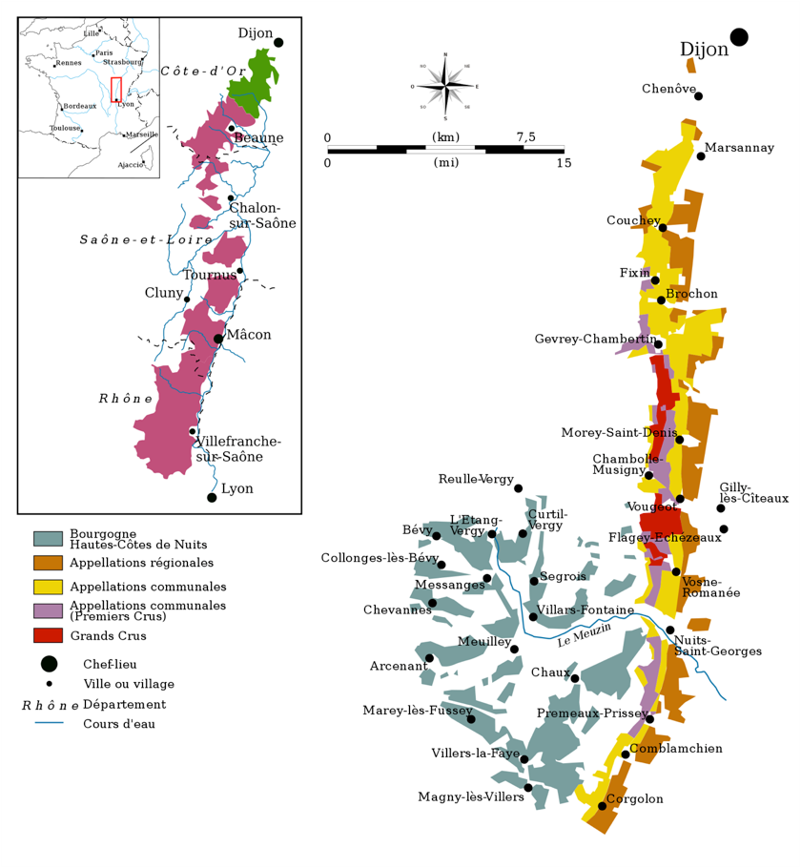
Cote de Nuits

Slide 25
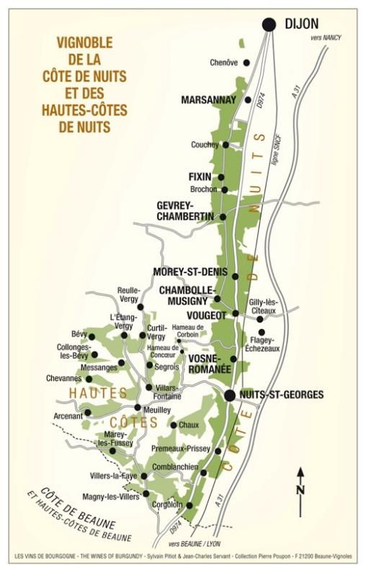
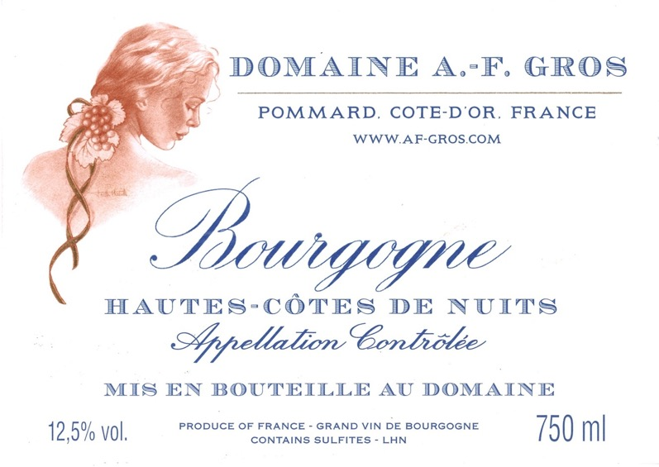
The wine comes from a vineyard located on top of the plateau overlooking the Cotes de Nuits; greater variability of supply depending on the vintage and its climate, but constantly rich fruit, full body and long aftertaste. Stylish Burgundy!

Slide 26
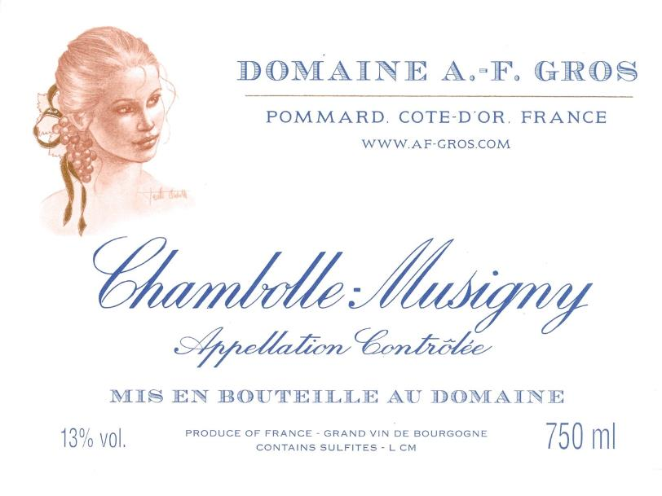
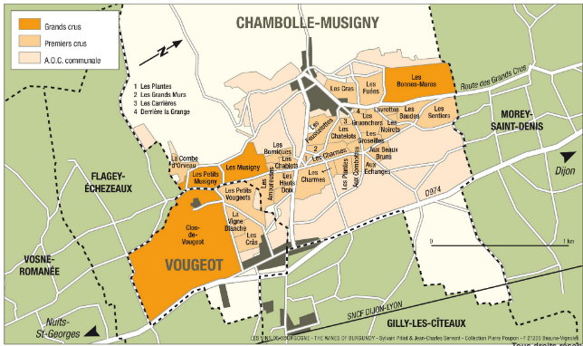
Part of the name of Chambolle-Musigny, Chambolle, comes from “champs bouillants”, in reference to the water running down the vineyards during heavy rains. The wine is refined, perfumed, and has an unmistakable elegance.

Slide 27

The mythic commune of Vosne Romanee

Slide 28
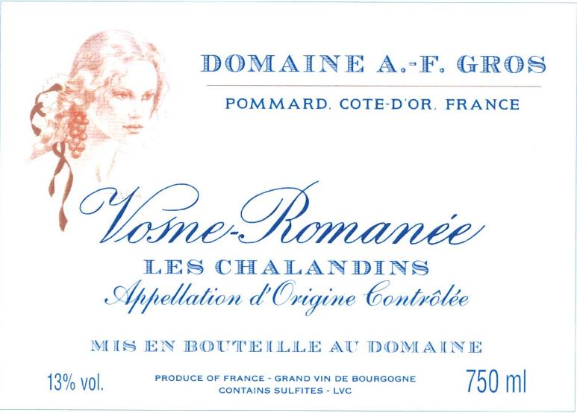
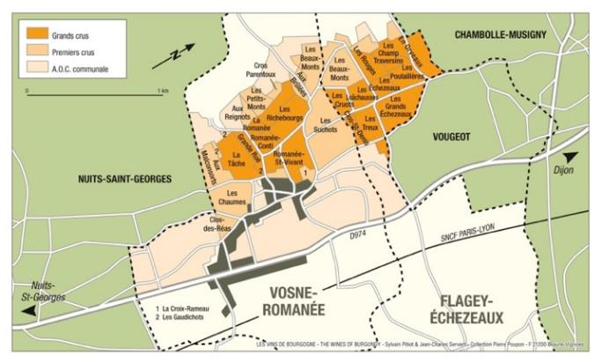
“Les Chalandins ”, is a “lieu-dit” or communal designation, located close to Clos Vougeot. Forward bouquet , nice spices, violets.
Very balanced palate, juicy fruit, elegant weight. Classic Vosne Romanee ! (0,33Ha)

Slide 29
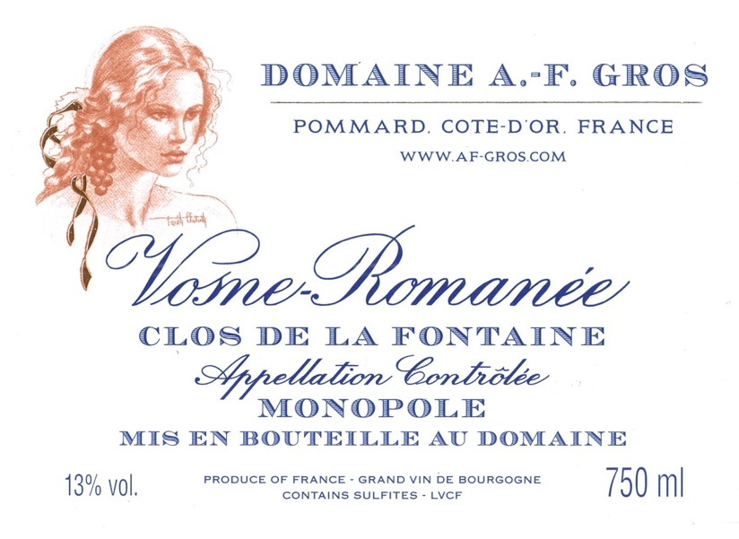
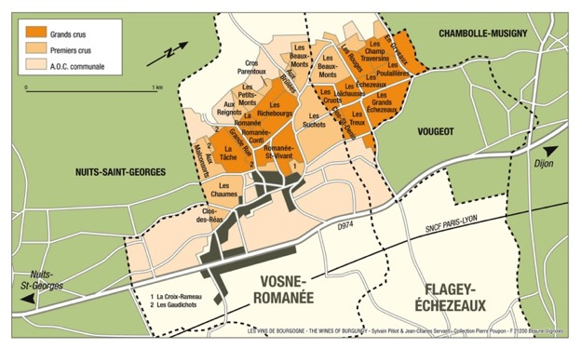
“Clos de la Fontaine” is an enclosed vineyard located near the village of Vosne Romanee; Domaine AF Gros is the sole proprietor of this vineyard of 0,35Ha, hence the “monopole” designation; it produces rich, deeply colored and generous wines, with great balance and superlative elegance.

Slide 30
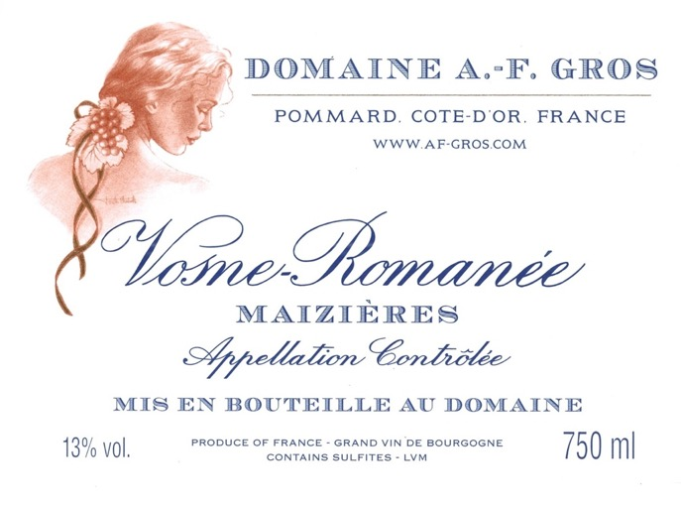
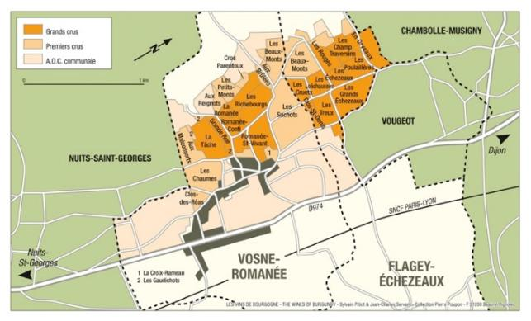
“Maizieres ” is a vineyard bordered by stone walls constructed long ago with the remnants of old buildings, one way to delineate the parcels in this intensely cultivated region. Velvety wine, great elegance and finesse that ages harmoniously.

Slide 31
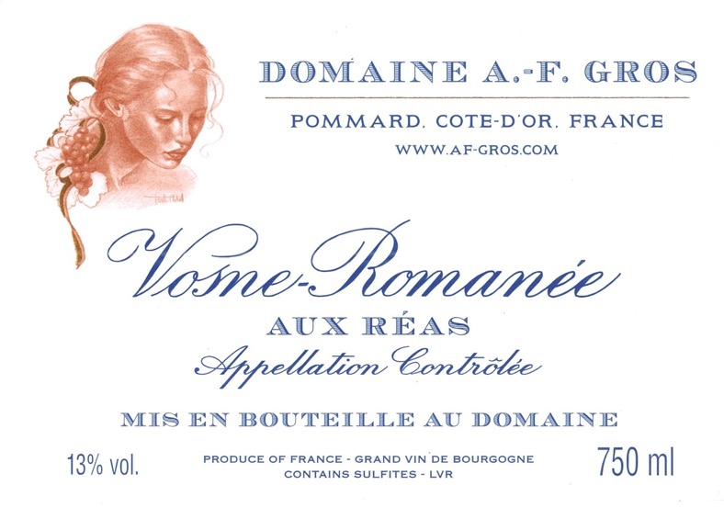

Aux Reas is a vineyard located next to the Grand Cru Clos des Reas. We run a parcel of 1,62 Ha
Wines with forward fruit, an elegant body, lingering aftertaste, that have great aging capabilities. They exemplify the unforgettable qualities of the appellation.

Slide 32
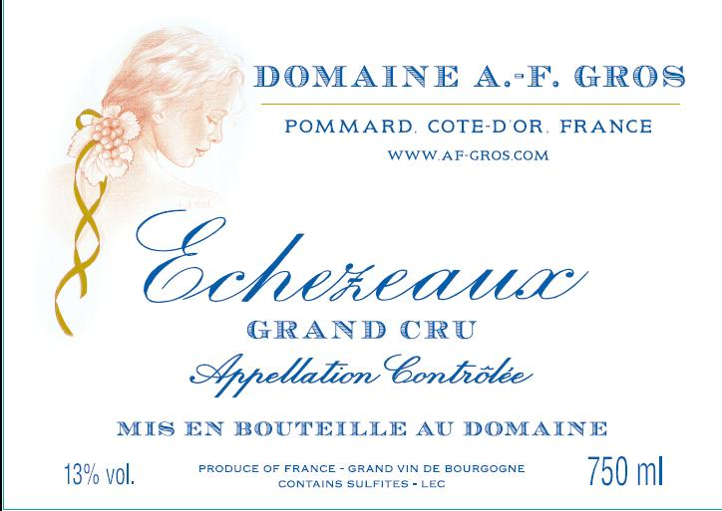
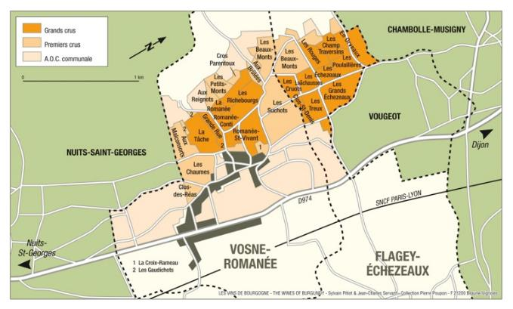
The wine comes from the “lieu dit Les Champs Traversin,” the premier site in Echezeaux whose neighbor “Les Poulalierre,” is home to the section of Domaine de la Romanee Conti. The 75 + year old vines are planted in a perfect location, halfway up the slope. Only maximum 125 cases produced. (0,2608Ha)

Slide 33
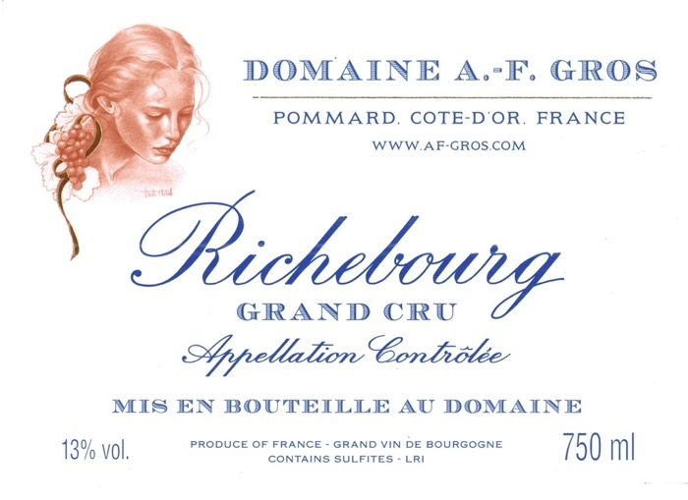

Vines are 15, 25 and 75 years of age. Richebourg is one of the top Grand Crus in Vosne. Explosive nose of black fruits, flowers, and smoky new oak. Voluptuous, opulent, layered and full-bodied in the mouth. 0,6Ha

Slide 34
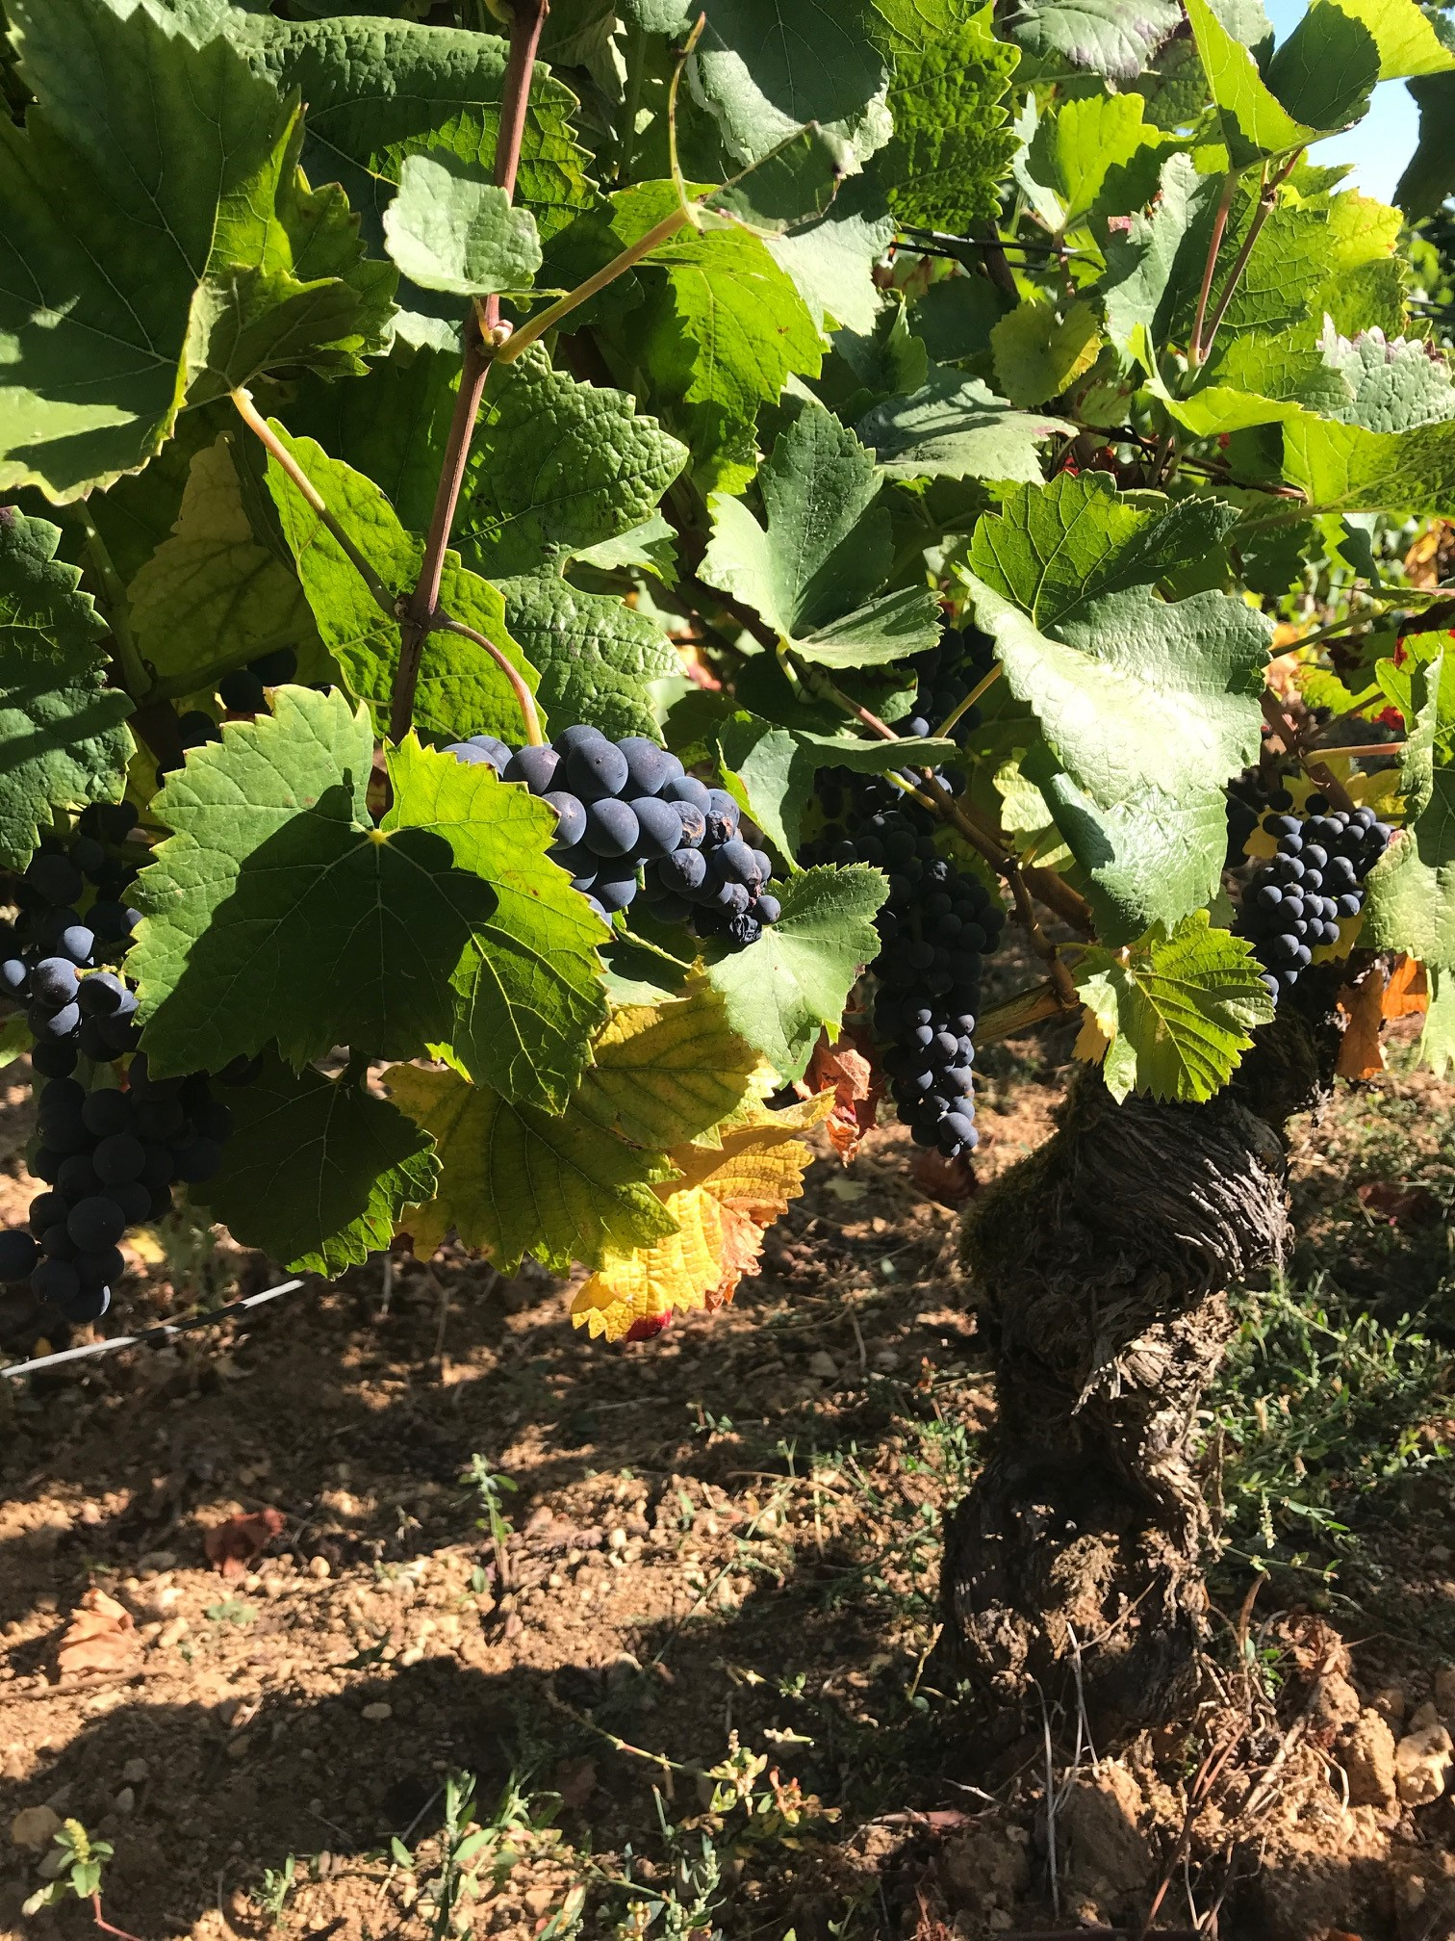
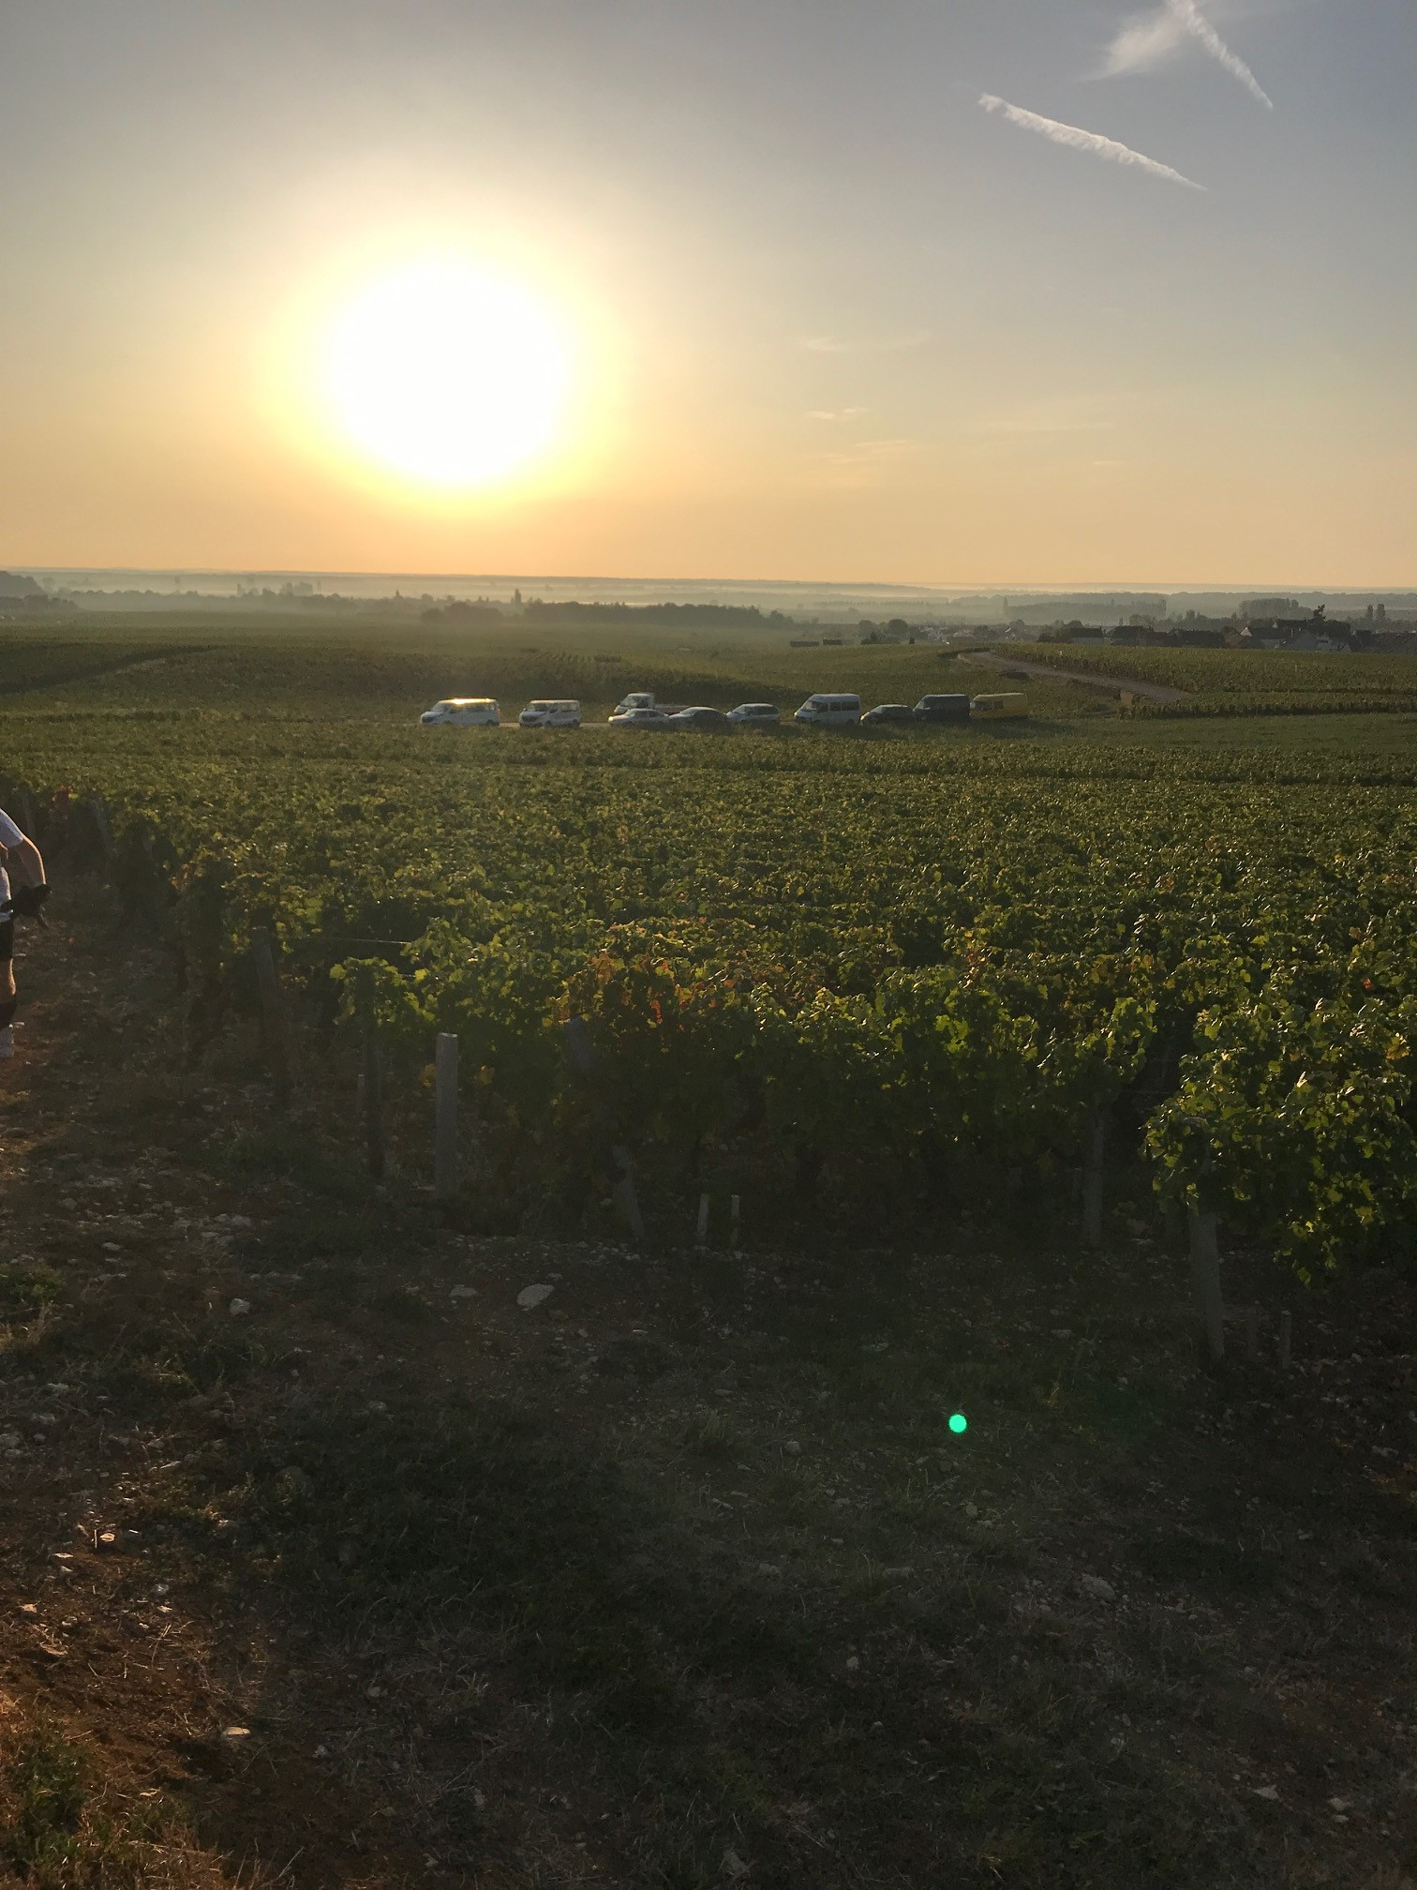
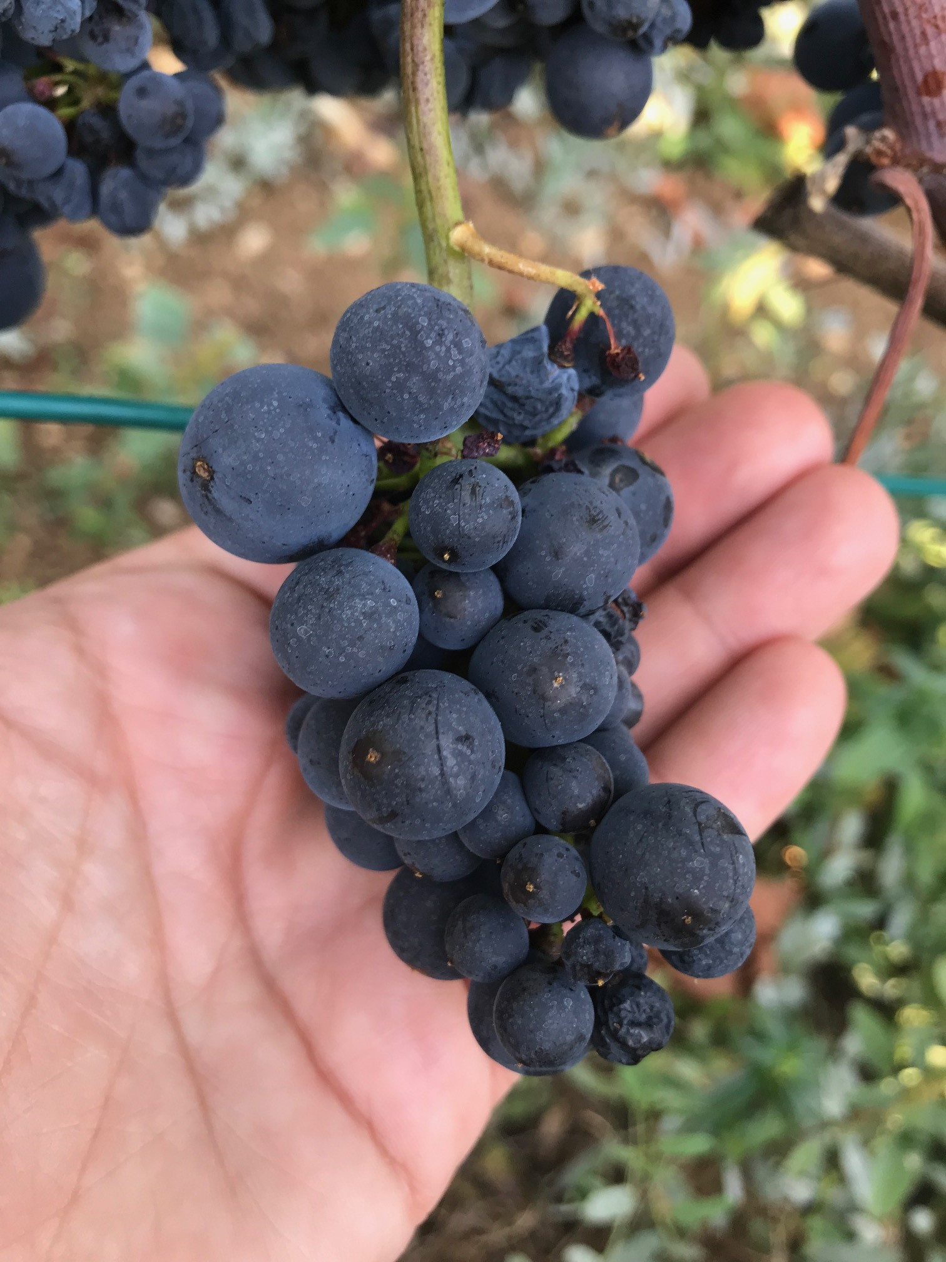
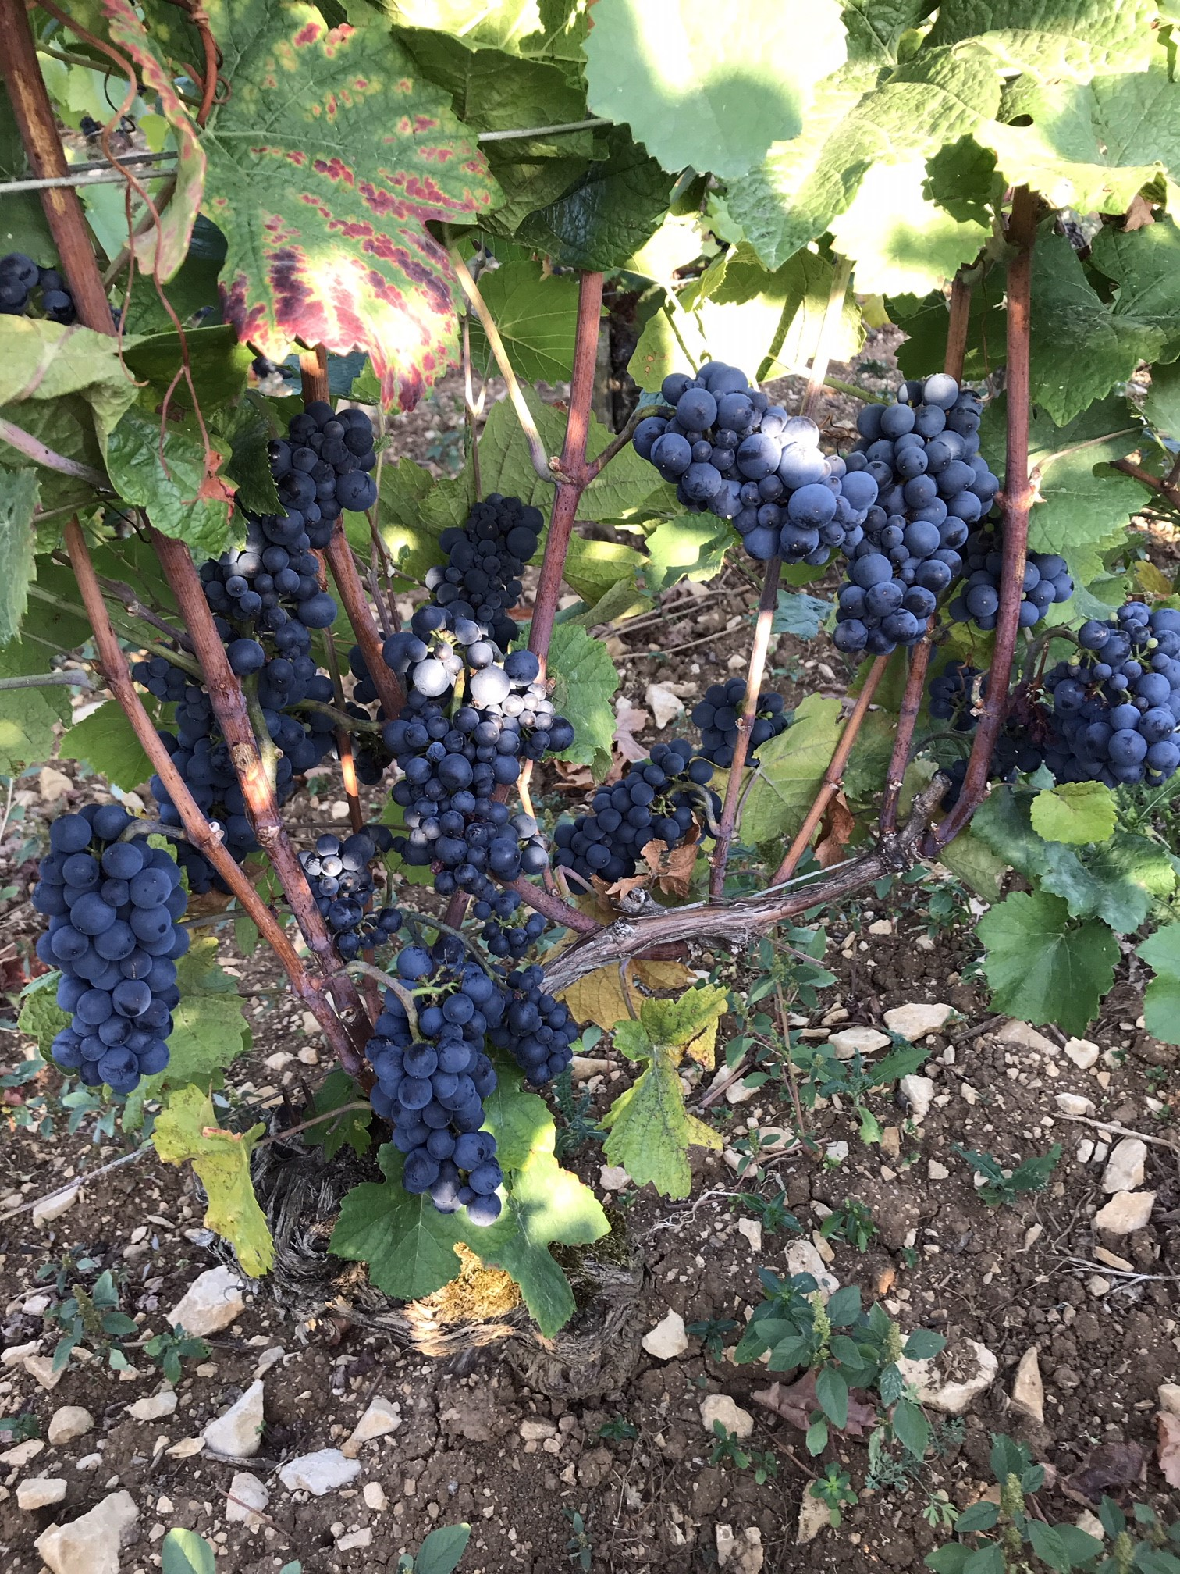
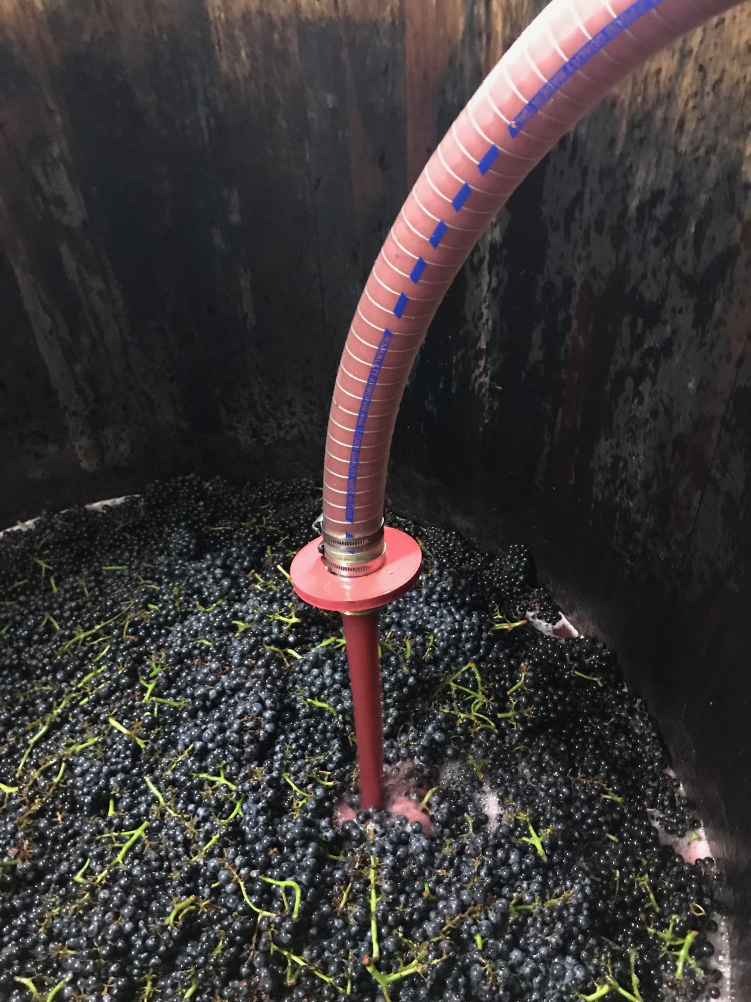
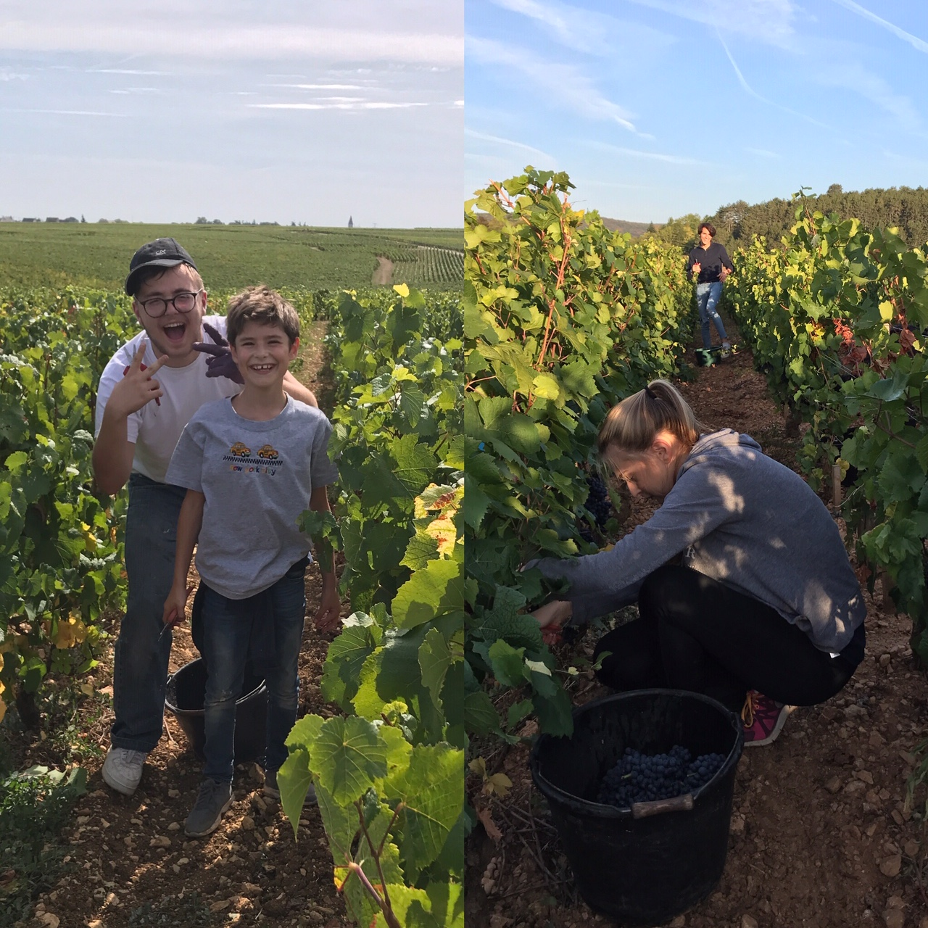
Burgundy News: 2019’

Slide 35
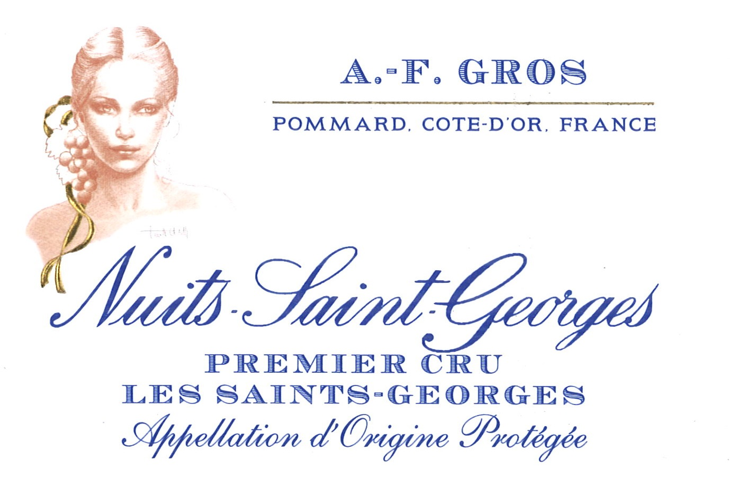
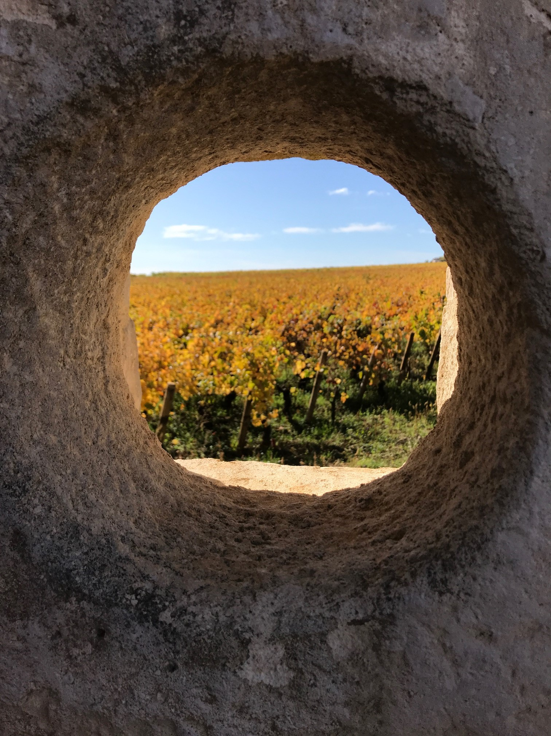

The News from the Domaine
Launch of our new label « AF GROS » for our purchase of grapes. Small quatities, nice appellations. We control the harvest, the vinification and the elevage.

Slide 36
“Burgundy makes you think of silly things, Bordeaux makes you talk of them and Champagne makes you do them.”
Jean-Anthelme Brillat-Savarin

Slide 37

Thanks for your attention!

