Slide 1
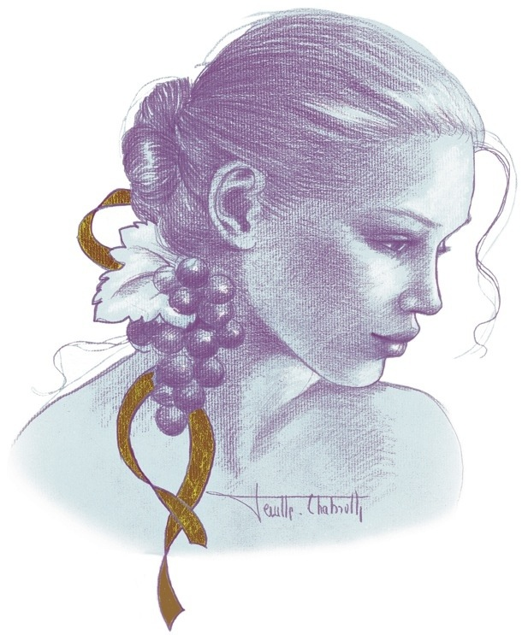
The wines of
Domaine AF Gros, Bourgogne

Slide 2
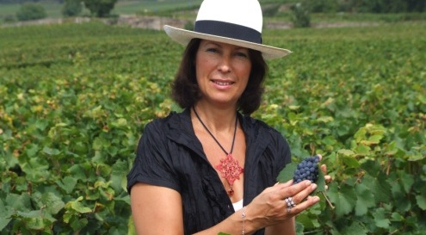
Anne-Francoise GROS
Notes:
NEED HIGHER QUALITY PICTURE

Slide 3
Anne-Francoise GROS’ domaine was created in 1988, when her father, Jean GROS, decided to retire, and his estate was divided among Anne-Françoise (Domaine A.-F GROS), and her 2 brothers, Michel (Domaine Michel GROS) and Bernard (Domaine GROS frère & soeur).
When she created the Domaine in the 80’s, her cousin, Anne GROS also created “Domaine Anne et François GROS” (which is now called “Domaine Anne Gros”. The confusion was big between AF and Anne, and Anne-Françoise decided to have a distinctive label with the face of a woman as a logo. Each face is different for each appellation. The aim is to reflect the characteristic of the wine on the front label.
The estate covers 10 hectares, planted mainly in Pinot Noir, both in Cote de Beaune and in Cote de Nuits.

Slide 4
François PARENT, Anne–Francoise’s husband, is the winemaker. He is known today all over the world for his highly extracted wines, their optimal expression of the Pinot Noir, and their unique combination of elegance and depth. Mathias PARENT, 25, is now doing the winemaking along with his father.
François PARENT inherited some vineyard from his own family, the PARENT’s family in Pommard. His vines are also run by Domaine AF GROS, but the wines are sold under the label « François PARENT », the label with the black truffle

Slide 5
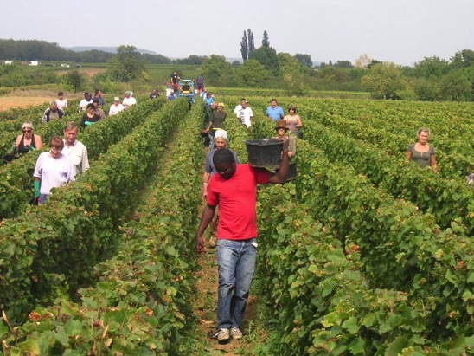
Traditional vineyard management based on sustainability principles.
Selective pruning to optimize yield and vigour, along with optimized leaf pulling, green harvest when needed, and ploughing of the soils.
No pesticides and no insecticides, use of sexual confusion.
100% manual harvesting.
The grapes are brought back to the winery in small cases to avoid any tamping down, in less than 20 minutes after they are cut.

Slide 6
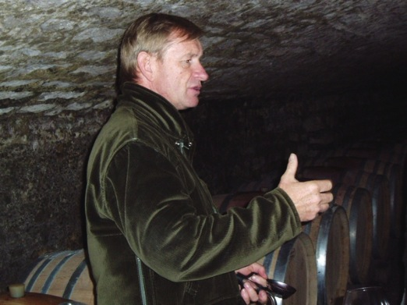
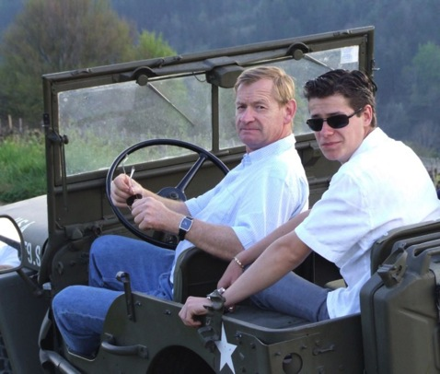
Comprehensive sorting in 4 steps:
In the vineyard,
With a dynamic sorting table at the arrival in the winery,
Manual sorting by 8 persons. The clusters are 100% de-stemmed.
Final sorting is done after de-stemming.
The new generation of de-stemmer that we use preserves the skin of the clusters (berries) so that the sugars will spread slowly and regularly to avoid any break in the fermentation.

Slide 7
For the vinification, we use stainless steel and wood tanks.
Cold maceration (5°C) for about 3-5 days to extract flavours and colour. During that time, we do some remontage (pump over) to keep a good contact between solid and liquid parts.
After 5 days, the alcoholic fermentation starts. Tanks are heated up to 25-30°C for over 10 days.
Pigeage (punch-down) depends on the appellation and structure of the wine. For each tank, 2 to 4 pigeage, at the beginning of the fermentation; also 2-3 daily pumping over.
After a gentle pressing with a pneumatic press, wines are decanted during 2-3 days at 12°C, and are barrelled.
Malo-lactic fermentation is done in barrels. Low temperature, about 45 days. Monitored for minimal use of SO2.
Elevage: The wines are aged between 12 to 18 months in French oak barrel. The oaks come mainly from forest of Troncey in Allier, Bertranges and Fontainebleau. We work with 3 main coopers and ask them for high toasted barrels, including a burning of the head of the barrels.
Generics are aged in 5000 Liters tank (60%) and in oak barrels from 2-3 wines (40%).
Elevage is done during an average of 12 months for village wines (50% new oak), 15 months for the 1er crus (65% new oak) and 18 months for the Grands Crus (100% new oak).
The wines are racked and placed in tanks for the last 3 months of elevage so that the fine lees can settle down.
We check the turbidity and, if necessary, do a light filtration (lenticular filer system: cellulose sheets) but no fining.
The wines are bottled by gravity. We pay attention to order our bottles with a bottleneck of 63 mm to avoid as much as possible leakage of the corks.

Slide 8
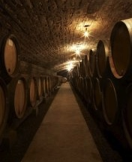
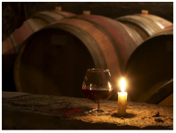
Ageing between 12 to 18 months in French oak barrels, from the forests of Troncey in Allier, Bertranges and Fontainebleau. High toasted barrels.
Elevage (ageing)lasts an average of 12 months for village wines (50% new oak), 15 months for the 1er crus (65% new oak) and 18 months for the Grands Crus (100% new oak).
The wines are racked and placed in tanks for the last 3 months so that the fine lees can settle down.
If necessary, light filtration (lenticular filer system), no fining.

Slide 9
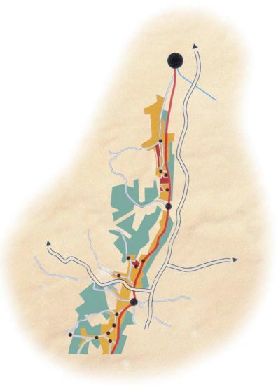
Dijon
Clos de Vougeot
Chambole Musigny
Vosne Romanee
Nuits St Georges
Savigny les Beaune
Pommard
Beaune

Slide 10
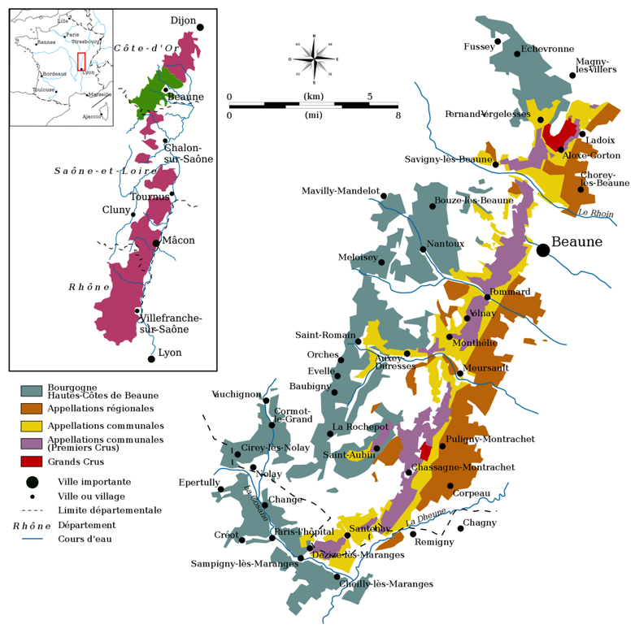
Cote de Beaune

Slide 11
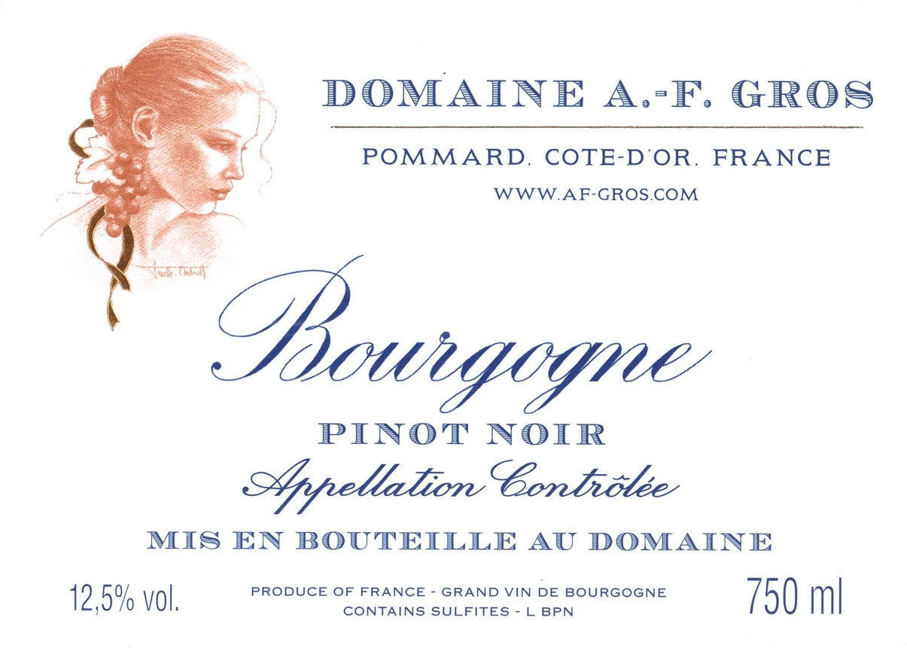
Our Bourgogne Pinot Noir comes from the flats of Pommard, and is made for early drinking, with a focus on red fruit flavors, soft and voluptuous flavors, and a distinct French Burgundy style.

Slide 12
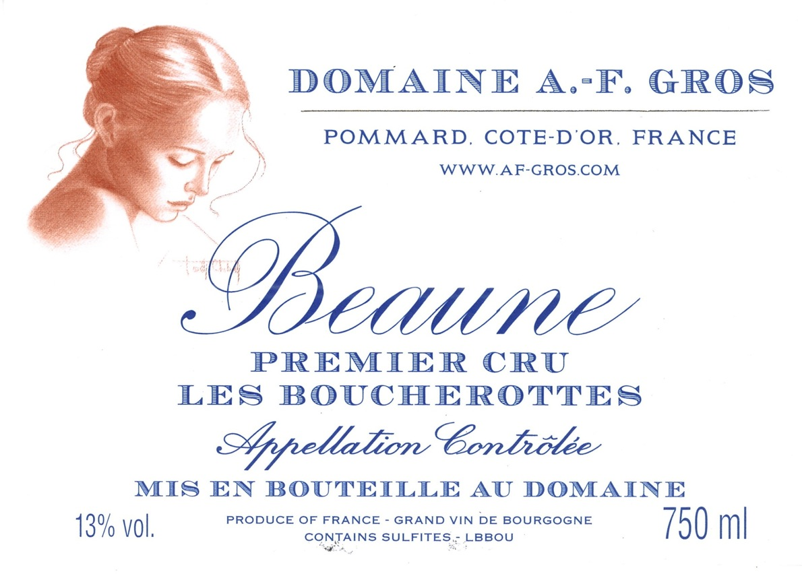
The “Boucherottes” name originally means “thorny bushes” and signifies that the vineyard is and was surrounded by vegetation that is typical of poor, high clay content soils. These soils give lushness to the wine, with rich fruit, plump texture, and a firm structure. This wine will age harmoniously for 12 to 15 years.

Slide 13
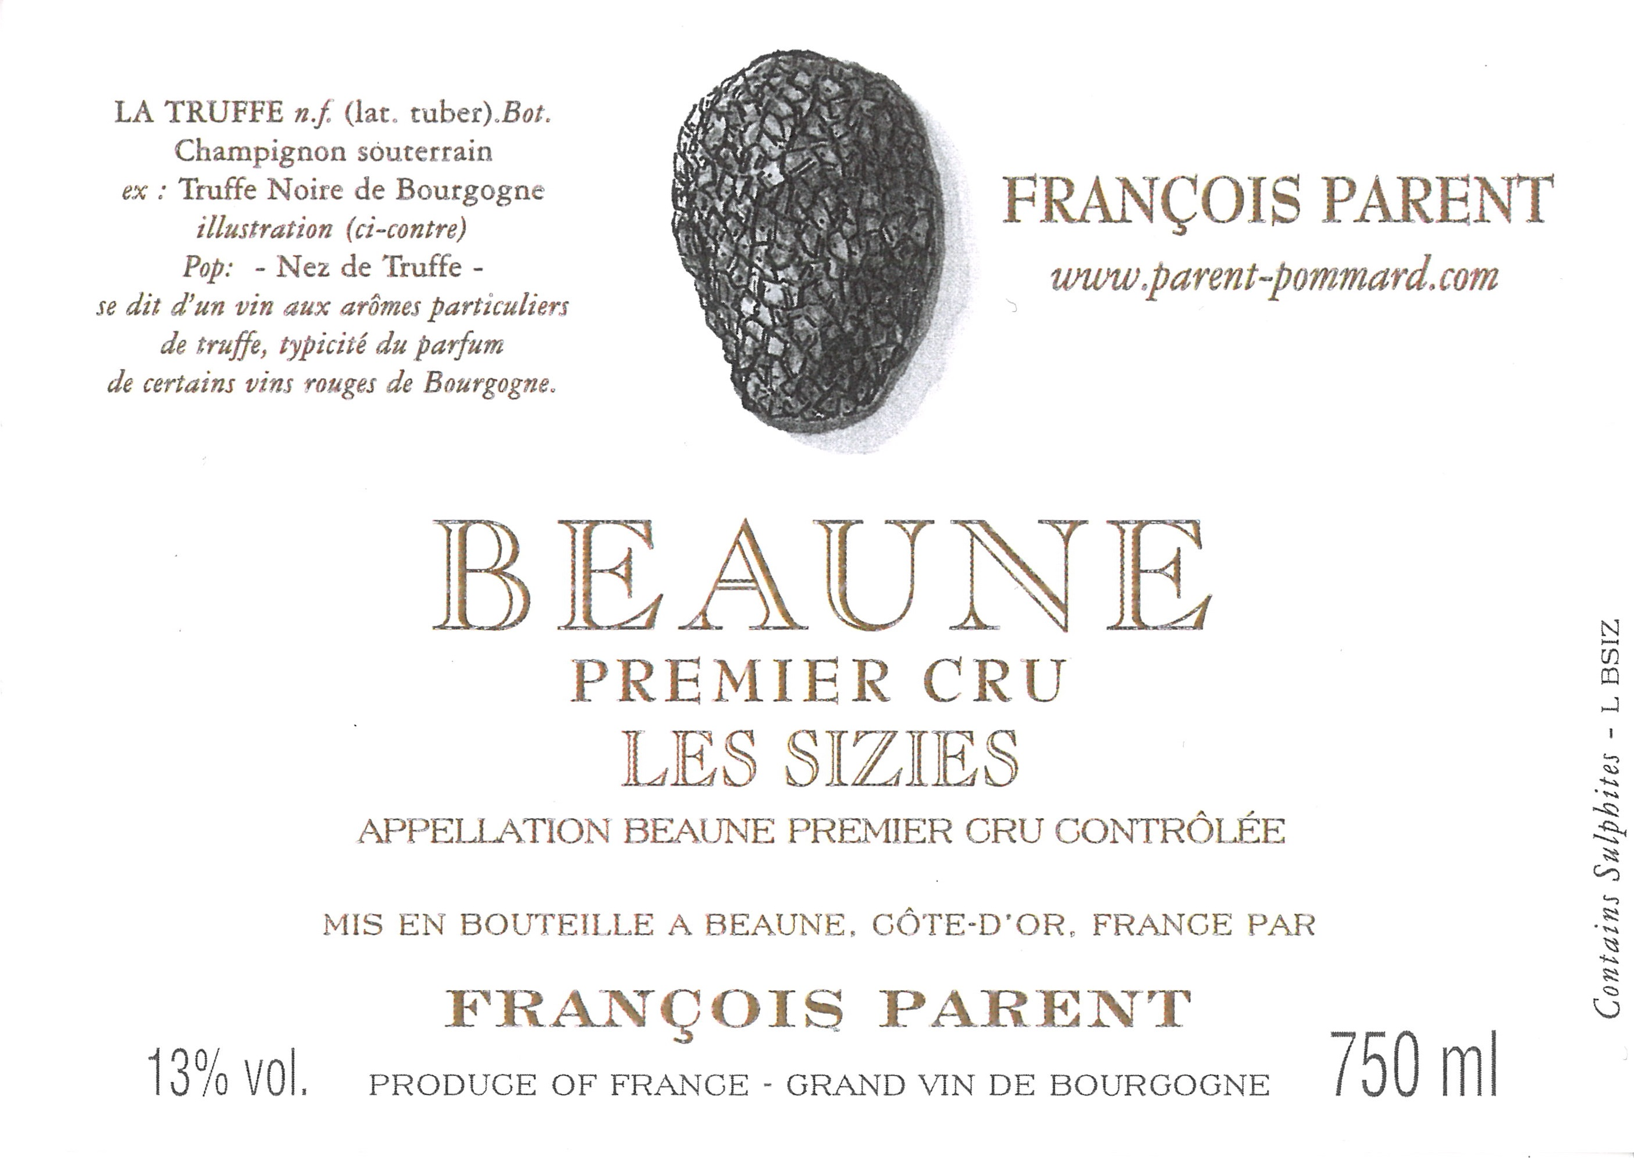

Slide 14
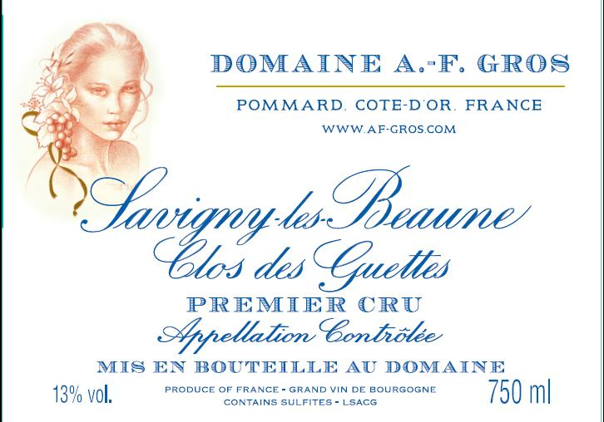
This parcel was bought in 1995 by François PARENT & Anne-Françoise GROS. It is planted in selection « massale » and the grapes produced are always very small, with tight beries. The wines are concentrated, full of black and red fruits aromas, with a good texture and a firm structure.

Slide 15
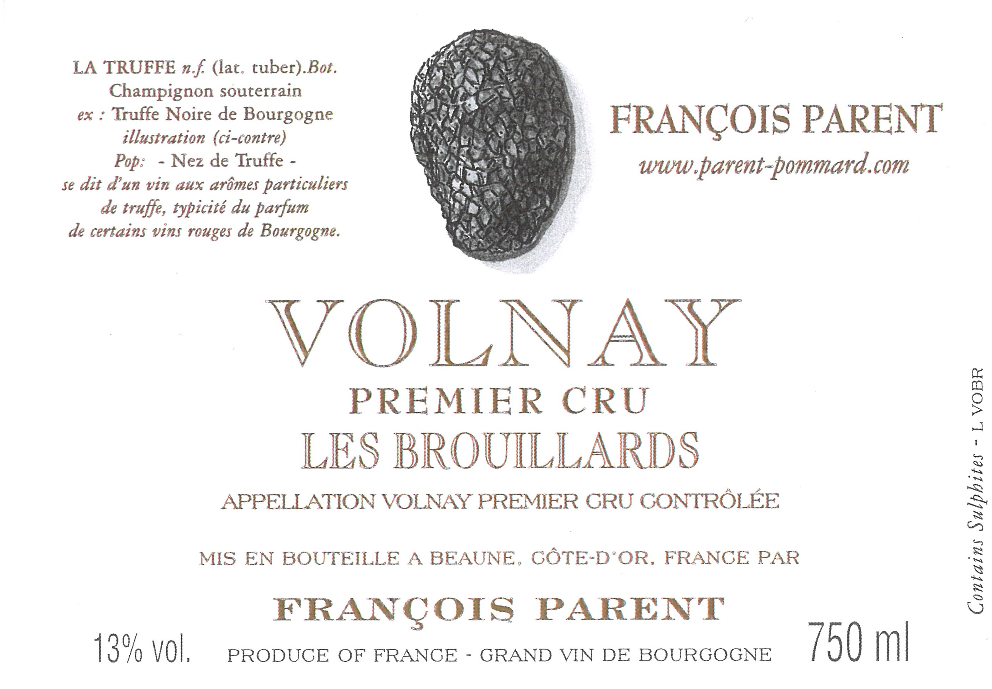

Slide 16
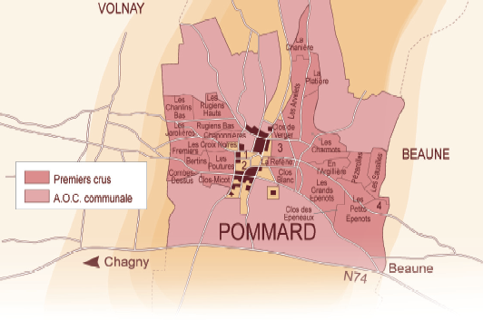
The geological fault of Pommard runs through the vineyard and separates 2 regions;
The side of Volnay with iron rich soils, giving more powerful, tannic, wines like the Pommard 1er cru les Rugiens.
The side of Beaune, with more limestone in the soil, producing deep, very elegant wines like the Beaune 1er Cru Boucherottes.

Slide 18
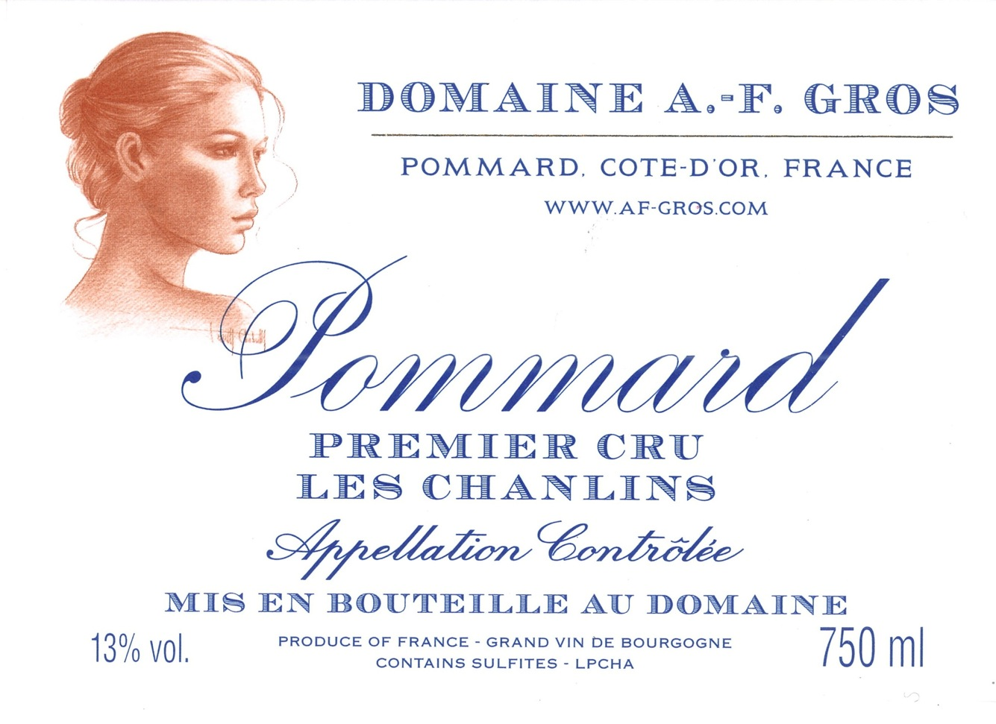
“Les Chanlins”, a premier cru bordering Volnay, is a continuation of Volnay Pitures (formerly known as Volnay Chanlins), the vineyard is steep with more limestone and pebbles rather than clay, producing classic wines which are typically generous and long lived .

Slide 19
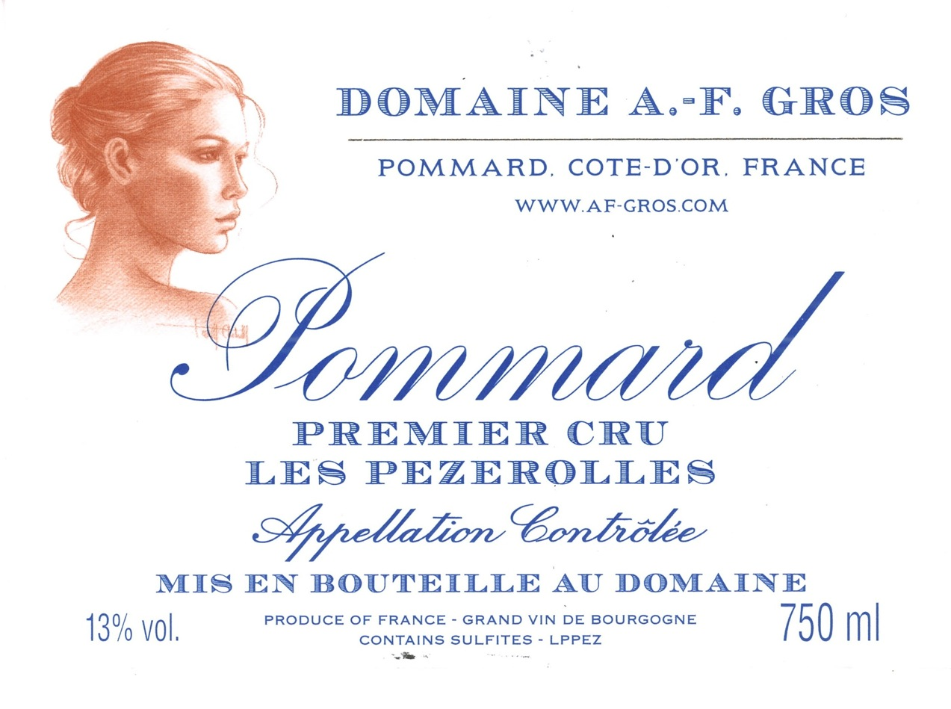
"Les Pézerolles", Premier Cru, produces a refined Pommard, akin to Volnay. The name comes from the old French "Poizerolles", which meant "chickpeas”, likely cultivated next to the vines in the Middle Ages. The wine has floral notes, subtle red fruit aromas, and a very elegant structure.

Slide 20
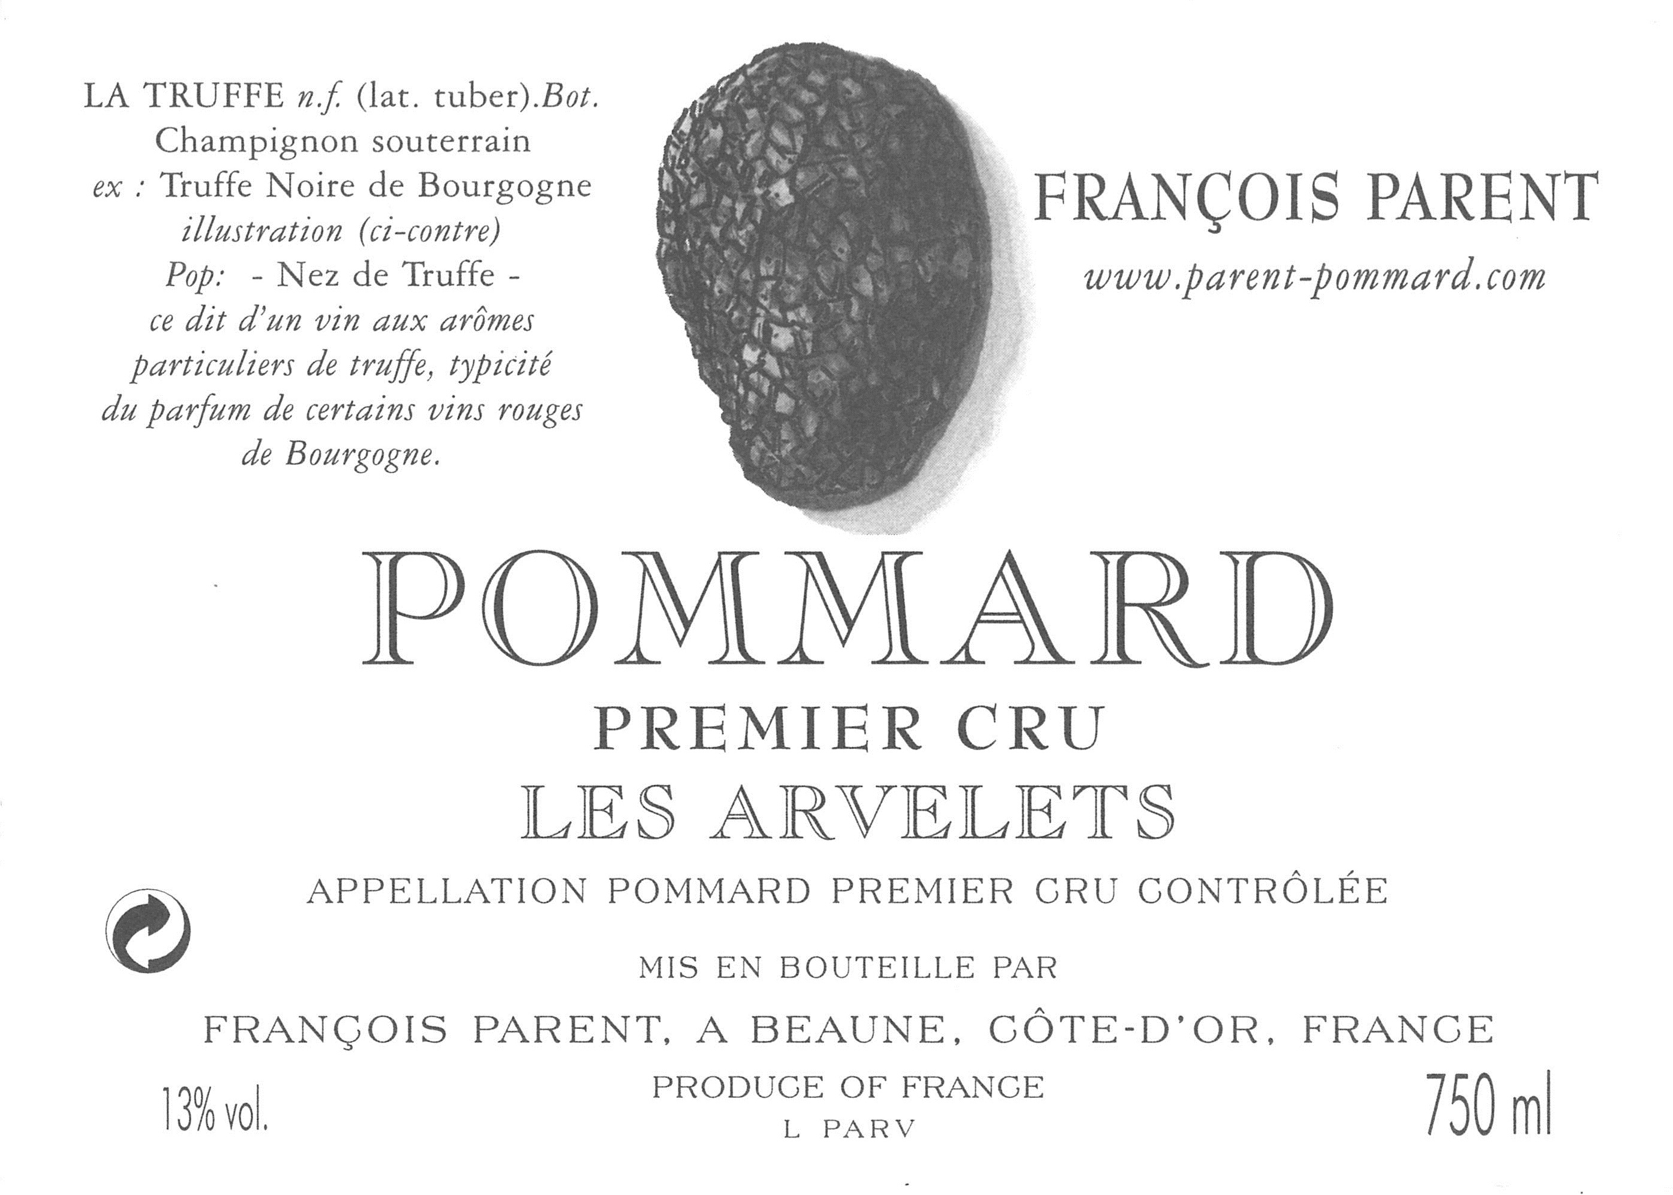

Slide 21
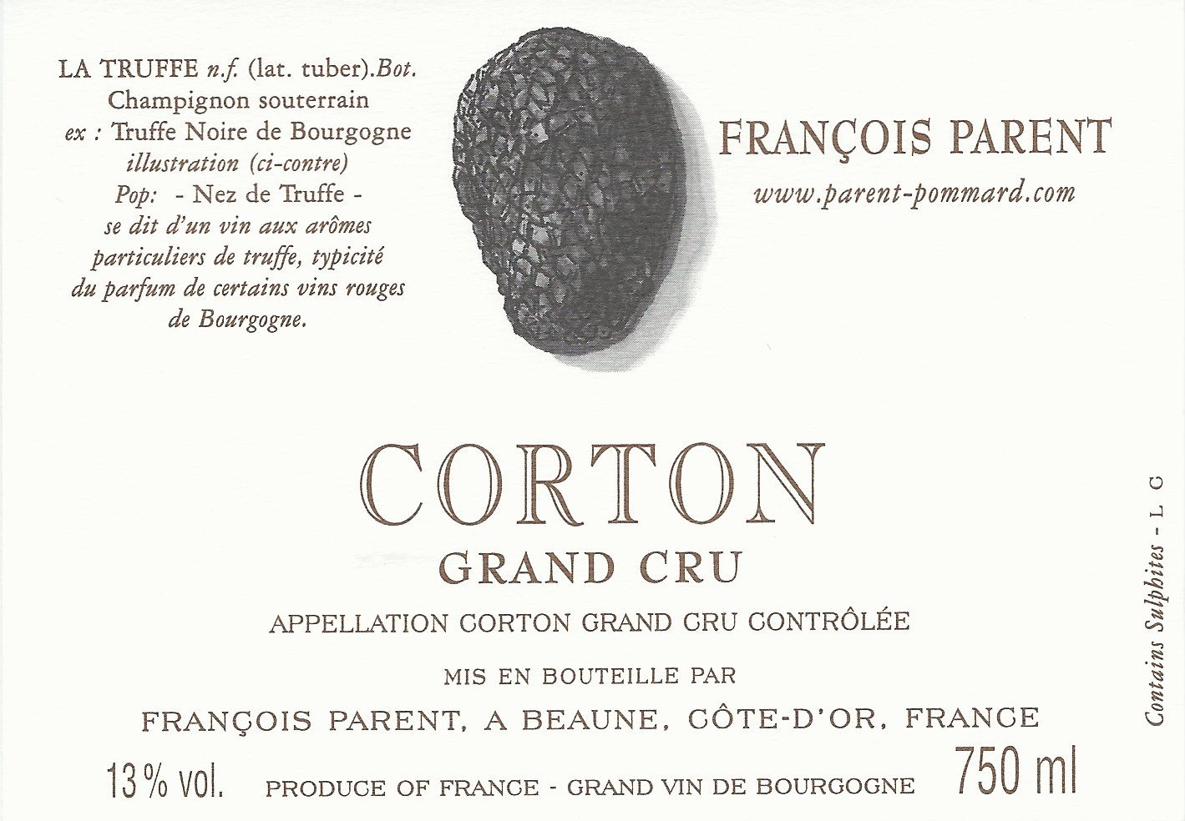
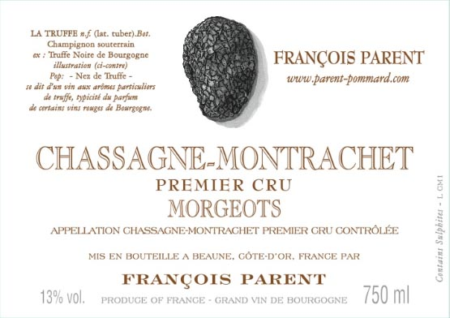

Slide 22
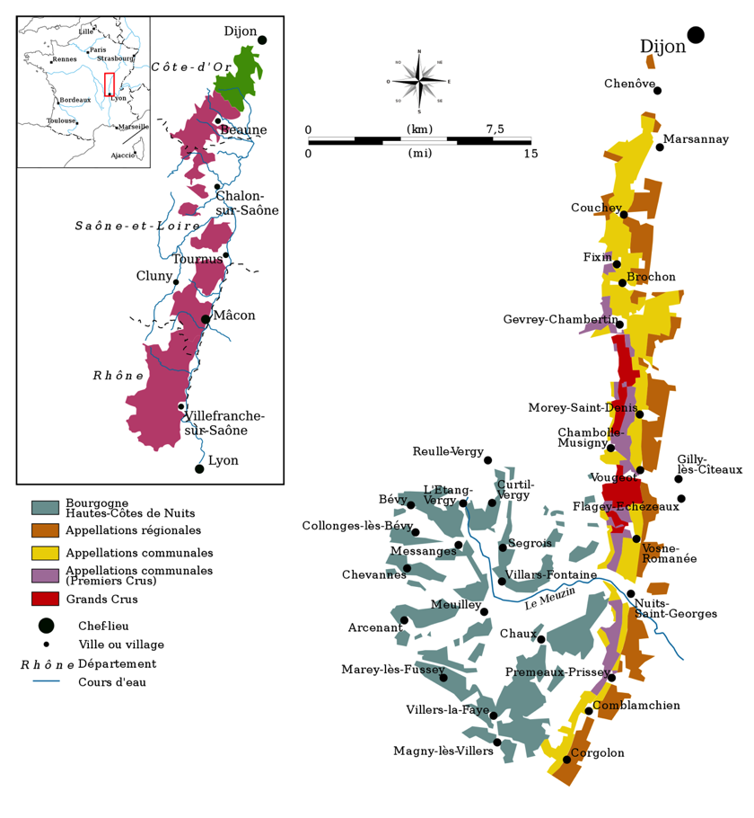
Cote de Nuits

Slide 24
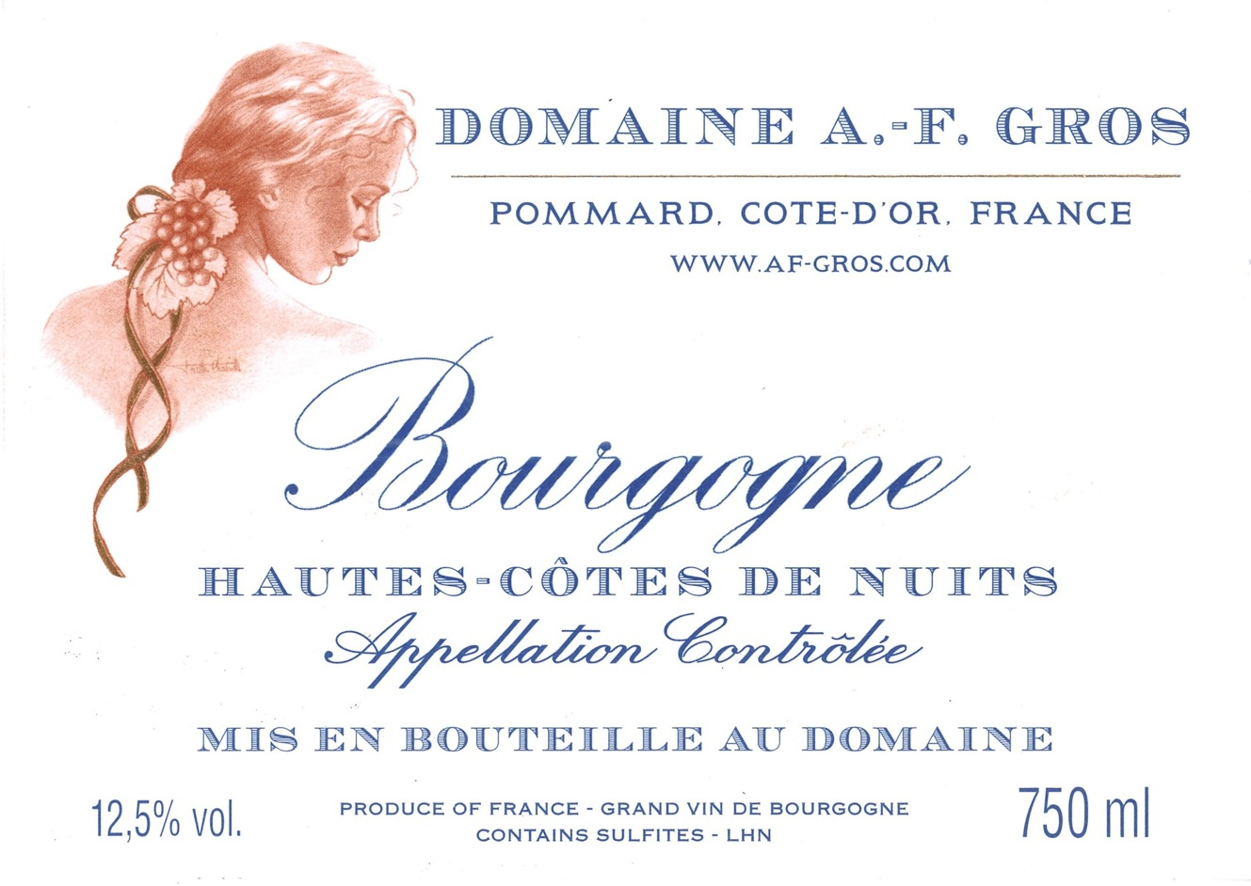
The wine comes from a vineyard located on top of the plateau overlooking the Cotes de Nuits; greater variability of supply depending on the vintage and its climate, but constantly rich fruit, full body and long aftertaste. Stylish Burgundy!

Slide 25
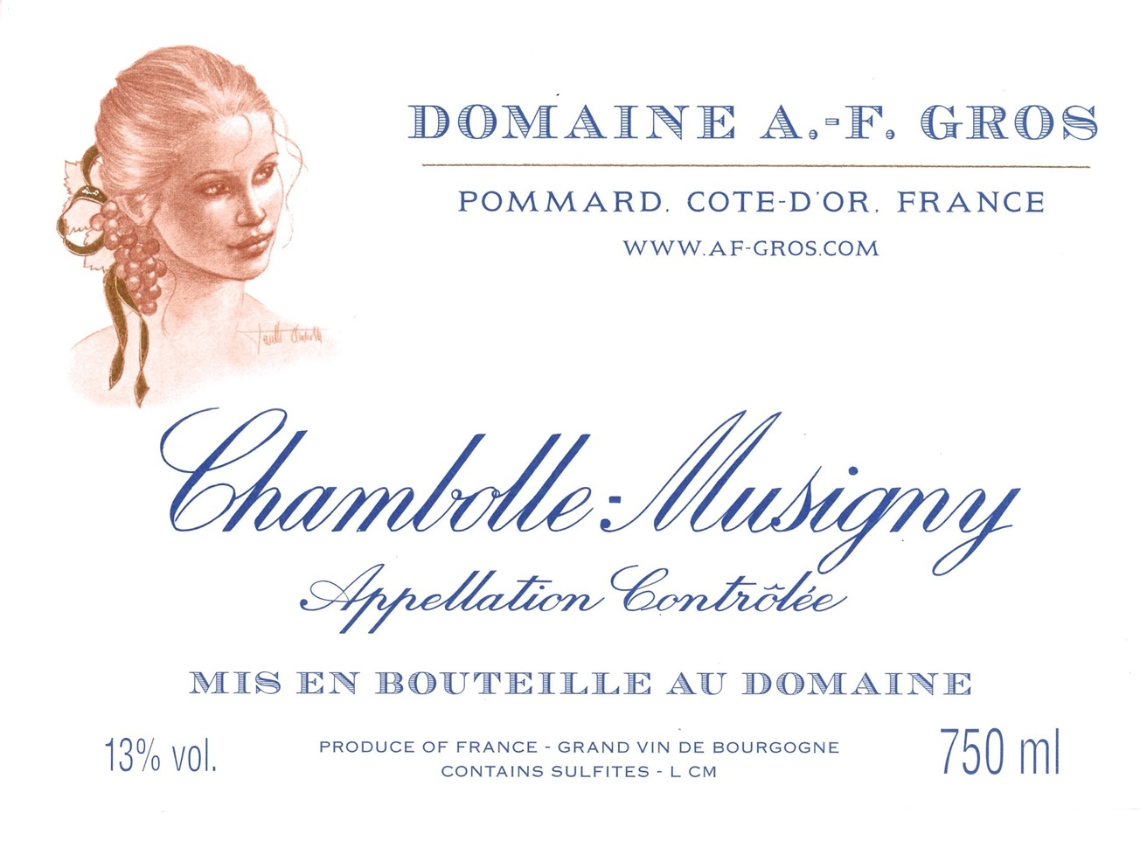
Part of the name of Chambolle-Musigny, Chambolle, comes from “champs bouillants”, in reference to the water running down the vineyards during heavy rains. The wine is refined, perfumed, and has an unmistakable elegance.

Slide 26
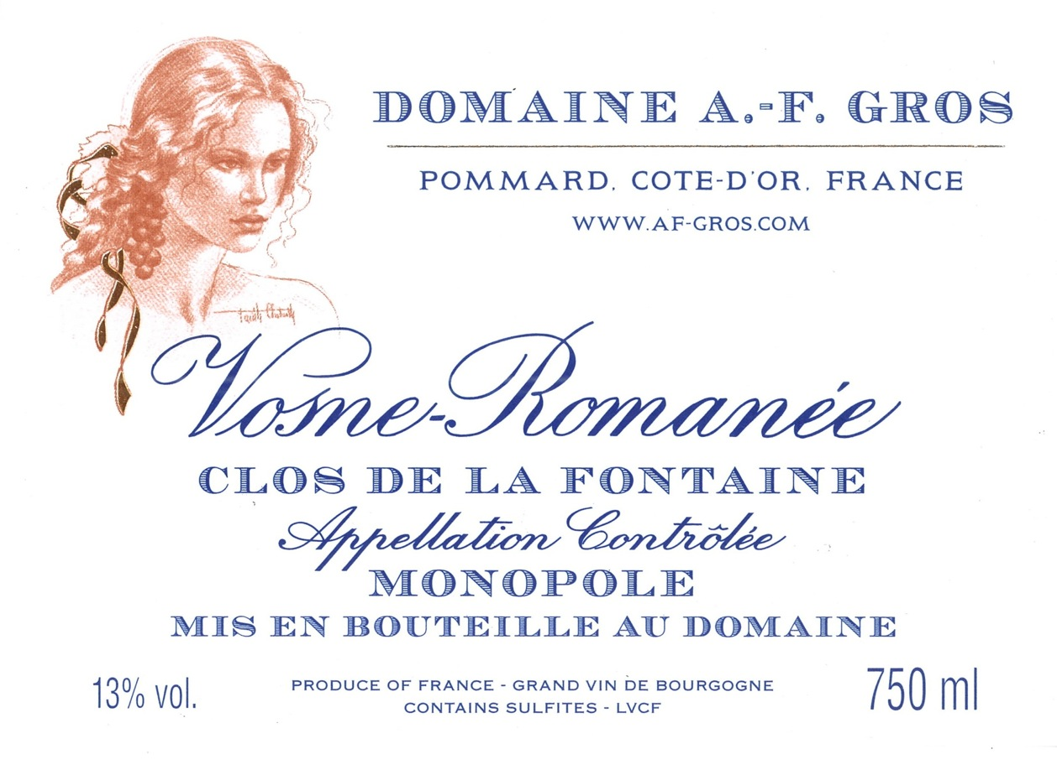
“Clos de la Fontaine” is an enclosed vineyard located near the village of Vosne Romanee; Domaine AF Gros is the sole proprietor of the vineyard, hence the “monopole” designation; it produces rich, deeply colored and generous wines, with great balance and superlative elegance.

Slide 27
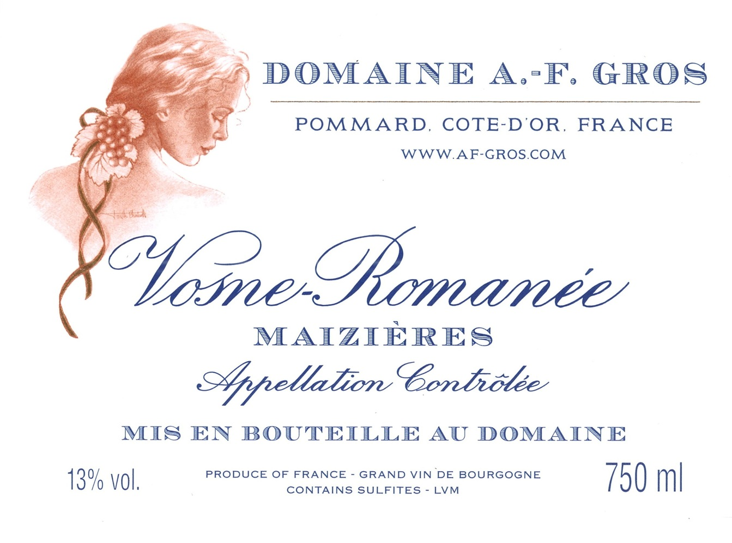
“Maizieres” is a vineyard bordered by stone walls constructed long ago with the remnants of old buildings, one way to delineate the parcels in this intensely cultivated region. Velvety wine, with great elegance and finesse that ages harmoniously.

Slide 28
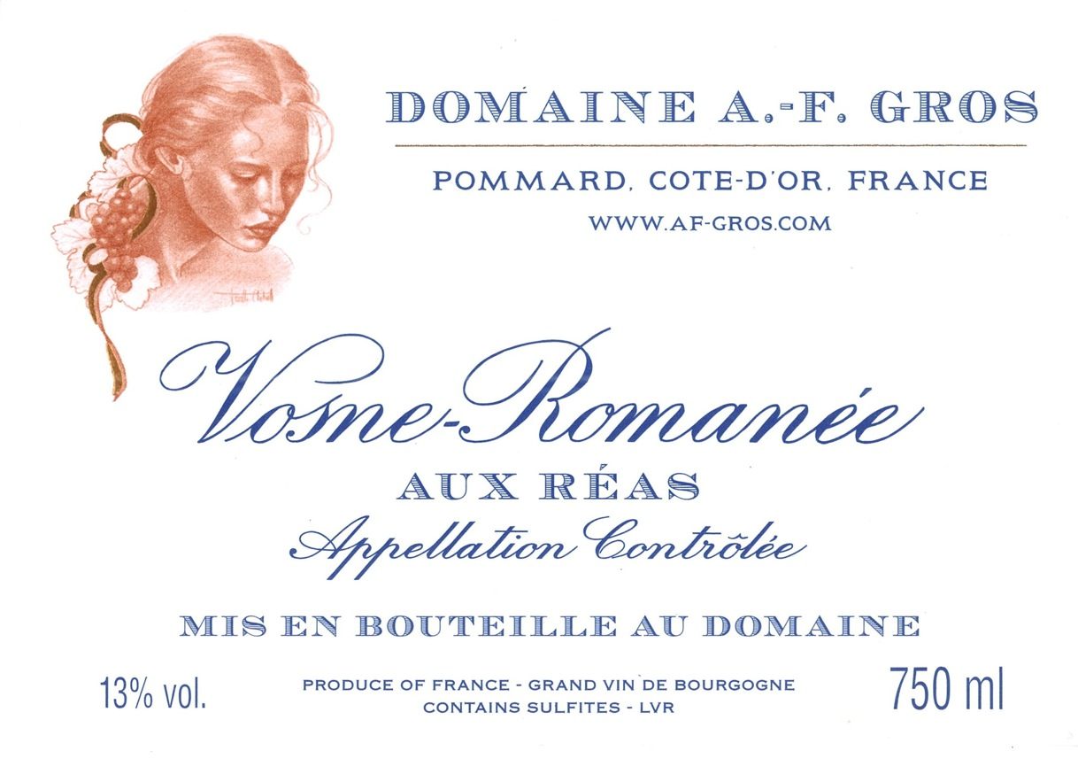
Aux Reas is a small vineyard located next to the Grand Cru Clos des Reas.
Wines with forward fruit, an elegant body, lingering aftertaste, that have great aging capabilities. They exemplify the unforgettable qualities of the appellation.

Slide 29
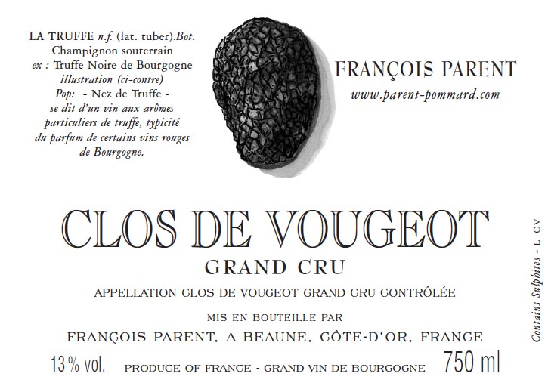

Slide 30
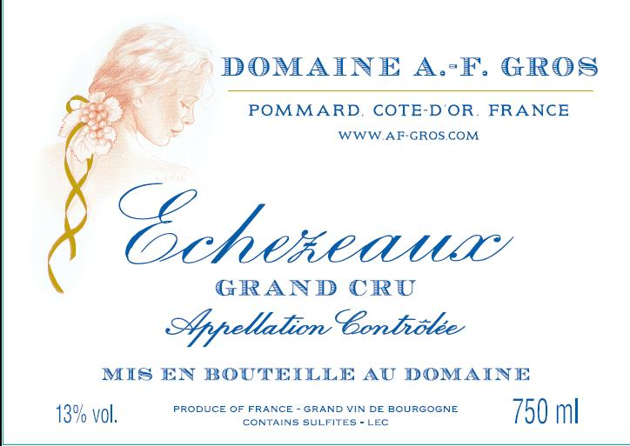
The wine comes from the “lieu dit Les Champs Traversin,” the premier site in Echezeaux whose neighbor “Les Poulalierre,” is home to the section of Domaine de la Romanee Conti. The 75 + year old vines are planted in a perfect location, halfway up the slope. Only 125 cases produced.

Slide 31
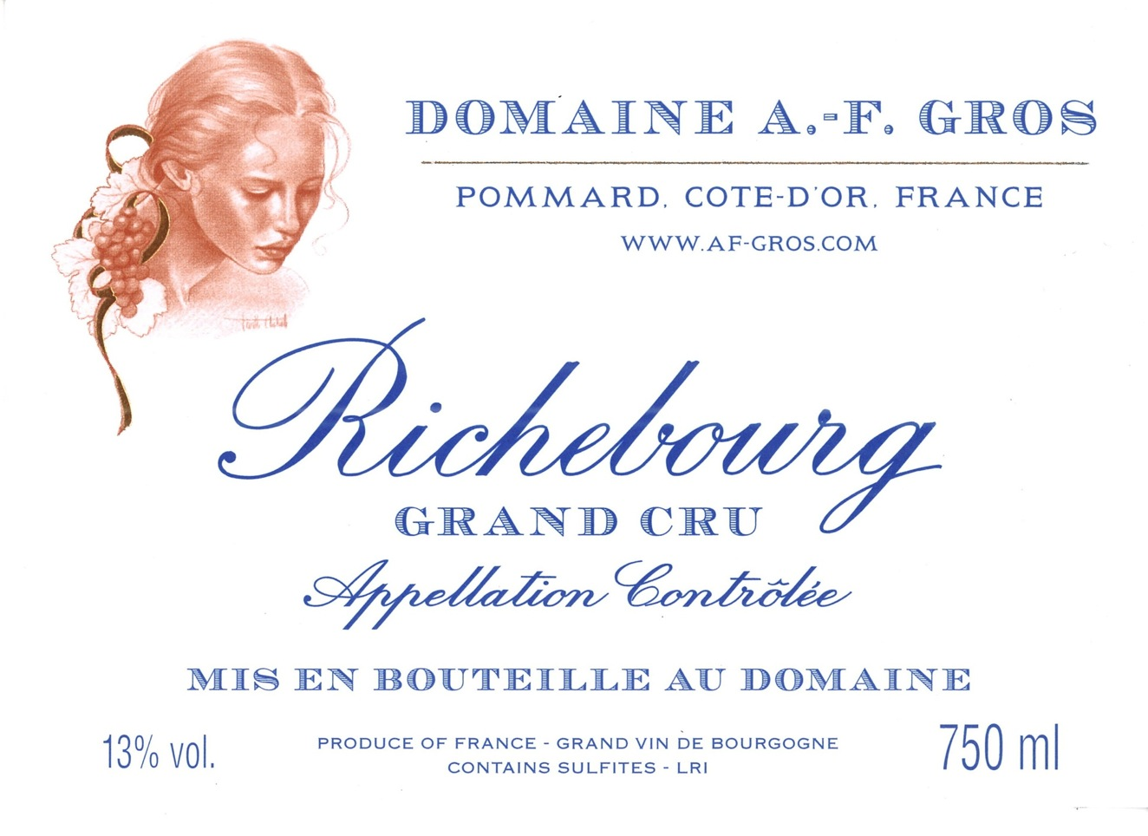
Vines are 15, 25 and 75 years of age. Richebourg is one of the top Grand Crus in Vosne. Explosive nose of black fruits, flowers, and smoky new oak. Voluptuous, opulent, layered and full-bodied in the mouth. 200 cases produced.

Slide 32
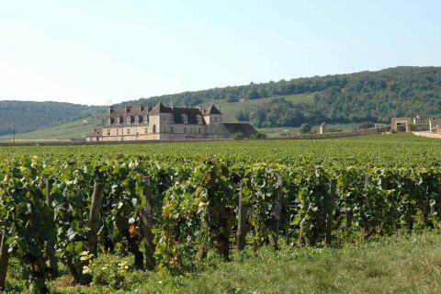
“Burgundy makes you think of silly things, Bordeaux makes you talk of them and Champagne makes you do them.”
Jean-Anthelme Brillat-Savarin

Slide 33
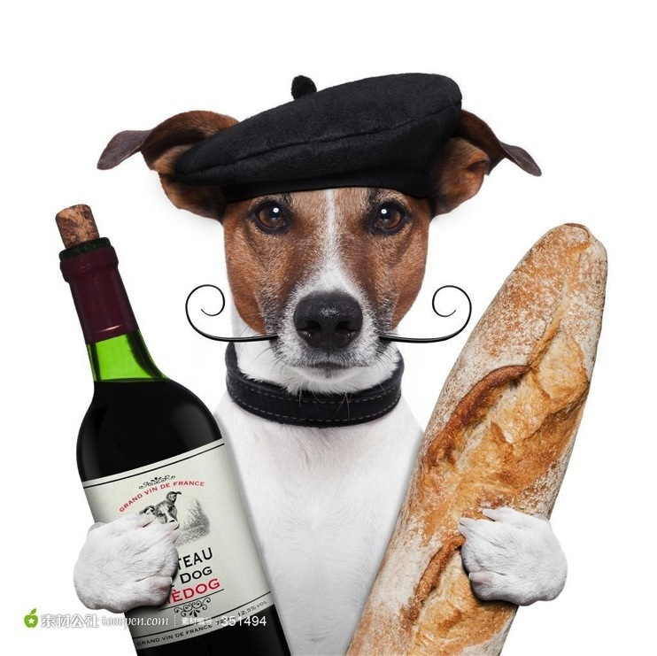
Thanks for your attention!

