Slide 1

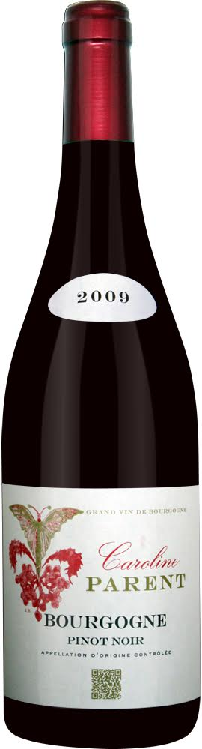
The wines of
Caroline PARENT

Slide 2
Caroline Parent-Gros is the daughter of Anne-Francoise Gros (Domaine AF Gros, Beaune) and Francois Parent (Pommard).
As such she incarnates the union between Cote de Nuits and Cote de Beaune.
Caroline sells primarily wines from her family’s holdings along with a few select wines from long term contracts.
Caroline’s focus is to provide the market with ready-to-drink premium and super premium Burgundies for mid to upscale restaurants and a few select wine shops.

Slide 3
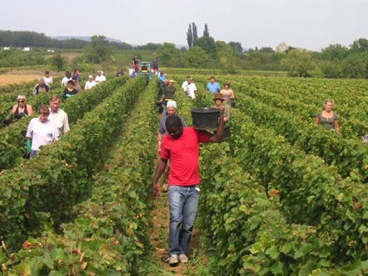
Viticulture principles
Traditional vineyard management based on sustainability principles.
Selective pruning to optimize yield and vigour, along with optimized leaf pulling, green harvest when needed, and ploughing of the soils.
No pesticides and no insecticides, use of sexual confusion.
100% manual harvesting.
The grapes are brought to the winery in small cases to avoid any tamping down, within 20 minutes of their being cut.

Slide 4
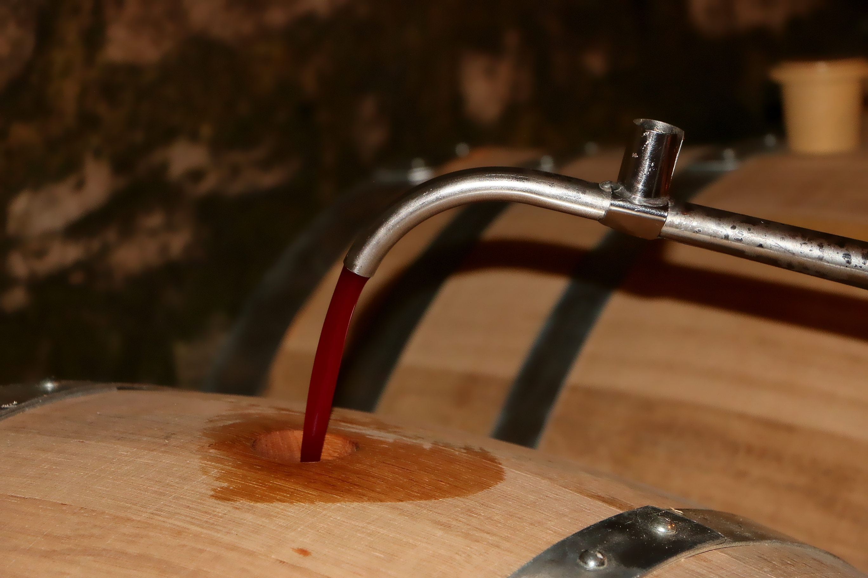
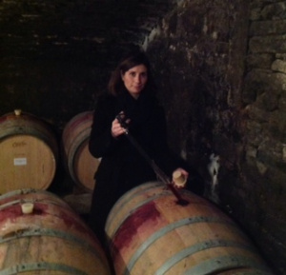
Red wine winemaking principles
Comprehensive sorting in 4 steps:
In the vineyard,
With a dynamic sorting table at the arrival in the winery,
Manual sorting by 6 persons. 100% de-stemming.
Final sorting is done after de-stemming.
The new generation of de-stemmer that we use preserves the skin of the clusters (berries) so that the sugars will spread slowly and regularly to avoid any break in the fermentation.

Slide 5
For the vinification, we use stainless steel and wood tanks.
Cold maceration (5°C) for about 4-5 days to extract flavours and colour. During that time, we do some remontage (pump over) to keep a good contact between solid and liquid parts.
After 5 days, the alcoholic fermentation starts. Tanks are heated up to 25-30°C for over 10 days.
Pigeage (punch-down) depends on the appellation and structure of the wine. For each tank, 2 to 4 pigeages, at the end of the fermentation; also 2-3 daily pumping over.
After a gentle pressing with a pneumatic press, wines are decanted during 2-3 days at 12°C, and are barrelled.
Malo-lactic fermentation is done in barrels. Low temperature, about 45 days. Monitored for minimal use of SO2.

Slide 6
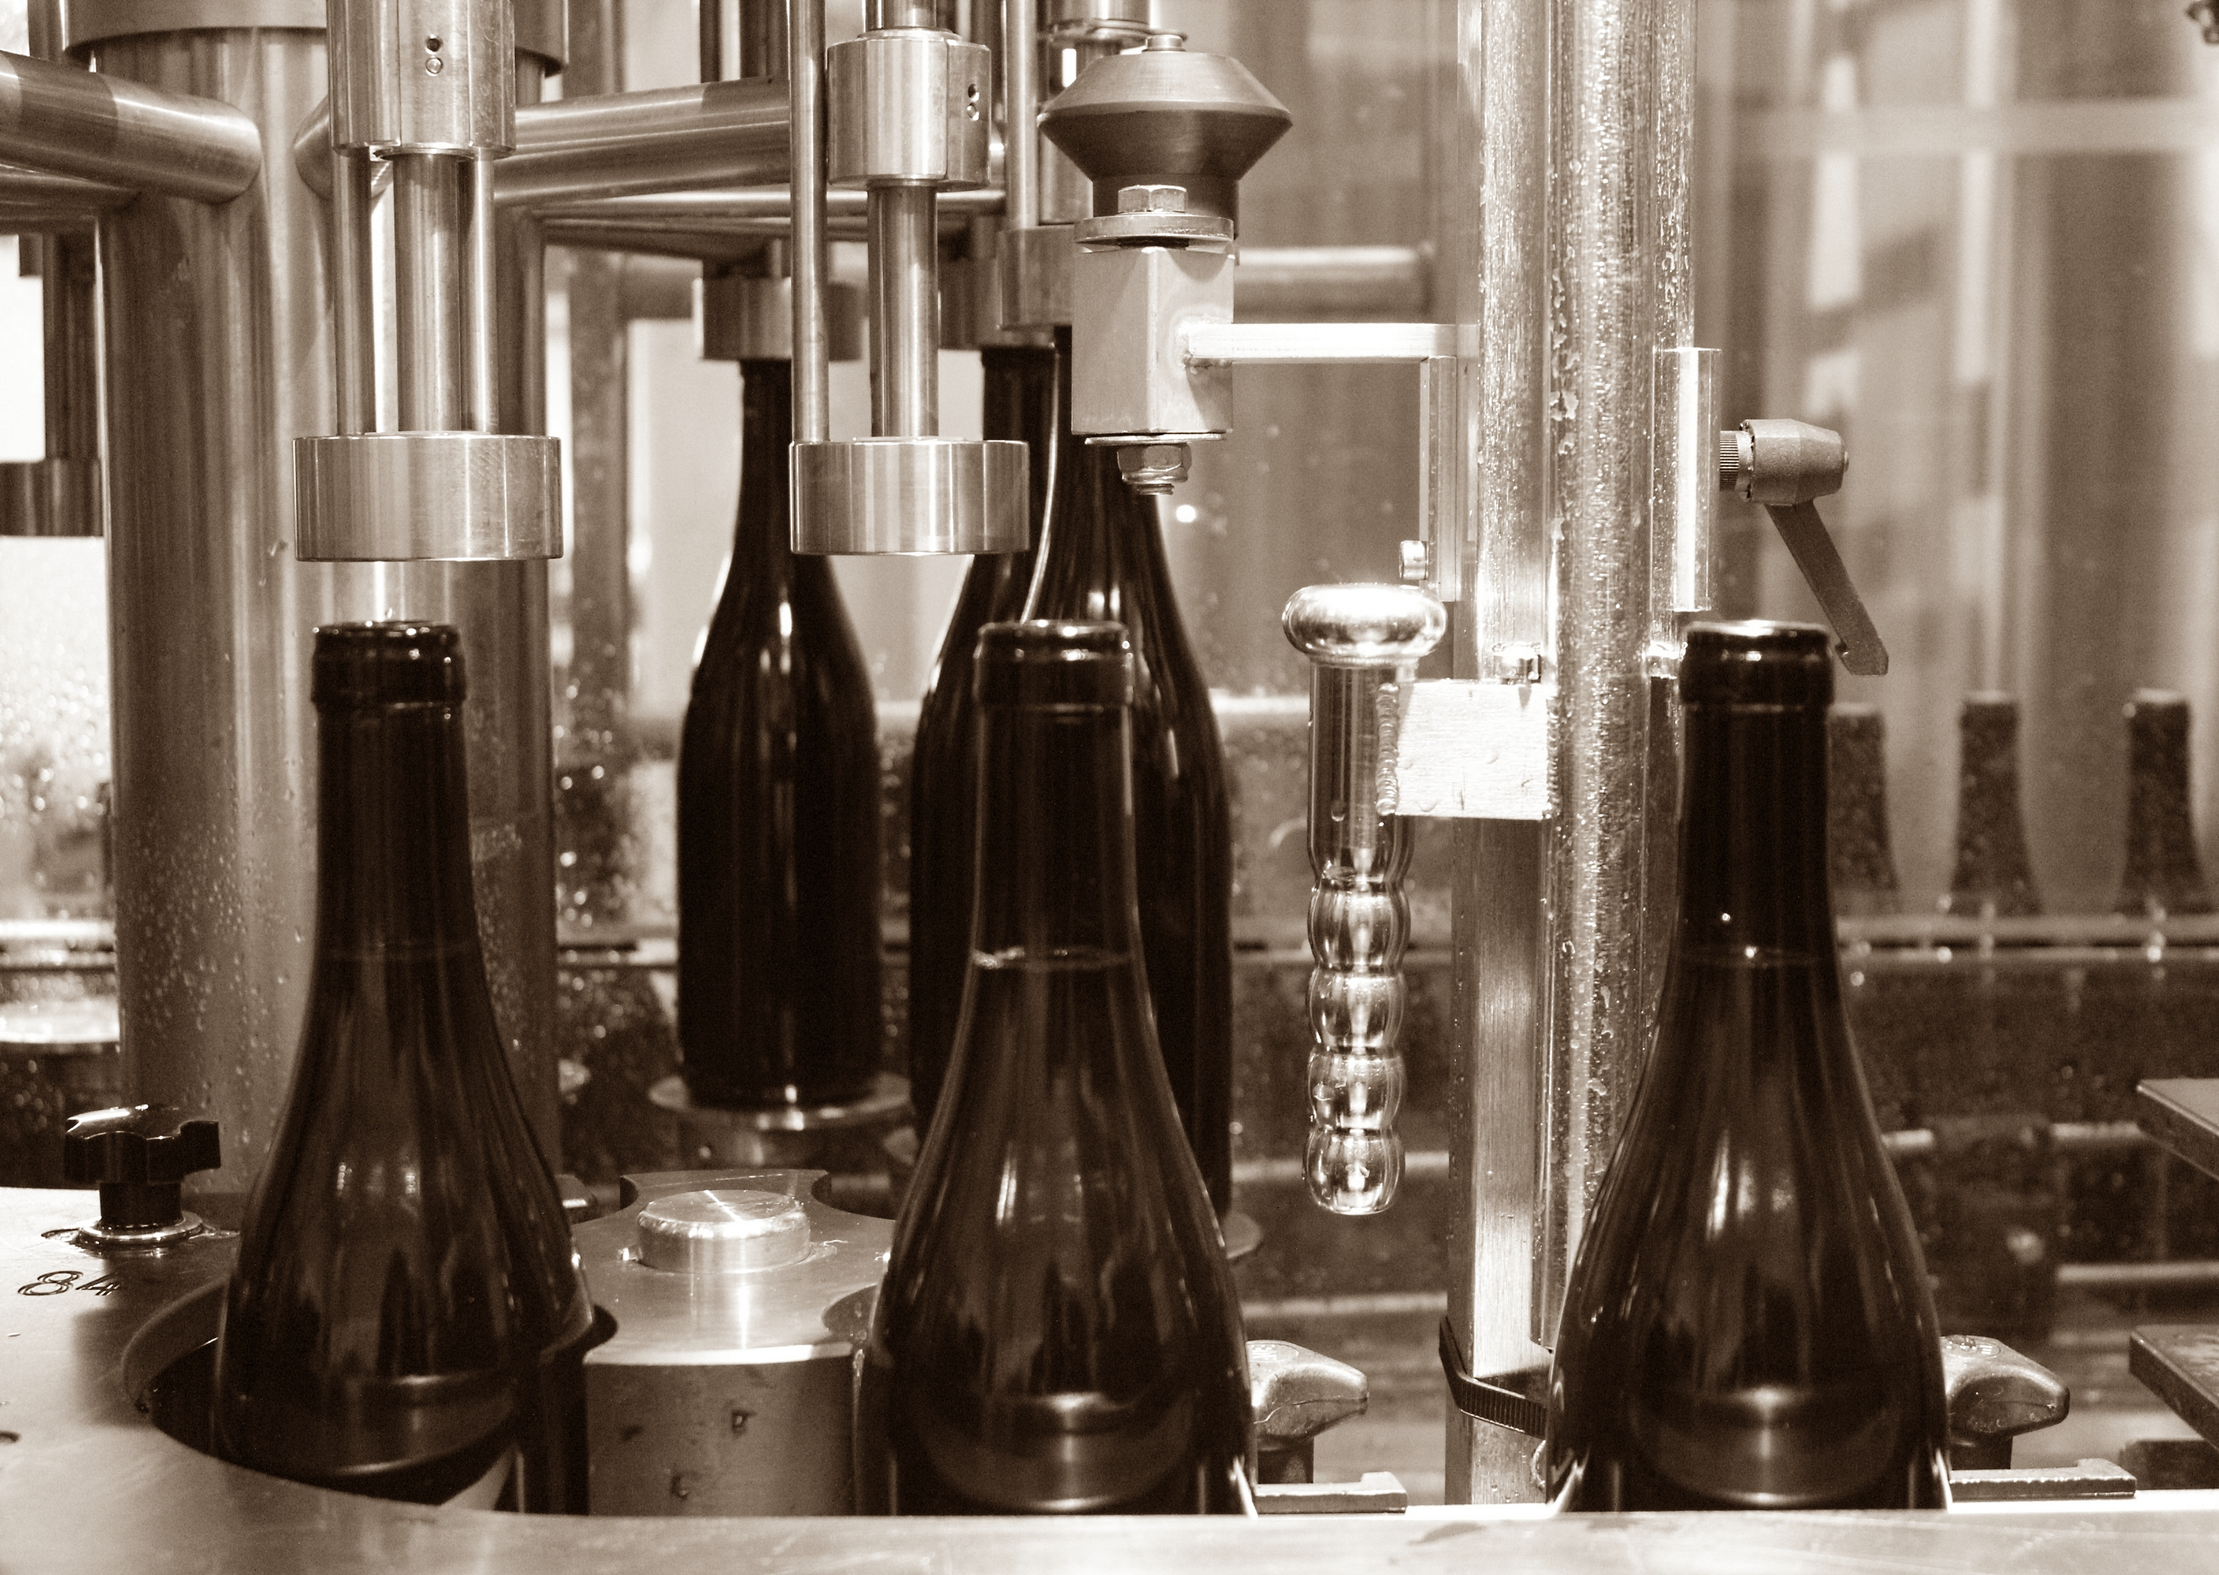
Ageing between 12 to 18 months in French oak barrels, from the forests of Chatillonais, Belleme and Fontainebleau.
Elevage (ageing)lasts an average of 12 months for village wines (50% new oak), 15 months for the 1er crus (65% -85% new oak) and 18 months for the Grands Crus (100% new oak).
The wines are racked and placed in tanks for the last 3 months so that the fine lees can settle down.
If necessary, light filtration (lenticular filer system), no fining.

Slide 7
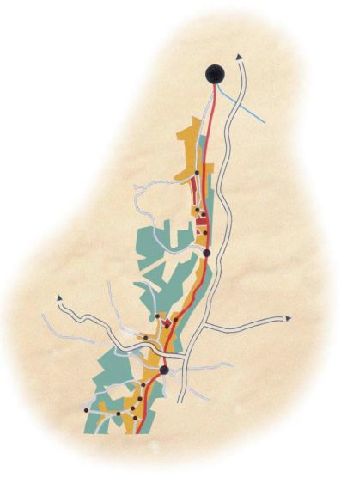
Dijon
Clos de Vougeot
Chambole Musigny
Vosne Romanee
Nuits St Georges
Savigny les Beaune
Pommard
Beaune

Slide 8
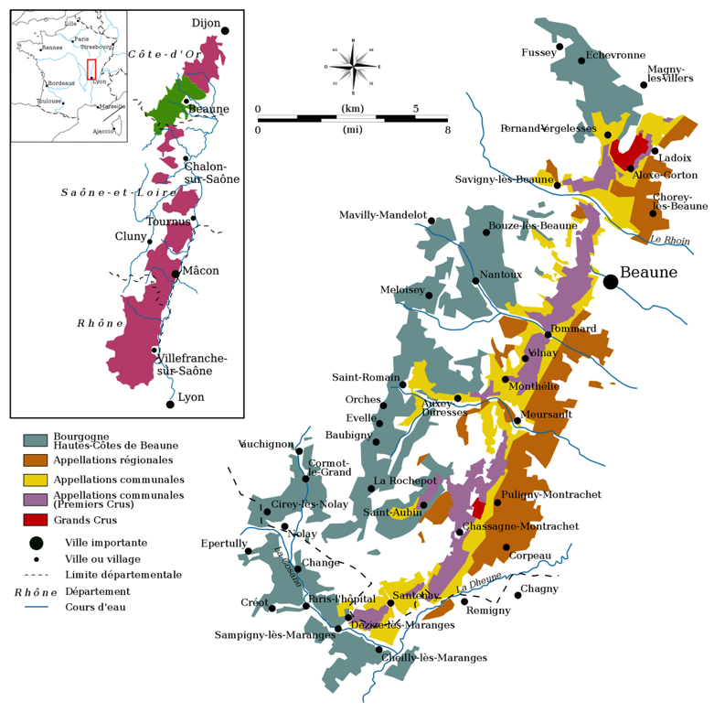
Cote de Beaune

Slide 9
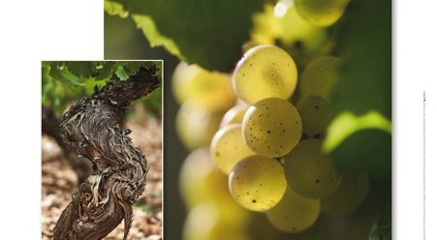
Vins Blancs

Slide 10
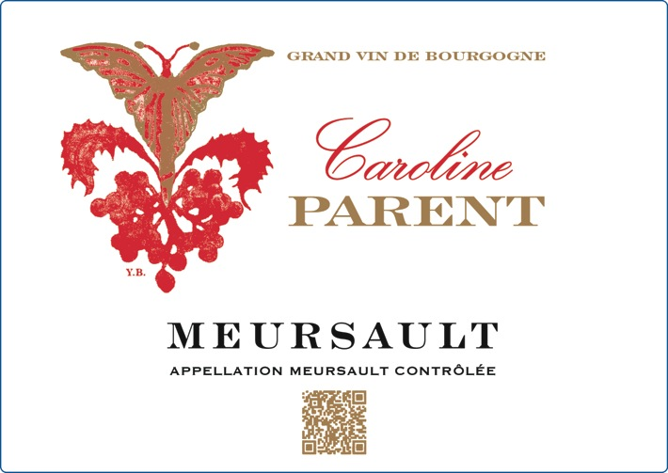
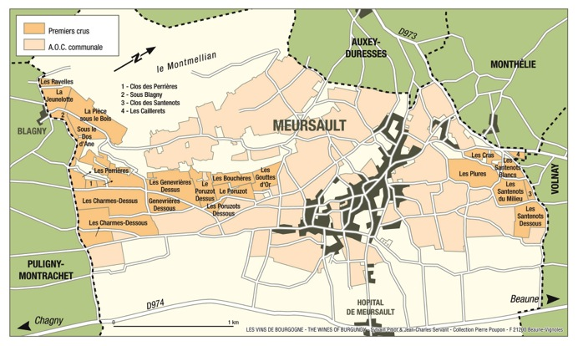
Caroline Parent Meursault
Green-gold color, limpid and brilliant. Redolent aromas of toasted almonds and hazelnuts in a floral (mayflower, elder, bracken, lime, verbena) and mineral (flint) setting. Rich and fat with a cheerful and appealing taste of hazelnut.

Slide 11

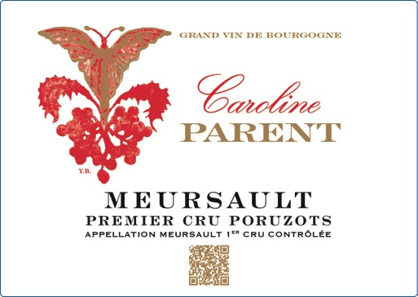
Caroline Parent Meursault
1er Cru Poruzots
Light canary yellow color, leaning towards bronze as it ages. Butter, honey, and citrus fruits aromas are present. Unctuousness and freshness are in silky balance. Long and structured, it needs time to mature – great white wine for laying down.

Slide 12
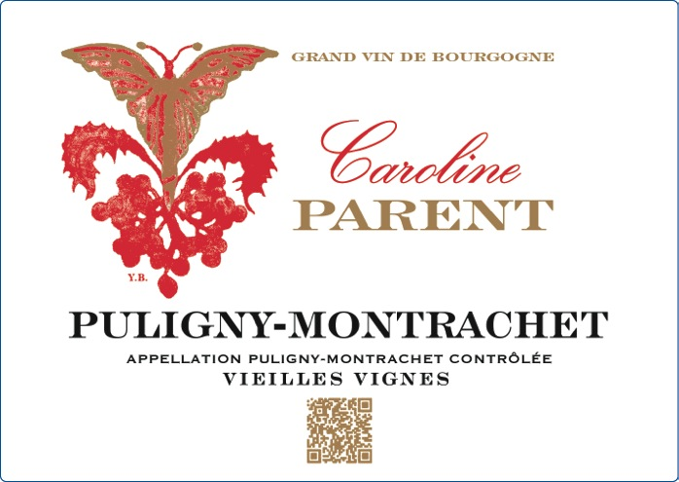
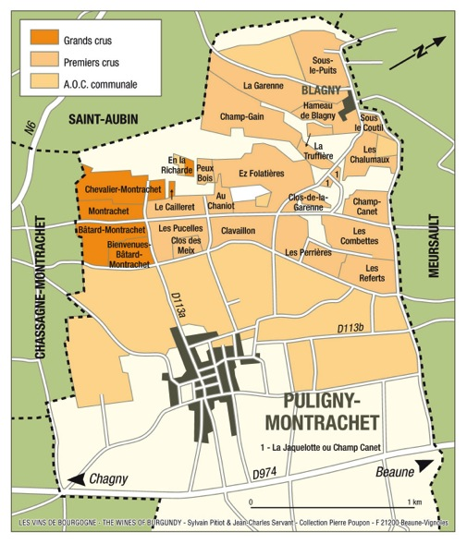
Caroline Parent Puligny Montrachet Vielles Vignes (50+ years old)
Bright gold color with greenish highlights, becoming more intense with age. Bouquet of ripe grapes, marzipan, hazelnut, amber, lemon-grass and green apple. Milky (butter, hot croissant) and mineral aromas (flint) are commonplace, as is honey. Body and bouquet blend into a subtle harmony. This wine combines grace with a well defined character and a remarkable concentration.

Slide 13
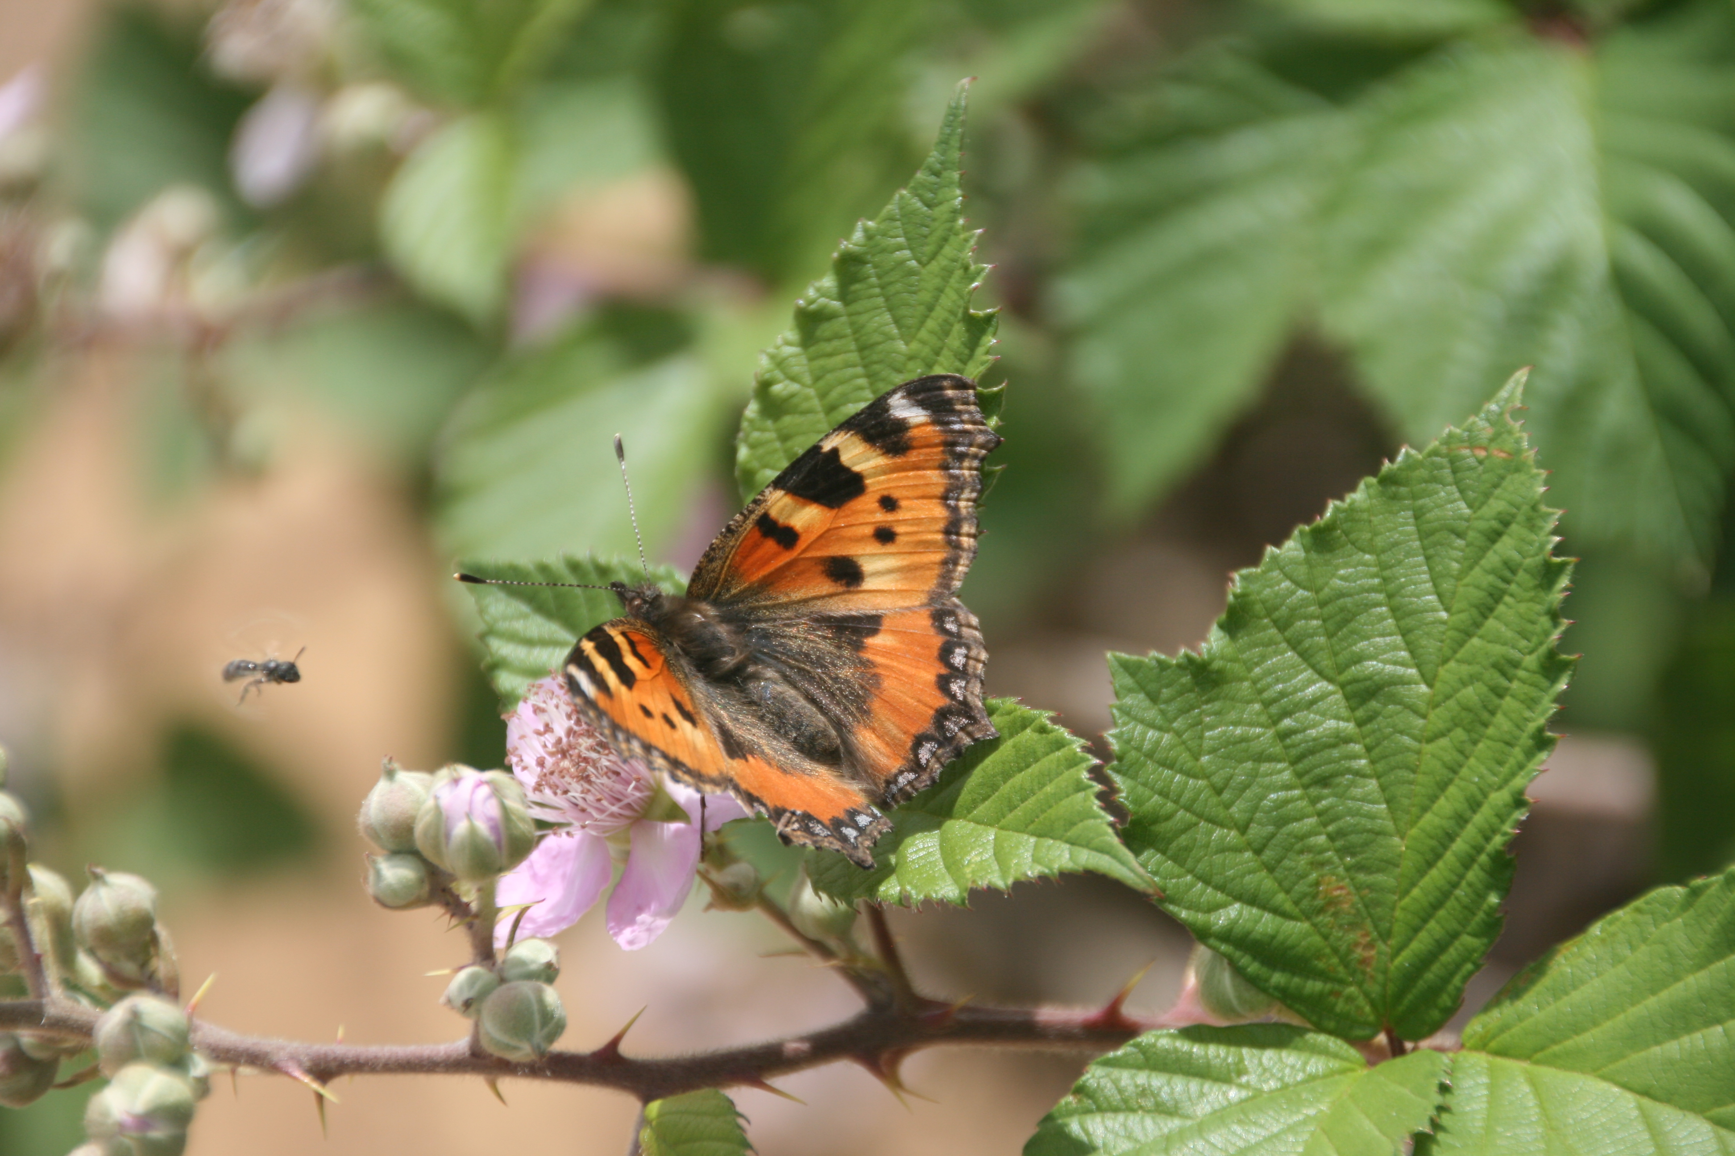
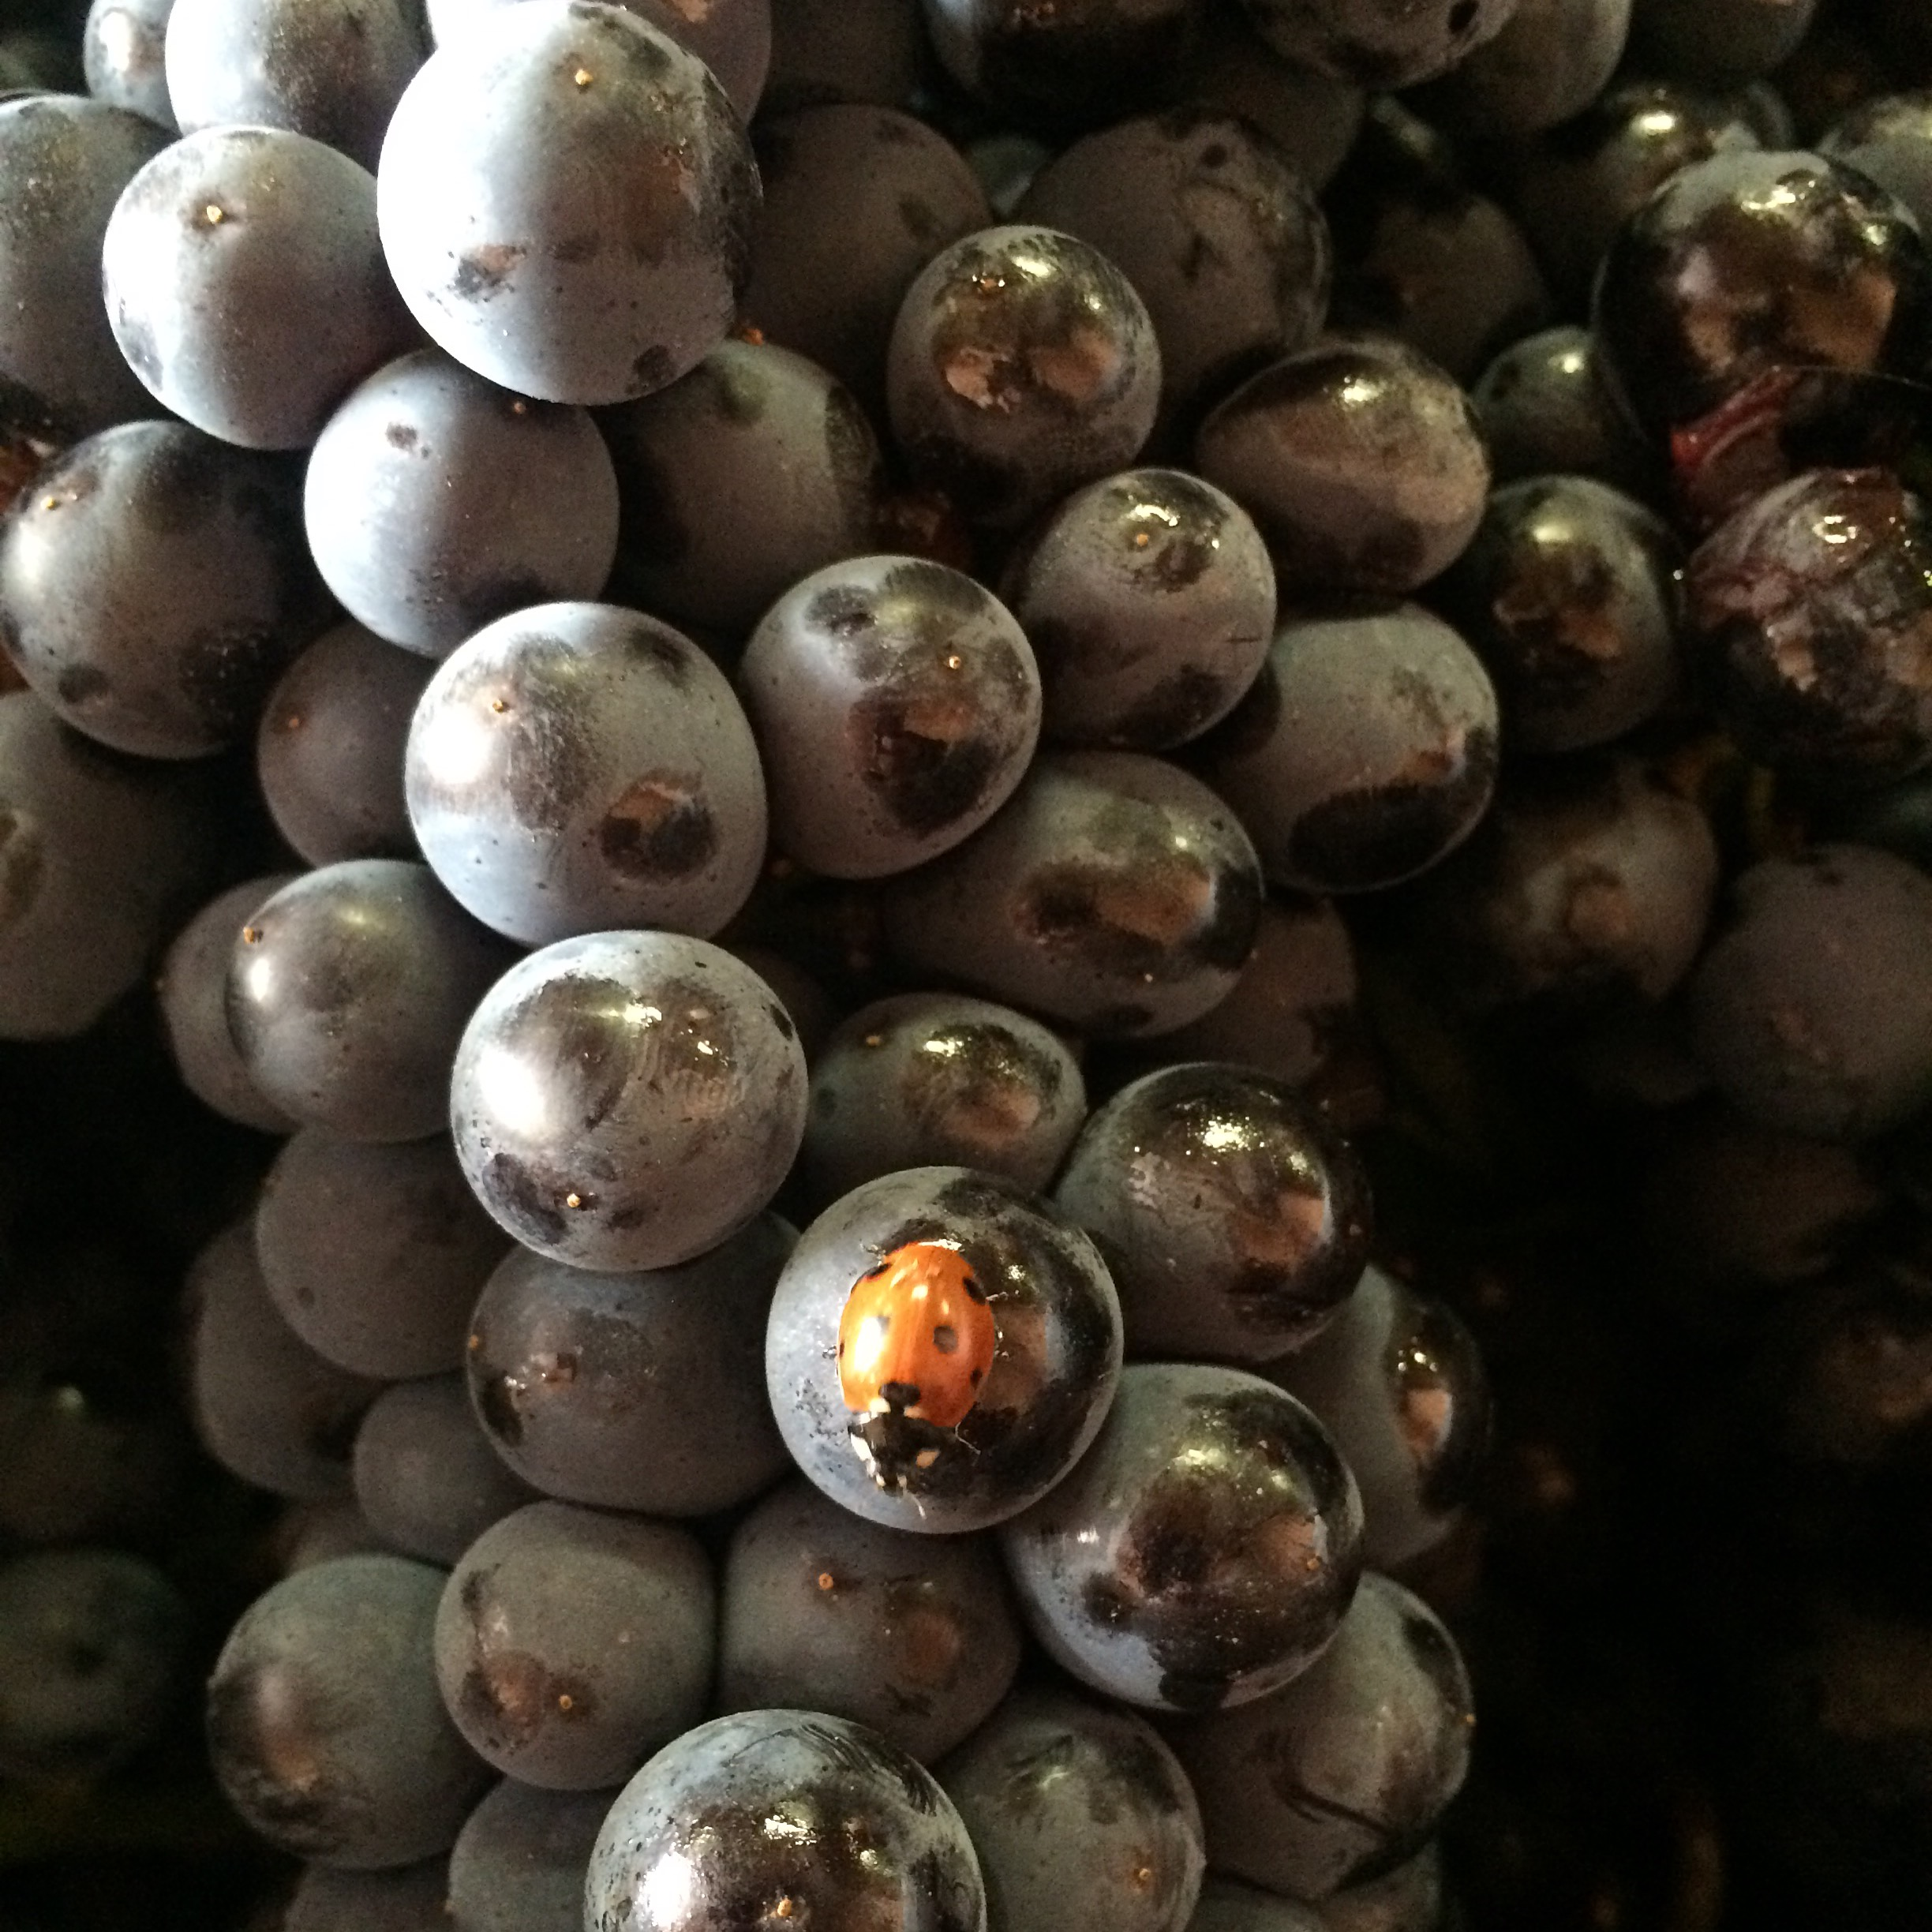
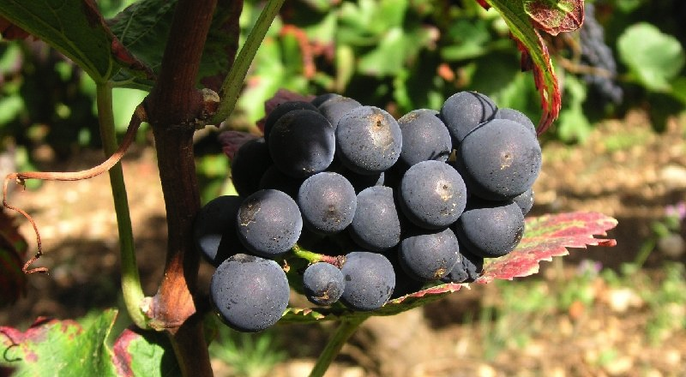
Vins Rouges

Slide 14
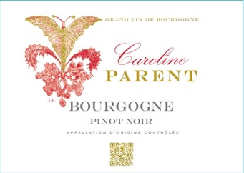
Caroline Parent Bourgogne Pinot Noir
Richly colored - crimson at first then, with age, shading towards dark ruby. Red and black fruit aromas (strawberry, cherry, blackcurrant, bilberry) later evolving into cooked prune, peppery notes, and notes of animal, underbrush, moss and mushroom. Lively and structured in the mouth with a well-rounded and supple backbone.

Slide 15
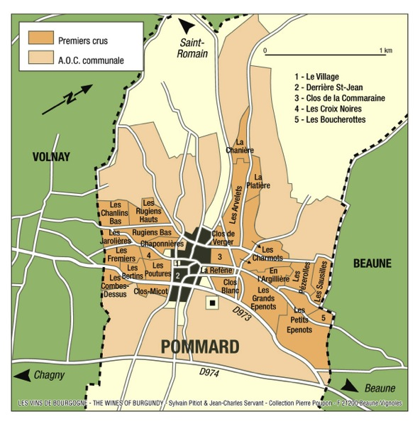
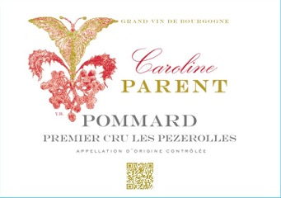
Caroline Parent Pommard
1er Cru Pezerolles
"Les Pézerolles", Premier Cru, produces a refined Pommard, akin to Volnay. The name comes from the old French "Poizerolles", which meant "chickpeas”, likely cultivated next to the vines in the Middle Ages. The wine has floral notes, subtle red fruit aromas, and a very elegant structure.

Slide 16
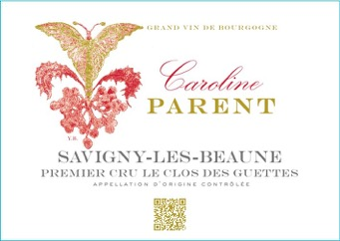
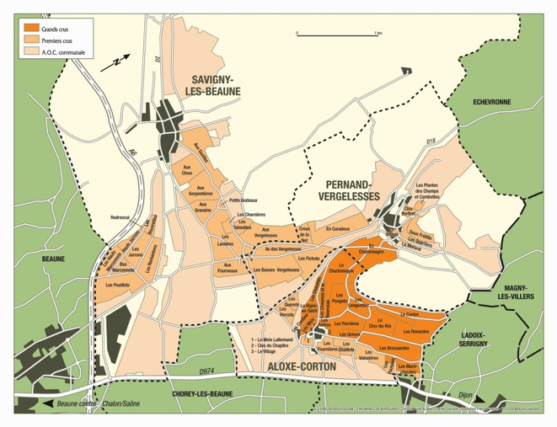
Caroline Parent Savigny Les Beaune 1er Cru Clos des Guettes
“Clos des Guettes” is a vineyard that is high up on the hill in Savigny; it was used in ancient times as a watching post. With great aromas and balance, the full-bodied wines it produces will age very well up to 12 years.

Slide 17
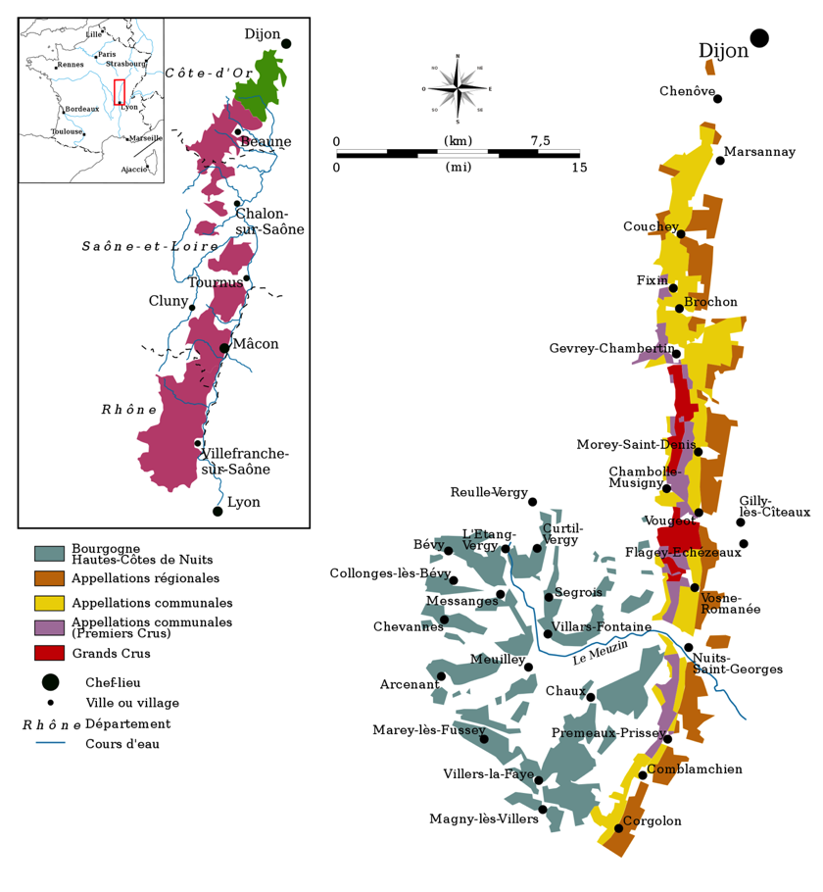
Cote de Nuits

Slide 18
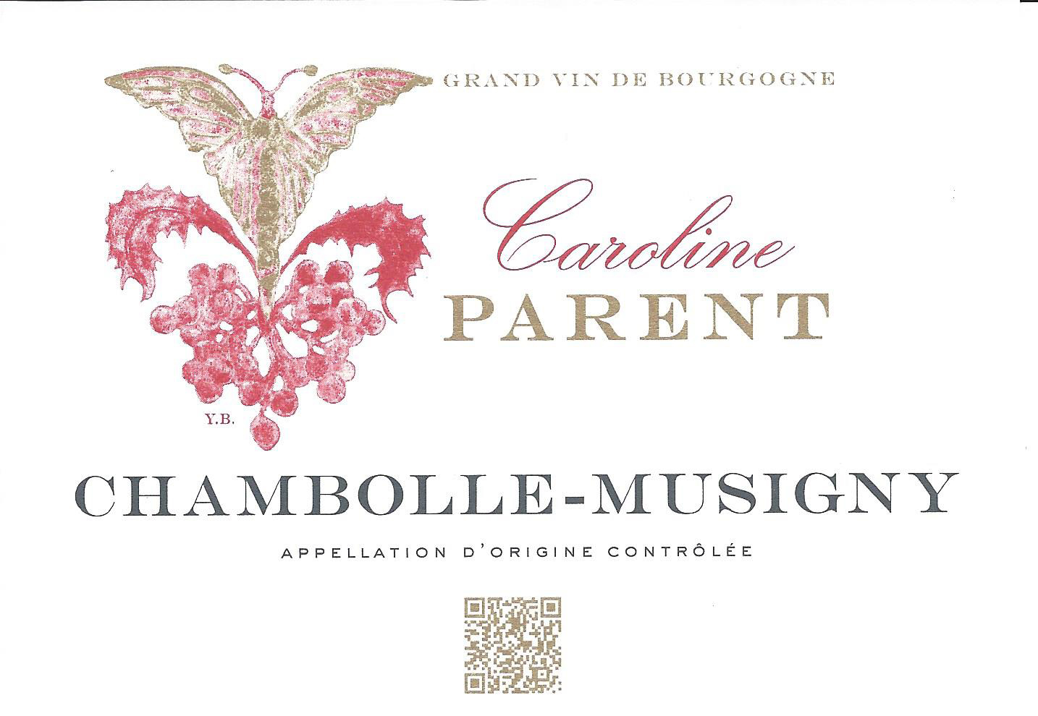
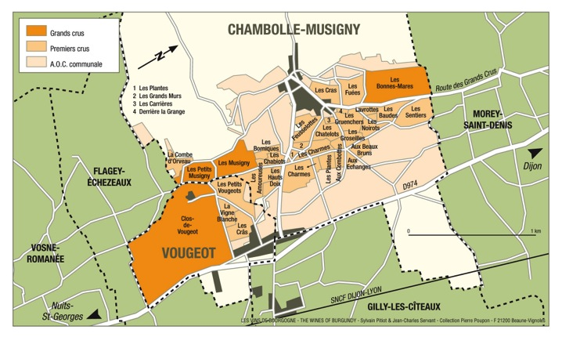
Caroline Parent Chambolle Musigny
Part of the name of Chambolle-Musigny, Chambolle, comes from “champs bouillants”, in reference to the water running down the vineyards during heavy rains. The wine is refined, perfumed, and has an unmistakable elegance.

Slide 19

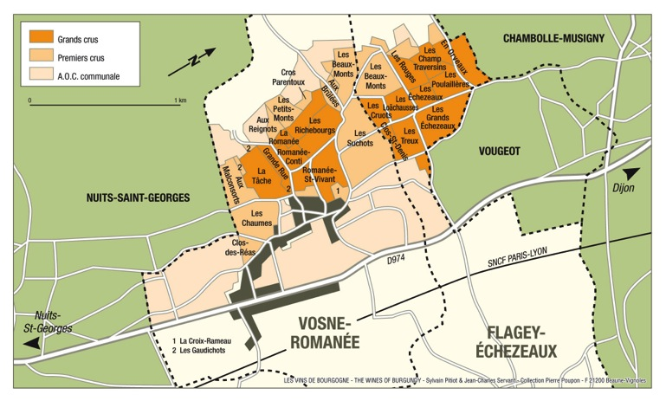
Caroline Parent Vosne Romanee
Fiery red color. Bouquet of ripe fruit, red berries. On the palate the wine is velvety and distinguished-Pinot Noir at the top of its form. The wine may seem a little austere in its youth; it needs time in the bottle to develop structure and fleshy texture. Often full-bodied and voluptuous, this wine reminds us of a Rubens nude.

Slide 20
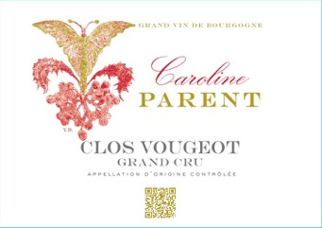

Caroline Parent Clos Vougeot Grand Cru
Very intense color, a suave bouquet, redolent of springtime of blown roses at dawn, of violets in the morning dew, blackberries, licorice and truffle... On the palate, the taste is masterful, rich, succulent and mellow, combining elegance and delicacy with meaty fullness. A long finish in the mouth and long aging potential (anything from 10 to 30 years and sometimes even more).

Slide 21
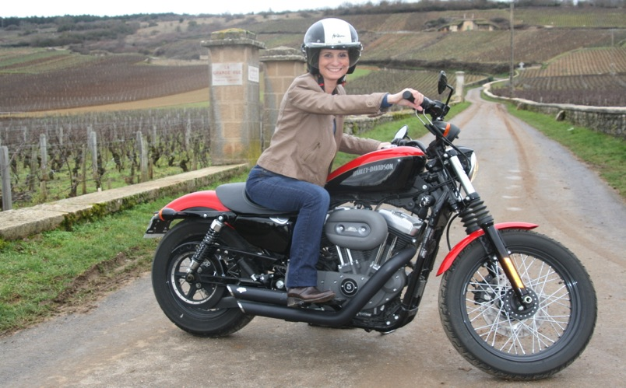
An exclusive offering from Caroline Parent et Associes
Beaune, France

