Slide 1
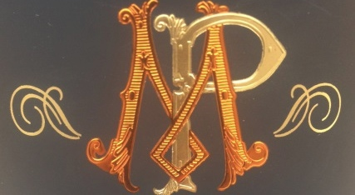
Bourgogne
Mathias PARENT

Slide 2
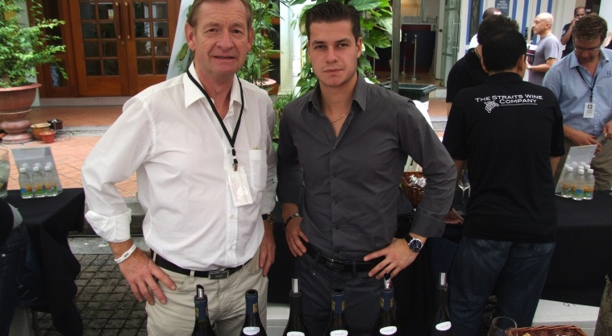
Mathias and Francois Parent

Slide 3
Mathias Parent is the son of François Parent and Anne Françoise Gros, two great families of Burgundy;
- The Gros family, growers in the Côte de Nuits, with prestigious appellations like Echezeaux and Richebourg.
- The Parent family, growers in Pommard and Côte de Beaune, where Mathias’ father, François, perpetuates the savoir-faire of the great lineage of which he is the thirteenth winemaker.
Mathias is the 14th generation of wine grower in the Parent’s family. His forefather, Etienne Parent, then a cooper in Beaune, befriended Thomas Jefferson during his travel in Burgundy and was requested by the latter to provide him with “sound wine for drinking”. He is also the winemaker at Domaine AF GROS, with his father François, as he is taking over this family estate with his sister Caroline.

Slide 4
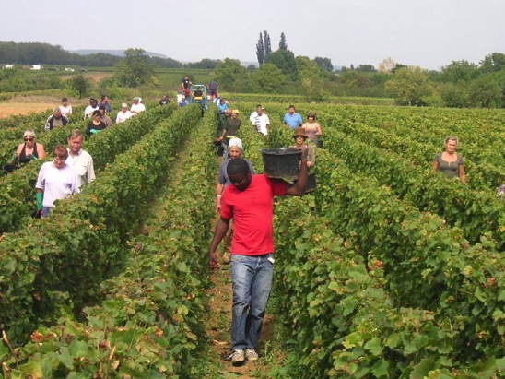
Traditional vineyard management based on sustainability principles.
Selective pruning to optimize yield and vigour, along with optimized leaf pulling, green harvest when needed, and ploughing of the soils.
No pesticides and no insecticides, use of sexual confusion.
100% manual harvesting.
The grapes are brought back to the winery in small cases to avoid any tamping down, in less than 20 minutes after they are cut.

Slide 5
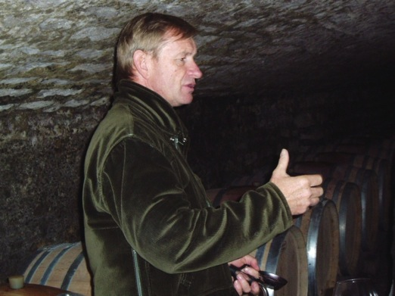
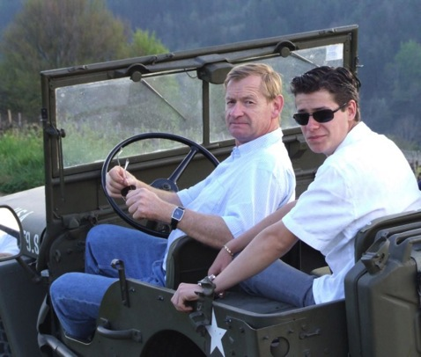
Comprehensive sorting in 4 steps:
In the vineyard,
With a dynamic sorting table at the arrival in the winery,
Manual sorting by 6 persons. The clusters are 100% de-stemmed.
Final sorting is done after de-stemming.
The new generation of de-stemmer that we use preserves the skin of the clusters (berries) so that the sugars will spread slowly and regularly to avoid any break in the fermentation.

Slide 6
For the vinification, we use stainless steel and wood tanks.
Cold maceration (5°C) for about 4-5 days to extract flavours and colour. During that time, we do some remontage (pump over) to keep a good contact between solid and liquid parts.
After 5 days, the alcoholic fermentation starts. Tanks are heated up to 25-30°C for over 10 days.
Pigeage (punch-down) depends on the appellation and structure of the wine. For each tank, 2 to 4 pigeage, at the beginning of the fermentation; also 2-3 daily pumping over.
After a gentle pressing with a pneumatic press, wines are decanted during 2-3 days at 12°C, and are barrelled.
Malo-lactic fermentation is done in barrels. Low temperature, about 45 days. Monitored for minimal use of SO2.
Elevage: The wines are aged between 12 to 18 months in French oak barrel. The oaks come mainly from forest of Troncey in Allier, Bertranges and Fontainebleau. We work with 3 main coopers and ask them for high toasted barrels, including a burning of the head of the barrels.
Generics are aged in 5000 Liters tank (60%) and in oak barrels from 2-3 wines (40%).
Elevage is done during an average of 12 months for village wines (50% new oak), 15 months for the 1er crus (65% new oak) and 18 months for the Grands Crus (100% new oak).
The wines are racked and placed in tanks for the last 3 months of elevage so that the fine lees can settle down.
We check the turbidity and, if necessary, do a light filtration (lenticular filer system: cellulose sheets) but no fining.
The wines are bottled by gravity. We pay attention to order our bottles with a bottleneck of 63 mm to avoid as much as possible leakage of the corks.

Slide 7
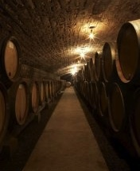
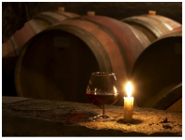
Ageing between 12 to 18 months in French oak barrels, from the forests of Tronçais in Allier, Bertranges and Fontainebleau. High toasted barrels.
Elevage (ageing)lasts an average of 12 months for village wines (50% new oak), 15 months for the 1er crus (65% new oak) and 18 months for the Grands Crus (100% new oak).
The wines are racked and placed in tanks for the last 3 months so that the fine lees can settle down.
If necessary, light filtration (lenticular filer system), no fining.

Slide 8
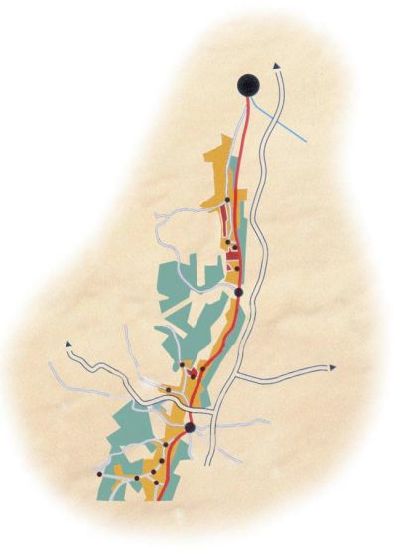
Dijon
Clos de Vougeot
Chambole Musigny
Vosne Romanee
Nuits St Georges
Savigny les Beaune
Pommard
Beaune

Slide 9
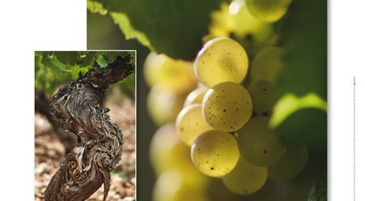
Vins Blancs

Slide 10
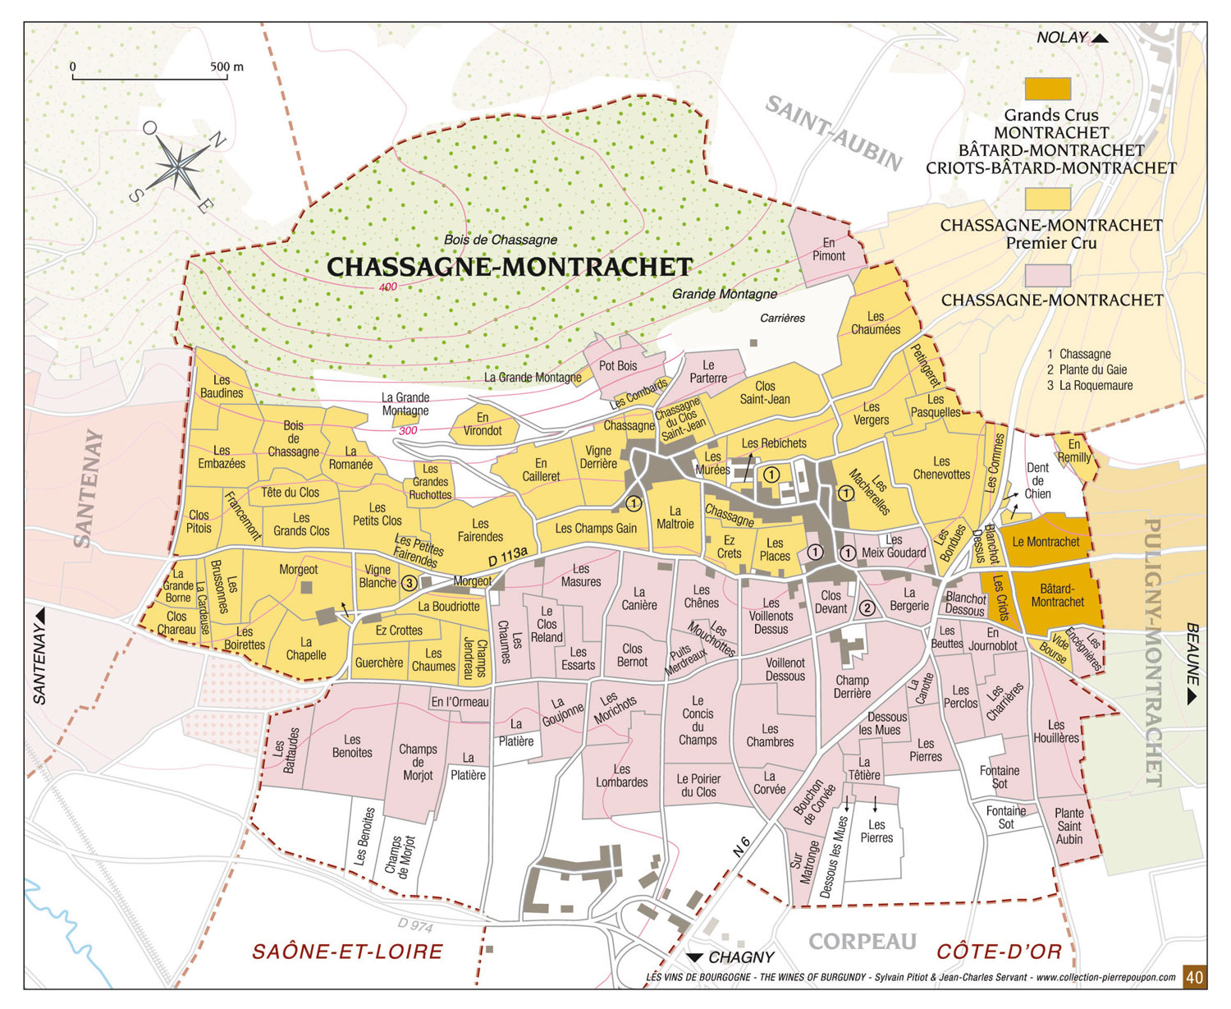
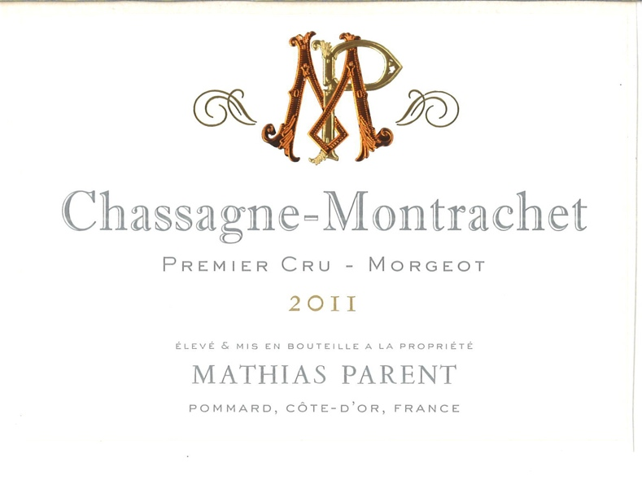
Mathias Parent Chassagne Montrachet
1er Cru Morgeots
Handsome golden highlights. Aromas with notes of acacia, mayflowers, Reinette apple, and fresh hazelnut. In the mouth, its mellow taste is backed by the degree of acidity which is a sine qua non of great white wines

Slide 11
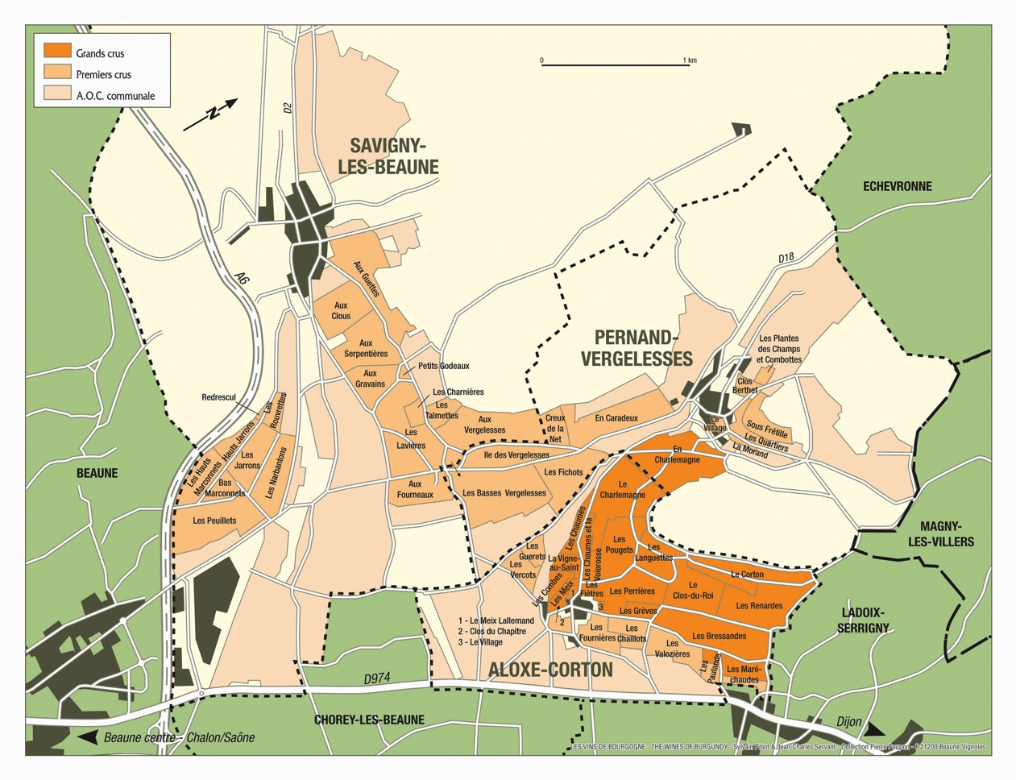
Mathias Parent Corton Blanc
Grand Cru
A rare white (grown mainly in the Climats of Vergennes and Languettes). Pale gold color, with green highlights. Mineral aromas (flint) blend with butter, baked apple, bracken, cinnamon and honey. Elegant and highly-bred, supple and well rounded, this unusual Chardonnay can age and improve up to 10 years.

Slide 12
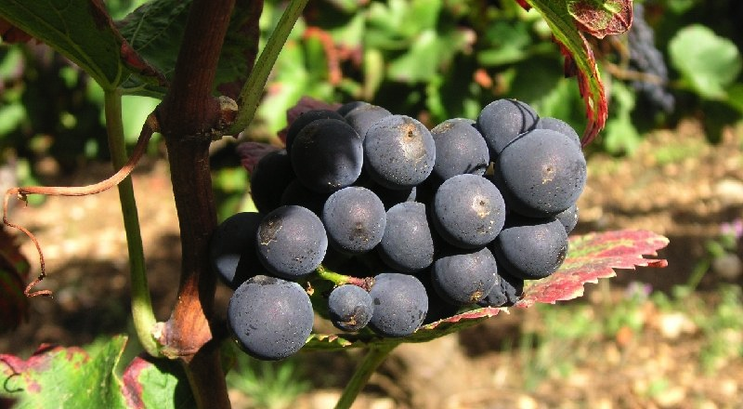
Vins Rouges

Slide 13
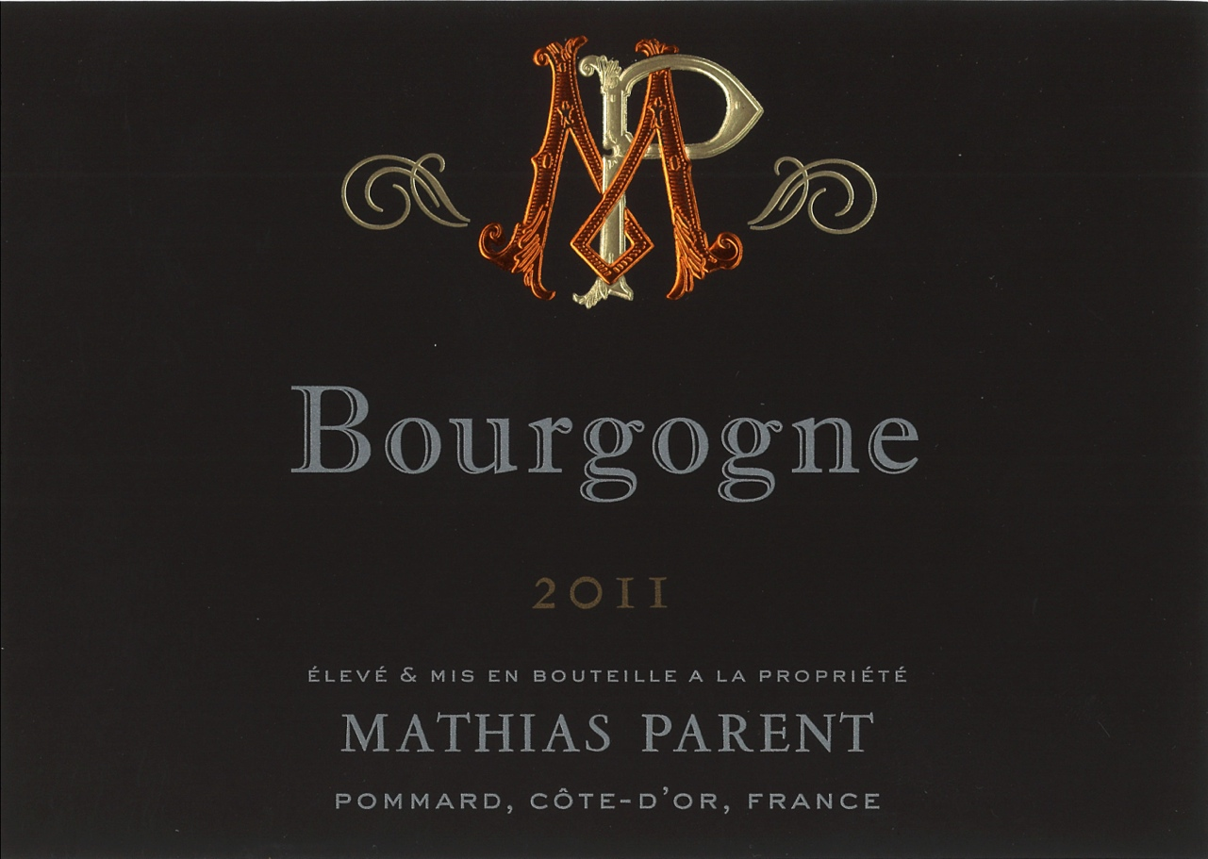
Mathias Parent Bourgogne
Richly colored - crimson at first then, with age, shading towards dark ruby. Red and black fruit aromas (strawberry, cherry, blackcurrant, bilberry) later evolving into cooked prune, peppery notes, and notes of animal, underbrush, moss and mushroom. Lively and structured in the mouth with a well-rounded and supple backbone.

Slide 14
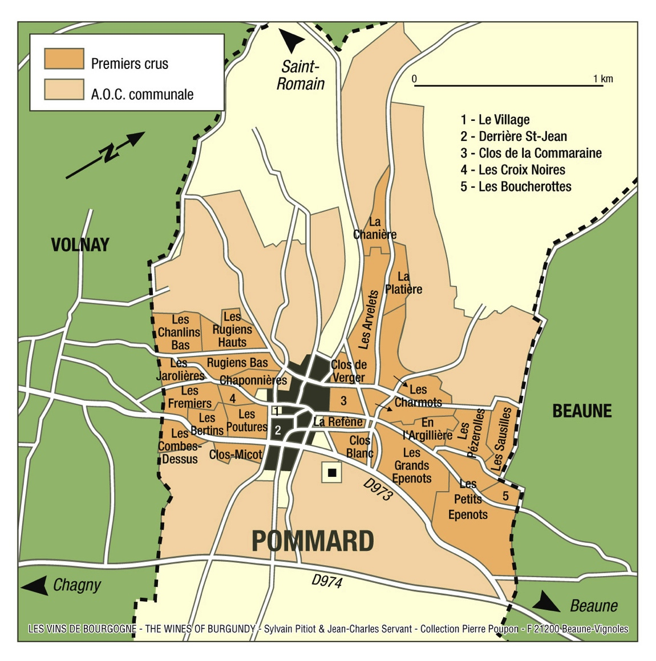
The geological fault of Pommard runs through the vineyard and separates 2 regions;
The side of Volnay with iron rich soils, giving more powerful, tannic, wines like the Pommard 1er cru les Rugiens.
The side of Beaune, with more limestone in the soil, producing deep, very elegant wines like the Beaune 1er Cru Boucherottes.

Slide 15
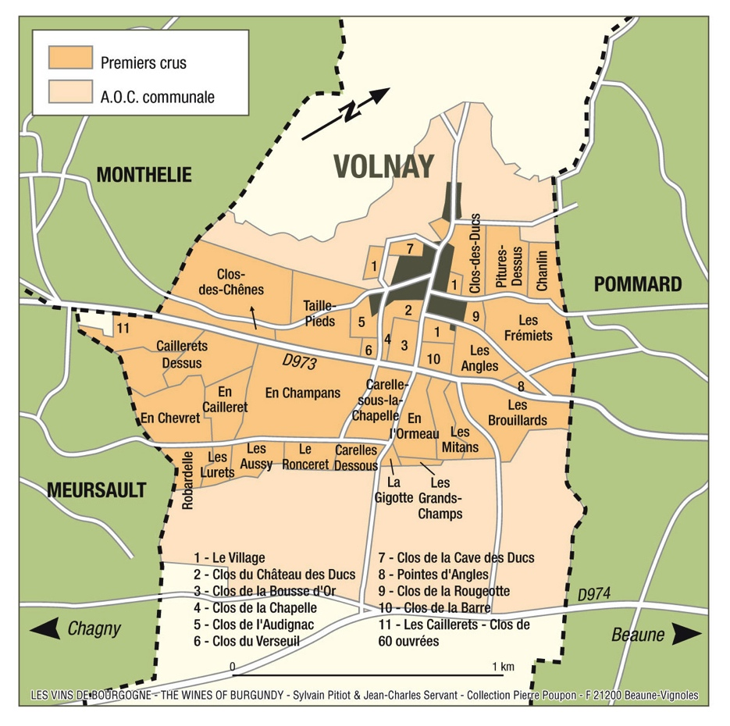
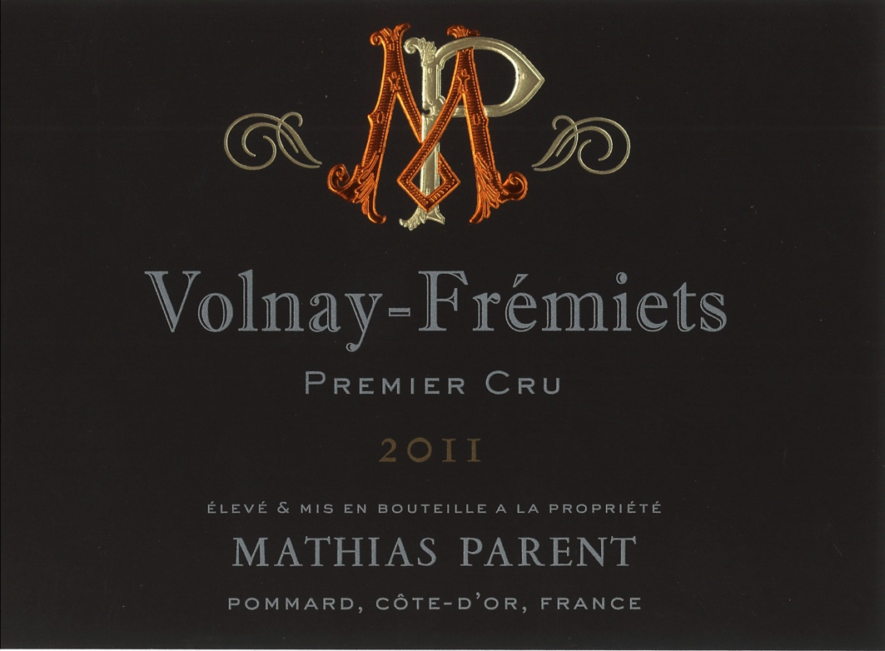
Mathias Parent Volnay
1er Cru Fremiets
Bright ruby color. Aromas of violet, gooseberry, cherry, and - with age - spices, game and cooked prune. Immediate appeal which, added to a slight natural precocity, means it can be fully open while still relatively young. The attack is fresh, the finish is warm. Drinking this wine, one seems to bite into a fresh fruit and breath in its heady aroma.

Slide 16
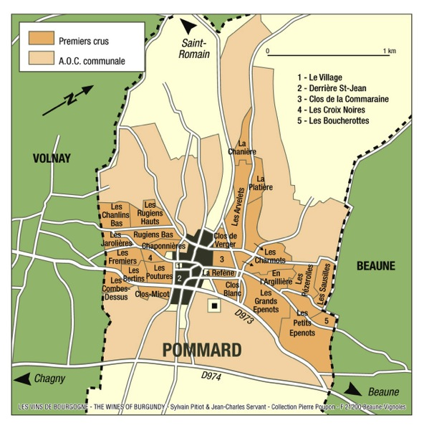
Pommard 1er Cru Les Pezerolles
"Les Pézerolles", Premier Cru, produces a refined Pommard, akin to Volnay. The name comes from the old French "Poizerolles", which meant "chickpeas”, likely cultivated next to the vines in the Middle Ages. The wine has floral notes, subtle red fruit aromas, and a very elegant structure.

Slide 17
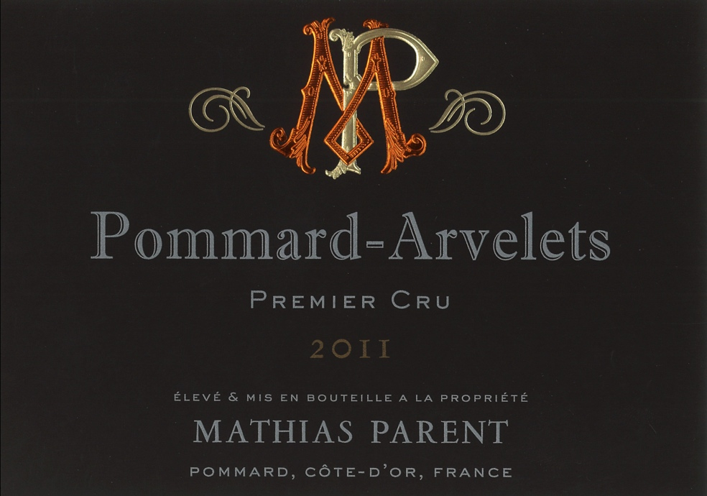
Mathias Parent Pommard
1er Cru Les Arvelets
The Arvelets Premier Cru vineyard is situated uphill from Pommard Epenots; the word Arvelets comes from the latin “Arva”, which means a cultivated field. Deep, dark red colour, with mauve highlights. Its aromas are redolent of blackberry, bilberry, or gooseberry, cherry pit and ripe plum. Often, wild and feline notes develop with age. At full maturity, it tends towards leather, chocolate and pepper.

Slide 18
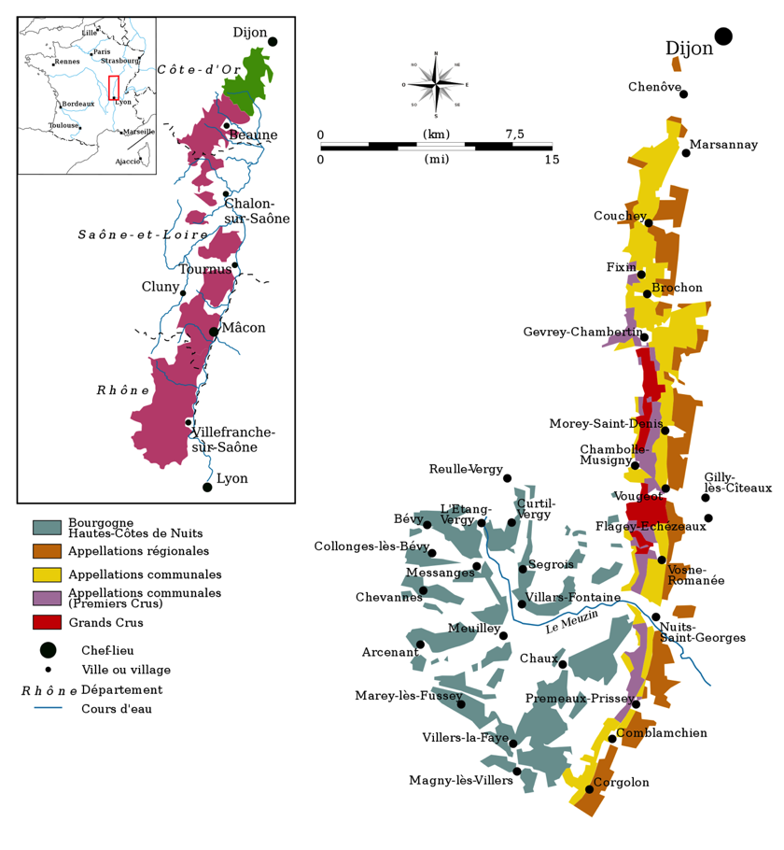
Cote de Nuits

Slide 19
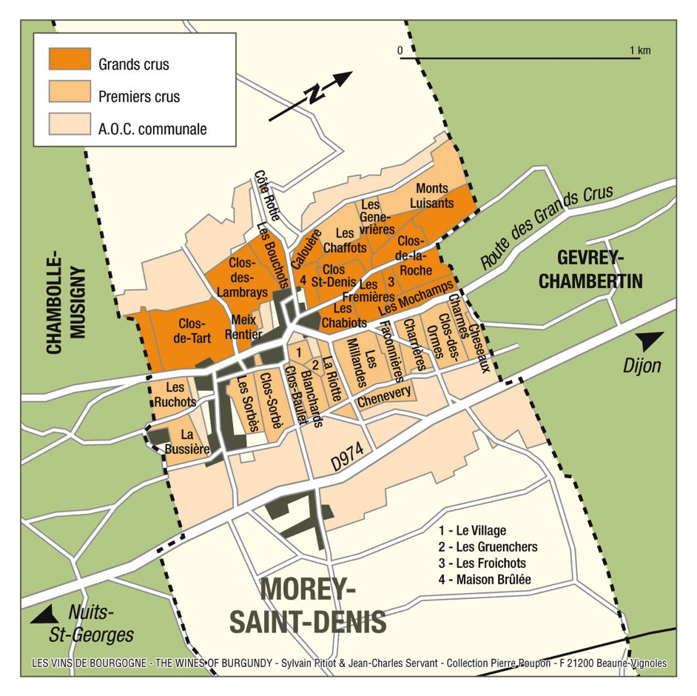
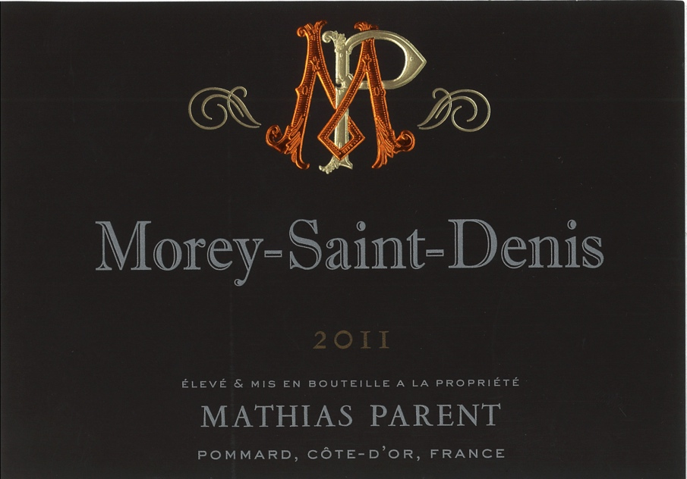
Mathias Parent Morey Saint Denis
Bright ruby color, with purplish highlights. Bouquet of black fruits (blackcurrant, bilberry) and red fruits such as cherries. When older it often evokes the “wildwood” scents of game, leather, and moss, even truffle. Sustained and structured, this wine lingers in the mouth with the right balance between body and fruit. With its rounded tannins and mouth-filling generosity, it sings tenor, so to speak, in the Burgundian choir.

Slide 21
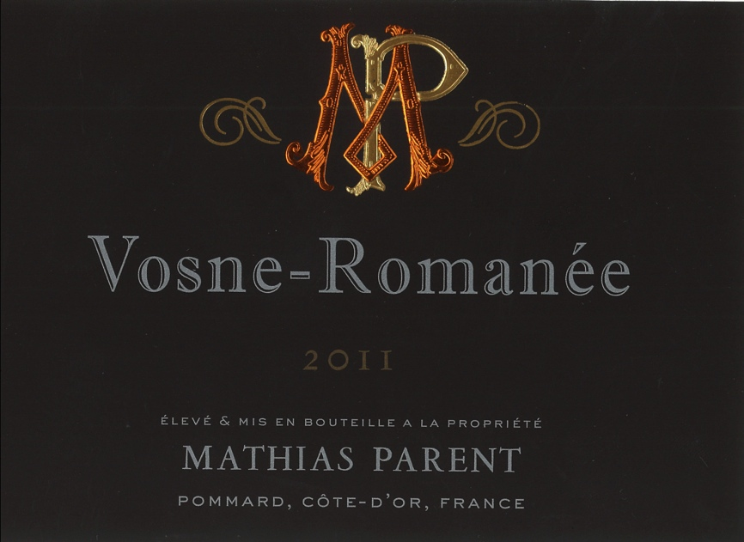
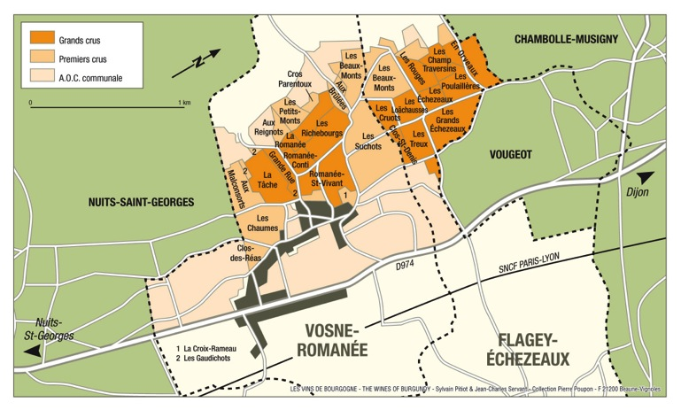
Mathias Parent Vosne Romanee
Fiery red color. Bouquet of ripe fruit, red berries. On the palate the wine is velvety and distinguished-Pinot Noir at the top of its form. The wine may seem a little austere in its youth; it needs time in the bottle to develop structure and fleshy texture. Often full-bodied and voluptuous, this wine reminds us of a Rubens nude.

Slide 22
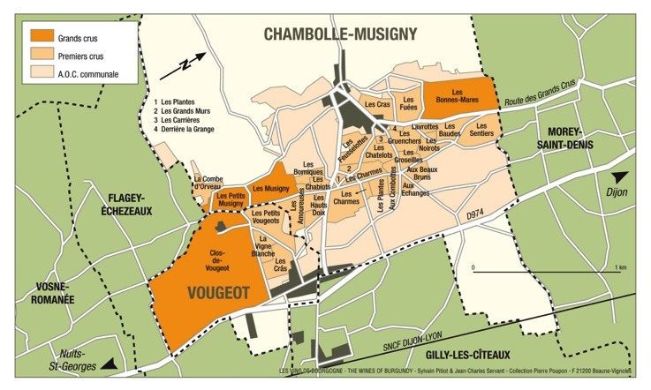
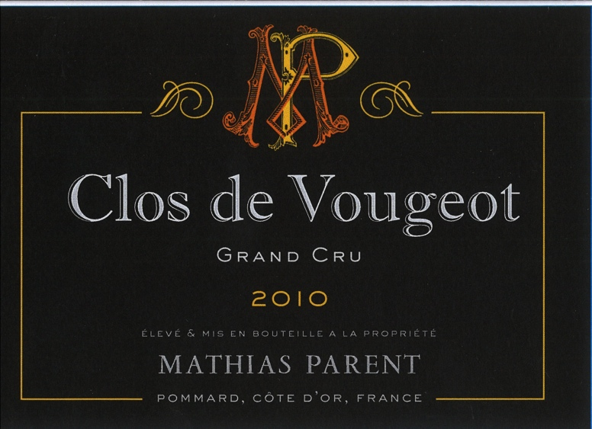
Mathias Parent Clos Vougeot Grand Cru
Very intense color, a suave bouquet, redolent of springtime of blown roses at dawn, of violets in the morning dew, blackberries, licorice and truffle... On the palate, the taste is masterful, rich, succulent and mellow, combining elegance and delicacy with meaty fullness. A long finish in the mouth and long aging potential (anything from 10 to 30 years and sometimes even more).

Slide 23
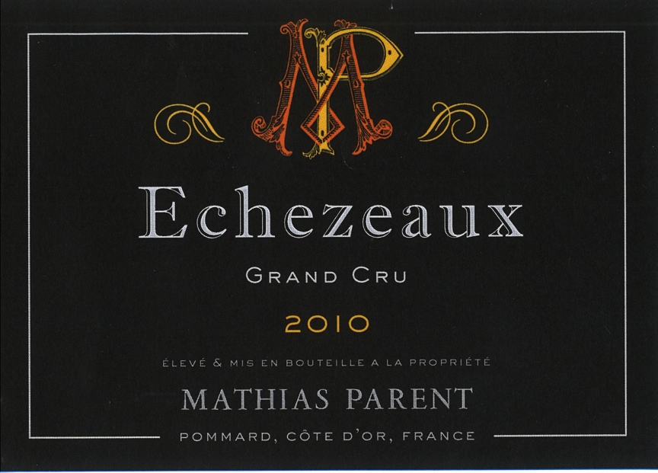
Mathias Parent Echezeaux Grand Cru
The wine comes from the “lieu dit Les Champs Traversin,” the premier site in Echezeaux whose neighbor “Les Poulalierre,” is home to the section of Domaine de la Romanee Conti. The 75 + year old vines are planted in a perfect location, halfway up the slope. Only 125 cases produced.

Slide 24
The motto of Mathias PARENT is to make “haute couture” wines with a very small production, but with complex and pure flavors, paying homage to their respective terroirs. To that end, everything is done in the vineyards and in the winery to get concentrated fruit that capture the authentic finesse and elegance of each appellation.

Slide 25
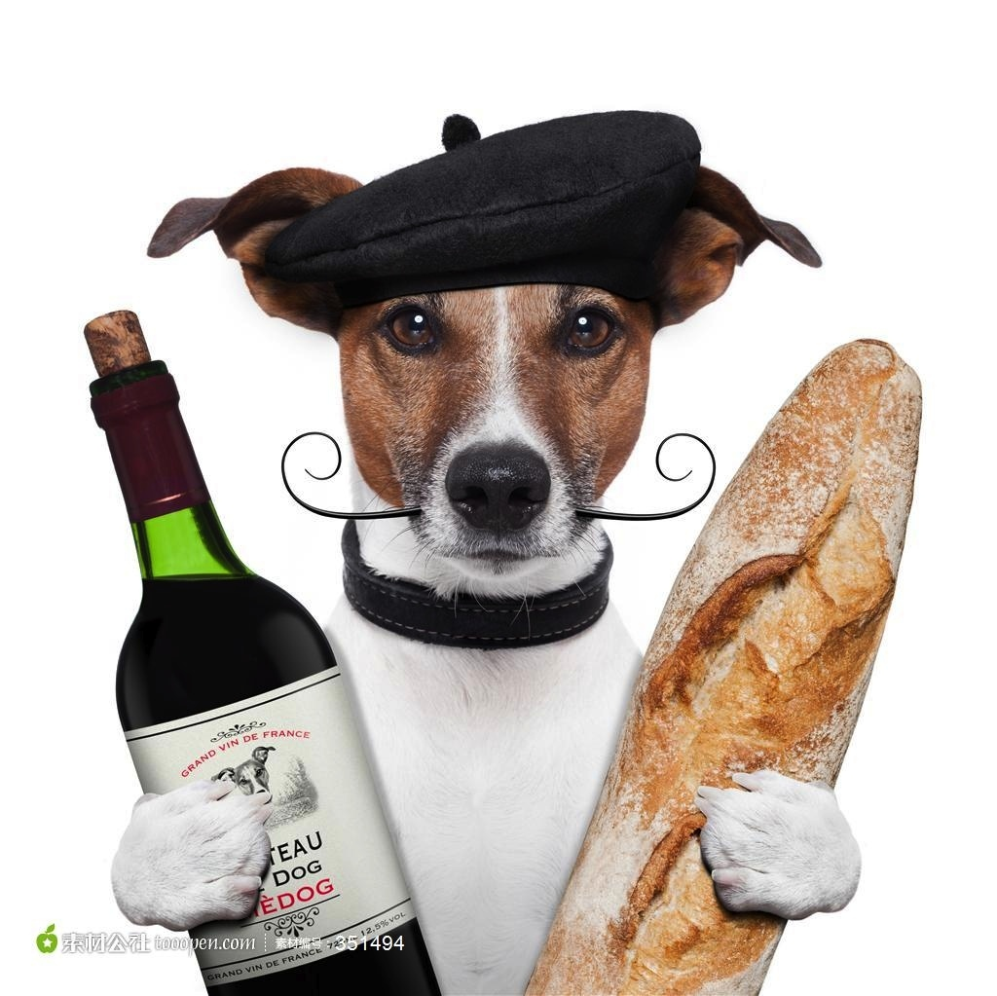
Merci pour votre attention!

Slide 26
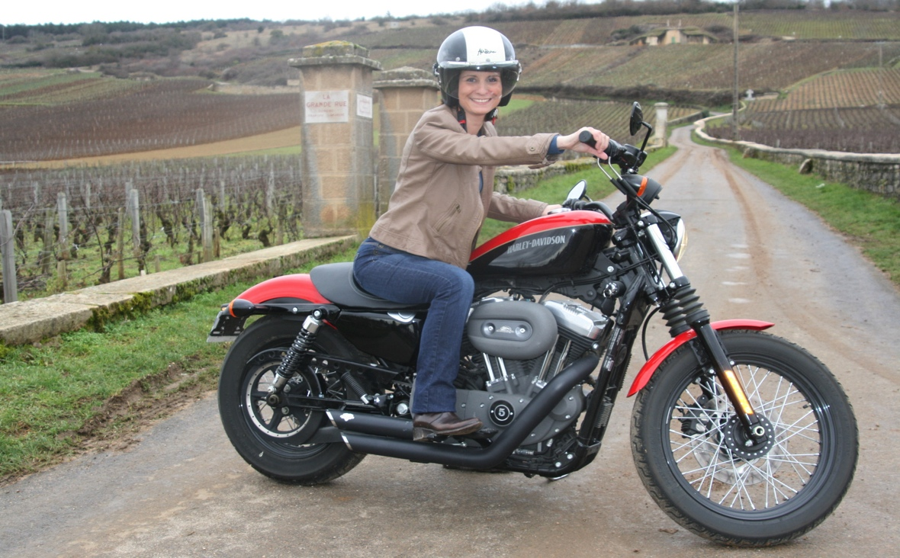
An exclusive offering from Caroline Parent et Associes
Beaune, France

